Slide 1
Introduction Acid/Base balance
Assoc. Prof. John Smithson

Slide 3
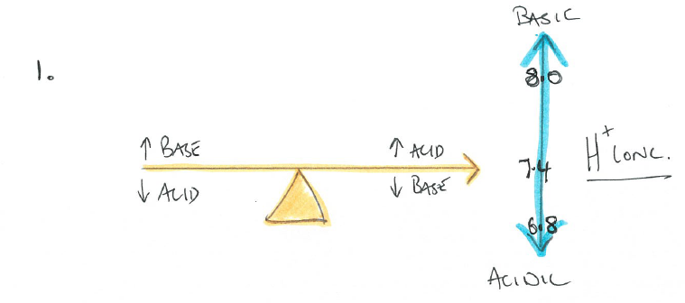
Acid – Base Balance
Why is pH regulation Critical?
The conformation of functional proteins (e.g. enzymes), and hence their activity, is affected by a change in pH
pH affects the protonation of molecules, thereby affecting chemical reactions that involve oxidation and reduction
Normal pH of arterial blood is 7.40 ± 0.05
Lower limit of pH at which someone can live for more than a couple of hours is pH 6.8
Upper limit of pH at which someone can live for more than a couple of hours is pH 8.0
Severe acidosis – depression of synaptic transmission, disorientation, coma and death
Severe alkalosis – over-excitability of synaptic transmission, nervousness, muscle spasm and death

Slide 4
Major physiologically active acids and bases
Acids
CO2
Lactic acid
H+
HCl
H2SO4
H3PO4
Beta hydroxybutyric acid
Bases
HCO3-
Lactate –
OH-
NH3-
SO4-
H2PO4-
Beta hydroxybutyrate

Slide 5
3 systems that regulate acid-base balance
Chemical acid-base buffer systems of the body – immediately combine with acid or base to prevent excessive changes in hydrogen ion concentration.
The respiratory centre that regulates the removal of carbon dioxide (and therefore H2CO3) from the blood.
The kidneys – which are capable of excreting large amounts of acid or base during acidosis or alkalosis.

Slide 6
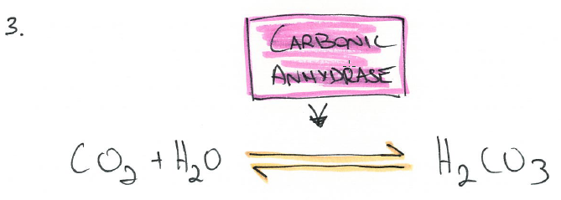
Bicarbonate buffer system
Acids release hydrogen ions (H+)
HCl is a strong acid
H2CO3 is a weak acid (carbonic acid)
Bases accept a hydrogen ion
Bicarbonate (HCO3 combines with H+ to form Carbonic acid)
Proteins with net negative charge act as buffers –
Hb protein takes up excess H+ ions and releases oxygen from the heme group as a consequence
The bicarbonate buffer system consists of two main ingredients in an aqueous solution
A weak acid - carbonic acid (H2CO3)
a bicarbonate salt such as NaHCO3 (sodium bicarbonate)
Notes:
Turns a strong acid/base into a weak acid/base

Slide 9
Physiological buffering (lungs and kidneys)

Slide 10
Respiratory regulation of acid-base balance
The respiratory system provides the second line of defense against acid-base disturbances – regulates concentration of CO₂ in extracellular fluid
Increased ventilation eliminates CO₂ from extracellular fluid, thereby reducing H⁺ ion concentration
Conversely, decreased ventilation increases CO₂ levels in extracellular fluid, thereby increasing H⁺ ion concentration

Slide 11
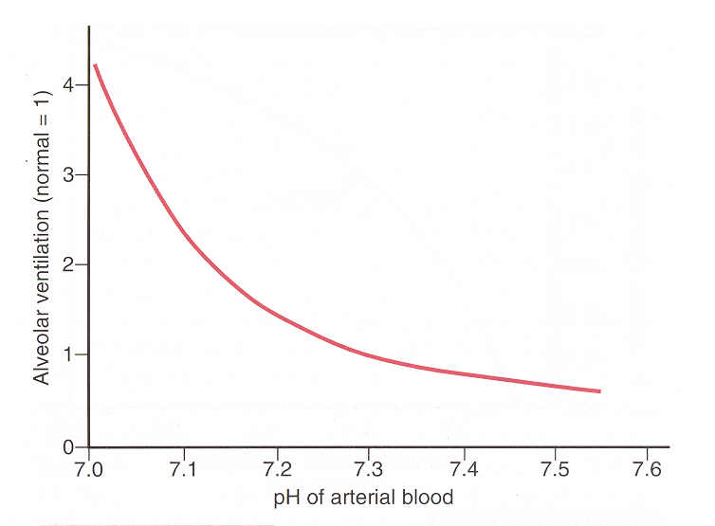
Physiological buffering - lungs
There is a relationship between [H⁺] and respiratory rate
As pH decreases (acidosis) – ventilation dramatically increases to remove the volatile acid
As pH increases, there is a modest reduction in respiratory rate

Slide 12
Let’s contextualize this – adding strong acid
Adding a strong acid to the body
HCl
Lactic acid

Slide 13
Let’s contextualize this – adding strong base
Adding a strong base to the body
Sodium hydroxide (NaOH)

Slide 14
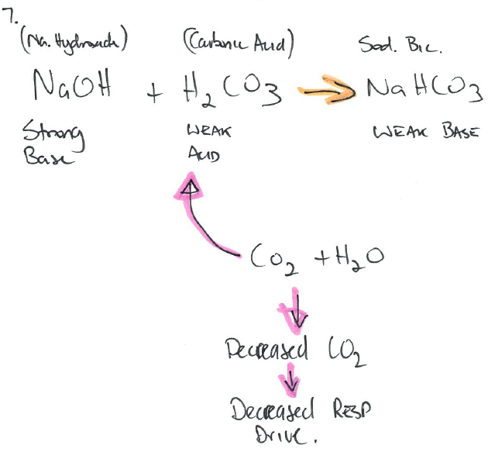
See the link between pH and respiratory rate

Slide 15
Renal control of acid-base balance
Renal system regulates acid-base balance by increasing or decreasing HCO3- concentrations in the body fluids
By virtue of the control of bicarb, H+ ion retention or excretion is also affected because
Large numbers of bicarb are filtered daily – most is reabsorbed
Large numbers of H+ are also secreted daily
This balance will alter pH of the blood

Slide 16
Proximal tubule control

Slide 17
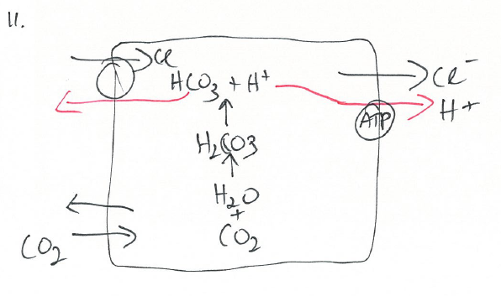
Distal tubule control

Slide 18
Some things to note:
Very powerful system
Slowest takes hours to days for effect
A bicarbonate ion must react with a hydrogen ion before it can be absorbed
During alkalosis – the kidneys fail to reabsorb filtered bicarb
Because bicarb buffers H+, the net effect is the same as adding H+ ions to the blood
The phosphate system is capable of generating new bicarbonate
The ammonia (NH3) / ammonium (NH4) system also binds H+ ions in the urine

Slide 19
4 Primary acid-base disturbances
 | pH | [H⁺] | PCO₂ | HCO₃⁻
Normal | 7.4 | 40 nmol/L | 40 mmHg | 24 mmol/L
Respiratory Acidosis | ↓ | ↑ | ⇑ | ↑
Respiratory Alkalosis | ↑ | ↓ | ⇓ | ↓
Metabolic Acidosis | ↓ | ↑ | ↓ | ⇓
Metabolic Alkalosis | ↑ | ↓ | ↑ | ⇑
Double arrows indicate primary event

Slide 20
Compensatory mechanisms

Slide 21
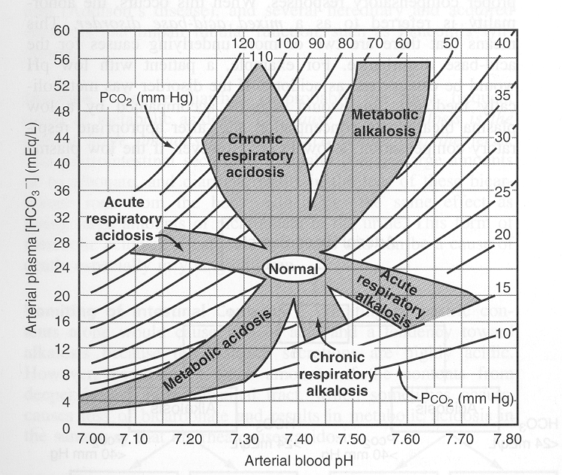
Davenport Acid/Base nomogram

Slide 22
Clinical measurements – arterial blood gases
Reference ranges you should be familiar with –
Bicarbonate 22 –26 mmol/L
Chloride 95 – 110 mmol/L
Sodium 137 – 146 mmol/L
pH 7.36 – 7.44
PaCO₂ 35 – 45 mm Hg
PaO₂ 80 – 100 mm Hg
Saturation (SpO2)95-100%
Base excess +/- 2 mmol/l ⁻¹

