Slide 1
Insulin and counter regulatory hormones
Assoc. Prof. John Smithson

Slide 2
Learning outcomes
Be able to:
Describe the role of the pancreas and liver in blood glucose regulation
Describe the role of insulin in the regulation of blood glucose levels
Describe the role of the counter regulatory hormones on blood glucose levels
Predict the effect of increasing or decreasing insulin or glucagon levels and the regulation of these two important blood glucose regulators
Compare the physiological effect of increased corticosteroid administration on blood glucose levels

Slide 3
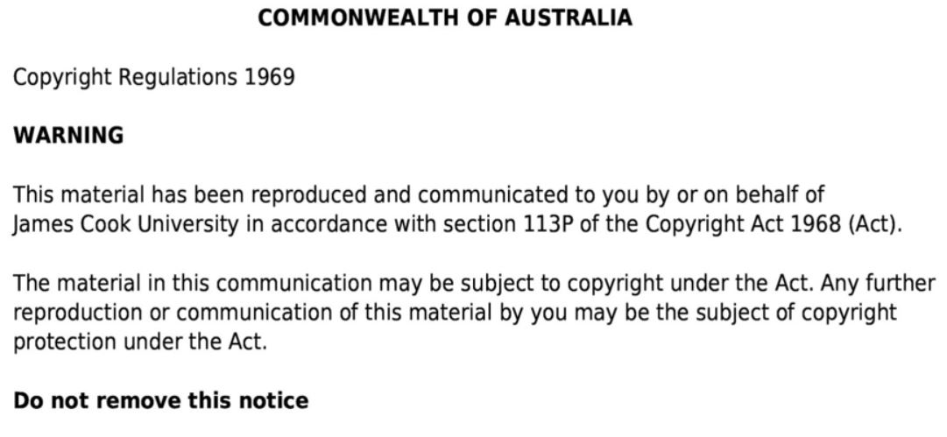

Slide 4
Anatomy of the pancreas
Exocrine and endocrine gland
Majority of pancrease function is exocrine – important in digestive system
Endocrine function is related to tiny clusters of pancreatic islets (aka islets of Langerhands)
4 main endocrine cells of pancreas:
Alpha cells – glucagon
Beta cells – insulin
Delta cells – somatostatin
F cells – pancreatic polypeptide
Figure 18.18 taken from Tortora, GJ., Derrickson, B., Burkett, B., Peoples, G.,Dye, D., Cooke, J., et al. Principles of anatomy and physiology. Second Asia-Pacific ed. Queensland, Australia: John Wiley & Sons; 2019.

Slide 5
Anatomy of the liver
Secretes bile salts, cholesterol, lecithin, bilirubin and ions
Stores glycogen, vitamins and minerals for later use
Activates vit D
Metabolises lipids and produces cholesterol
Processes drugs and hormones
Figure 24.16 adapted from Tortora, GJ., Derrickson, B., Burkett, B., Peoples, G.,Dye, D., Cooke, J., et al. Principles of anatomy and physiology. Second Asia-Pacific ed. Queensland, Australia: John Wiley & Sons; 2019.

Slide 6
Anatomy of the liver
Stores glycogen, vitamins and minerals for later use
Glucogenolysis
Carbohydrate metabolism – glycogen is converted to glucose
Converts other sugars (fructose and galactose) into glucose
Gluconeogenesis
Converts amino acids and lactic acid to glucose
When blood glucose is high, liver converts glucose to glycogen and triglycerides for storage
Figure 24.16 adapted from Tortora, GJ., Derrickson, B., Burkett, B., Peoples, G.,Dye, D., Cooke, J., et al. Principles of anatomy and physiology. Second Asia-Pacific ed. Queensland, Australia: John Wiley & Sons; 2019.

Slide 7
Insulin and counter regulatory hormones
Glucagon
Adrenaline
Somatostatin
Growth Hormone
Insulin
Protects against hyperglycemia
Counter regulatory hormones
Protects against hypoglycemia – counters effect of insulin
Insulin

Slide 8
Insulin
Produced by Beta cells of pancreatic islets
Main anabolic hormone regulating metabolism of
Carbohydrates
Fats
Protein
Promotes absorption of glucose from blood into
Liver - increases hepatic conversion of glucose to glycogen (glycogenesis) for storage
Fat – inhibits breakdown of triglycerides and the release of fatty acids & facilitates entry of glucose into adipocytes → glycogen
Skeletal Muscle – increases uptake of glucose, promotes protein and glucose synthesis (and inhibits their breakdown in muscle)

Slide 9
Insulin
Insulin released in response to high blood glucose levels (hyperglycaemia)
BGL detected by beta cells in pancreas
Insulin released in response to glucagon
Consumption of protein and presence of glucose in small intestine
Insulin inhibited by –ve feedback – hypoglycaemia decreases insulin release and glucagon release
FAST
Figure 18.19 taken from Tortora, GJ., Derrickson, B., Burkett, B., Peoples, G.,Dye, D., Cooke, J., et al. Principles of anatomy and physiology. Second Asia-Pacific ed. Queensland, Australia: John Wiley & Sons; 2019.

Slide 10
Counter regulatory hormones - glucagon
Released from Alpha cells of pancreatic islet cells
Released in response to hypoglycaemia
Released in response to increased sympathetic division of ANS
Raises blood glucose by increasing liver breakdown of glycogen to glucose (glucogenolysis) and gluconeogenesis (AA to glucose)
FAST
Figure 18.19 taken from Tortora, GJ., Derrickson, B., Burkett, B., Peoples, G.,Dye, D., Cooke, J., et al. Principles of anatomy and physiology. Second Asia-Pacific ed. Queensland, Australia: John Wiley & Sons; 2019.

Slide 11
Other counter regulatory hormones
Adrenaline – other main counter regulatory hormone
Increases hepatic glucose production by stimulating glycogenolysis and gluconeogenesis
FAST
Cortisol – longer term (hours) response to hypoglycaemia
Stimulates the hepatic production of glucose from protein (gluconeogenesis) and lipids
Inhibits insulin release and promotes glucagon release
Decreases muscle uptake of glucose – switches to protein derived glucose supply (gluconeogenesis)
Stimulates lipolysis → releases glycerol and free fatty acids → energy
SLOWER (Hours)

Slide 12
Other counter regulatory hormones
Growth hormone – increases blood glucose levels through
Gluconeogenesis and glyconeolysis
Suppresses glucose uptake in adipose tissue
SLOWER (Hours)

