Slide 1
Children’s respiratory conditions
Assoc. Prof. John Smithson

Slide 2
Learning outcomes
Be able to:
Be able to describe the pathophysiology of asthma, bronchitis, bronchiolitis, croup and epiglottitis.
Recognise the cardinal symptoms of croup and describe the pharmacological rationale for steroid therapy.
Provide relevant evidence based education to patients and carers regarding the pathophysiology and treatment of bronchitis and bronchiolitis.
Describe the appropriate signs and symptoms and referral of a patient with suspected epiglottitis
Describe typical antibiotic and corticosteroid therapy for patients with epiglottitis.

Slide 3
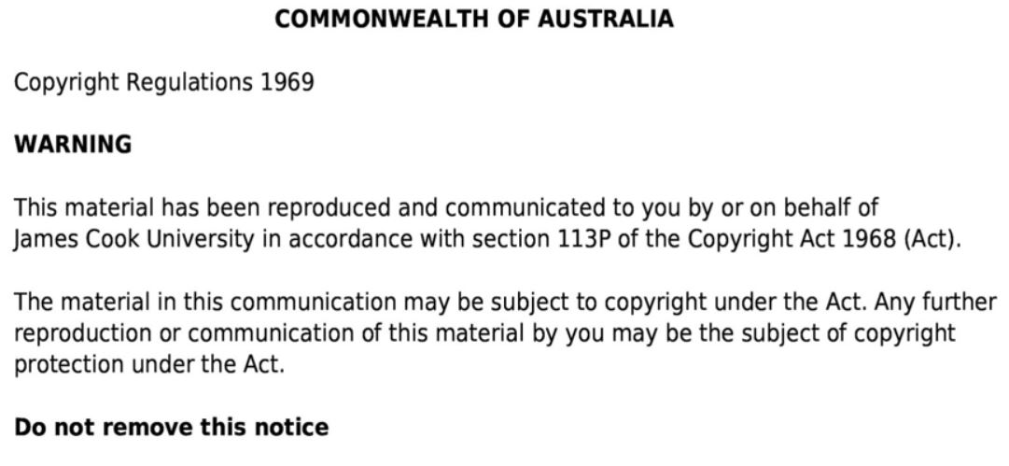

Slide 4
Common respiratory conditions in children
Asthma in children – previously covered in Asthma lecture
Croup
Bronchitis
Broncholitis
Epiglottitis - uncommon but rapidly life threatening

Slide 5
Croup
Also known as laryngotrachoebronchitis
Common childhood disease
Characterised by a sudden onset of distinctive barking or brassy cough accompanied by
Stridor – a noisy high pitched inspiratory breathing sound
Hoarse voice in children who are old enough to talk
Upper airway obstruction causing respiratory distress
Usually accompanied by fever and coryza (inflammation of the mucous membrane in the nose)
More common in children under the age of 5
More common in children 1-3 years
but can occur at any age.
Adults less susceptible due to larger airways
Mostly a self-limiting disease and relatively easily treated with a short course of corticosteroids but can be life threatening
Duration usually around 2-5 days
Post-infective cough may persist
Treatment is indicated for all presentations of Croup
More severe cases may require hospitilisation / overnight monitoring
Infrequently can cause death – less common now as Croup is better understood in the community

Slide 6
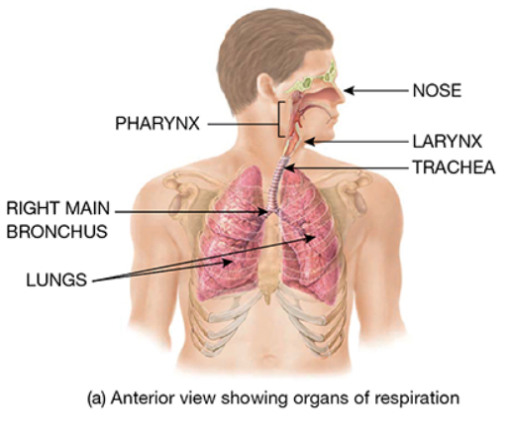
Croup
Caused by a viral infection leading to swelling of the larynx and trachea
Croup usually caused by parainfluenza, influenza or other virus
Swelling of the airway narrows airway and causes distinctive symptoms
Croup is a clinical diagnosis – based on the signs rather than a laboratory diagnostic test
Nasopharyngeal aspirate (NPA) confirms croup but does not alter management
Image taken from Tortora, GJ., Derrickson, B., Burkett, B., Peoples, G.,Dye, D., Cooke, J., et al. Principles of anatomy and physiology. Second Asia-Pacific ed. Queensland, Australia: John Wiley & Sons; 2019.

Slide 7
The barking cough and stridor or croup
Stridor audio - https://youtu.be/vDdJo0RPKa8
Infant with croup and a barking cough https://youtu.be/fGP0vKQO4CY
3 year old boy with croup and a barking cough https://youtu.be/s7qomuX0Gjw?t=20

Slide 8
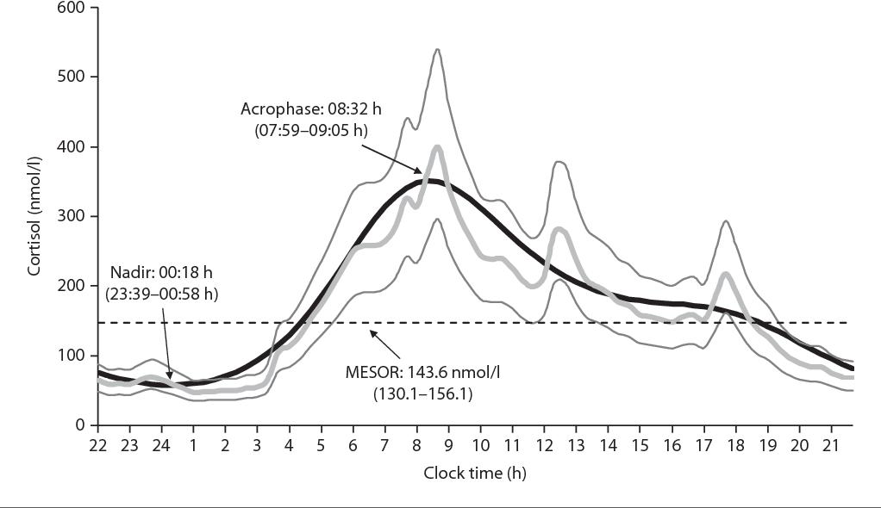
Croup
Croup symptoms features more predominantly at night or early in the morning as the diurnal levels of endogenous glucocorticoids are lower
Image taken from Debono, M. & Ross, R. Optimal glucocorticoid therapy (Figure 1). Endocrine development. 2011;20:173-180. 10.1159/000321241. Accessed date 11 February 2020.

Slide 9
Croup
Severity assessed on clinical features which will direct therapy
Increased respiratory rate
Increased heart rate
Presence of anxiety, agitation or confusion
Use of accessory muscles indicating increased work of breathing
Presence and degree of stridor
Hypoxia – a late sign
Management is simple
Mild to moderate croup
Oral corticosteroids
Single dose budesonide 2mg via nebulizer
Dexamethasone 0.15mg/kg orally as a single dose
Prednis(ol)one 1mg/kg
Observation for first hour
Allow child to adopt the most comfortable position
Do not upset the child (will worsen the symptoms)

Slide 10
Croup
Severe or life threatening Croup
Urgent nebulised adrenaline 1:1000 x 5ml undiluted. Use oxygen as driving gas if possible. Repeat after 30 minutes if no improvement plus
Nebulised or oral corticosteroids – as per mild-moderate croup
Ambulance to hospital
Observation for at least 4 hours after treatment with adrenaline
Allow child to adopt the most comfortable position
Do not upset the child (will worsen the symptoms)

Slide 11
Croup
Severe or life threatening Croup
Urgent nebulised adrenaline 1:1000 x 5ml undiluted. Use oxygen as driving gas if possible. Repeat after 30 minutes if no improvement plus
Nebulised or oral corticosteroids – as per mild-moderate croup
Ambulance to hospital
Observation for at least 4 hours after treatment with adrenaline
Allow child to adopt the most comfortable position
Do not upset the child (will worsen the symptoms)
Improvement in symptoms fairly fast
Nebulised adrenaline – 10-30 minutes
Effect can last for as little as 2 hours – watch rebound airway obstruction
Oral corticosteroids – improvement in around 6 hours.

Slide 12
Croup
Benefits of steroids in Croup
Moderate to severe Croup
Improve respiratory symptoms
Reduction in hospital administration
Reduced hospital stay
Reduced admission to ICU
Reduction in representation to GP
Mild Croup (normal mental state, no stridor or only when distressed, no accessory muscle use, normal heart rate, can talk)
Still benefit
All children with Croup benefit from corticosteroids – irrespective of duration or severity

Slide 13
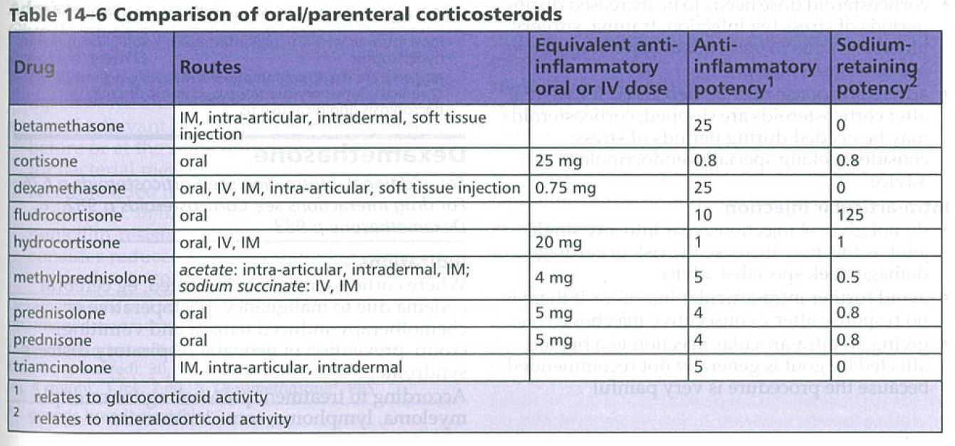
Croup
Refer all suspected cases of Croup to GP or in severe cases – ambulance to hospital – do not delay referral
Affected children may also have asthma – treatment is the same
Not recommended
Hydrocortisone as treating steroid – shorter duration of action does not give adequate coverage
Upsetting the child – keep child with carer - do not separate
Humidifiers or steam – no evidence of benefit
Examining the airway in a pharmacy setting
Antibiotics (most common cause parainfluenza virus)
Table 14-6 Comparison of oral/parental corticosteroids in section 14.5.2 Corticosteroids (page 677) in the Australian Medicines Handbook (2019).
Notes:
Hydrocortisone and cortisone – short acting (8-12 hours) and relatively lower glucocorticoid activity
Prednis(ol)one, methylprednisolone and triamcinolone – intermediate acting (12-36 hours) and relatively potent glucocorticoid activity.
Dexamethasone and betamethasone – long acting (36-72 hours) and very potent glucocorticoid activity
Liu, D., Ahmet, A., Ward, L. et al. A practical guide to the monitoring and management of the complications of systemic corticosteroid therapy. Allergy, Asthma and Clinical Immunology. 2013; 9(1): 30. Available at https://www.ncbi.nlm.nih.gov/pmc/articles/PMC3765115/.

Slide 14
Bronchitis
Acute self-limiting lower respiratory tract infection of the bronchi
Most common cause of presentation of cough in General Practice
90% of cases caused by common respiratory virus
Influenza
Respiratory syncytial virus (RSV)
Parainfluenza virus
Adenoviruses
Less common cause
Mycoplasma peumoniae
Chlamydophila pneumonia
Bacterial infection less common
Image taken from Tortora, GJ., Derrickson, B., Burkett, B., Peoples, G.,Dye, D., Cooke, J., et al. Principles of anatomy and physiology. Second Asia-Pacific ed. Queensland, Australia: John Wiley & Sons; 2019.

Slide 15
Bronchitis
Non-specific symptoms
purulent or coloured sputum
dyspnoea
wheeze
chest discomfort or pain (due to frequent coughing)
nasal congestion
headache
fever.
Cough typically lasts for 2-3 weeks and is resolved within 4 weeks for most patients
Cough may persist for up to 8 weeks.

Slide 16
Bronchitis
Self-limiting condition
Viral in nature
Antibiotics not typically indicated
Patient expectation
Antibiotics are reasonably commonly prescribed despite lack of evidence for benefit and risk of harm
May be used if the patient is at high risk of developing / has developed pneumonia
Pain from cough and fever:
NSAIDs or paracetamol
Quit smoking
Avoid irritants – dust, chemical fumes, other air pollutants
Useful to communicate this risk to patients who might ask you about antibiotics and bronchitis
Antibiotic resistance
Thrush infections
Clostridium difficile
Diarrhoea
Rash
Nausea
Hypersensitivity reactions

Slide 17
Bronchitis and broniolitis
Bronchitis
Affects bronchi – larger airways and is more common in older children and adults
Bronchiolitis
Affects the smaller bronchioles and is more common in children under two years of age

Slide 18
Bronchiolitis
Viral infection of the lower respiratory tract
Affects children more commonly under the age of 1 year– more common in that group under the age of 6 months
Risk factors
Exposure to smoke
Premature birth
Hematological malignancy
Male children
Usually begins with an acute upper respiratory tract infection followed by
Cough
Tachypnoea
Intercostal recession
Widespread inspiratory crackles
Expiratory wheeze
Fever
Post-viral cough may persist for weeks after resolution of bronchiolitis

Slide 19
Bronchiolitis
Diagnosis based on clinical presentation
No investigations
No pharmacological management
Supporting feeding and fluid intake
Small frequent feeds or
Nasogastric tube feeding
Oxygenation as required (when SpO2< 90%)
Minimal handling of infant
Admission to hospital for moderate to severe bronchiolitis
Normally self limiting
Peak severity usually around day 2-3 of illness with resolution over about 7-10 days
Admission to hospital typically required for symptomatic care
difficulty feeding
moderate to severe work of breathing
increased respiratory rate.
oxygen saturation measured by pulse oximetry (SpO₂) less than 94%.

Slide 20
Bronchiolitis
Not useful
B2-agonists
Corticosteroids
Adrenaline unless in arrest or peri-arrest
Nebulised hypertonic saline
Antibiotics
antivirals
Antibiotics may be used when there is evidence of a secondary bacterial lung infection

Slide 21
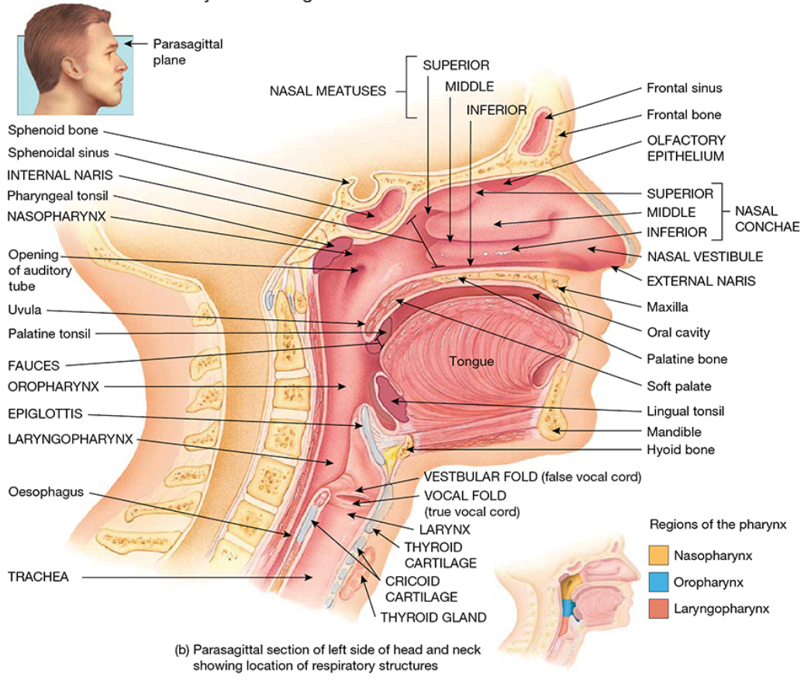
Epiglottitis – acute upper airway obstruction
Epiglottis small tissue covered cartilage flap that closes over the larynx and trachea to protect airway during swallowing
During epiglottitis, the epiglottis and surrounding tissue swells and can block off the larynx / airway
Very serious event
Image taken from Tortora, GJ., Derrickson, B., Burkett, B., Peoples, G.,Dye, D., Cooke, J., et al. Principles of anatomy and physiology. Second Asia-Pacific ed. Queensland, Australia: John Wiley & Sons; 2019.

Slide 22
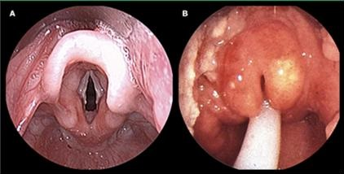
Epiglottitis
Can be caused by bacterial infection of the epiglottis and surrounding tissue
Haemophilus influenza type B
Streptococcus pneumoniae
Before the routine vaccination against Haemophilus influenza type B with the Hib vaccine (at 2, 4, 6 and 18 months), infection most common in children
now more common in adults and those not vaccinated against Haemophilus influenza type B
Children as still at greater risk of poor outcome due to smaller airway compared with adults
Still potential fatal in both groups
Epiglottis
Vocal folds and larynx
Image adapted from figure provided in Southwest Journal of Pulmonary and Critical Care quiz available at http://www.swjpcc.com/storage/manuscripts/volume-15/issue-5-nov/130-17/130-17%20Panel%203.html. Accessed July 2020.
A. Normal epiglottis and vocal folds
B. Epiglottitis with ETT tube inserted

Slide 23
Scope of epiglottitis
https://youtu.be/4ghkNlg86tU

Slide 24
Epiglottitis
Sudden development of symptoms
Severe throat pain
Difficulty / pain swallowing
Fever
Drooling
Change in voice – sounds muffled
Sepsis often accompanies epiglottitis
Treatment
Airway management – ETT
Tracheotomy
IV Antibiotics
Maybe steroids
Transition to oral therapy
Prevention
Haemophilus influenza type B vaccine

Slide 25
Epiglottitis
Treatment
If you suspect epiglottitis – do not look at the throat – it can trigger a complete closure of the larynx and respiratory arreast
Epiglottitis is a medical emergency and needs to be sent to hospital
Keep the person calm and comfortable
Keep carer with child
Call ambulance
Examination of the airway needs to be done with airway management facilities at hand
ED
Theatre
ICU

Slide 26
Epiglottitis
IV antibiotics for acute epiglottitis
ceftriaxone 1 g (child 1 month or older: 50 mg/kg up to 1 g) intravenously, daily;
for patients with septic shock or requiring intensive care support, use ceftriaxone 1 g (child 1 month or older: 50 mg/kg up to 1 g) intravenously, 12-hourly.
cefotaxime 1 g (child: 50 mg/kg up to 1 g) intravenously, 8-hourly;
for patients with septic shock or requiring intensive care support, use cefotaxime 2 g (child: 50 mg/kg up to 2 g) intravenously, 8-hourly.

Slide 27
Epiglottitis
Alternative to ceftriaxone or cefotaxamine is moxifloxacin
IV Dexamethasone
0.15mg/kg up to 10 mg single dose
Can repeat after 24 hours if necessary
Evidence weak for benefit of corticosteroids but still commonly administered in epiglottitis
Once patient begins to improve
Switch to oral therapy
Amoxicillin + Clavulanate 875+125 mg 12 hourly
or
Cefuroximine 12 hourly
or
moxifloxacin

