Slide 1
Pulmonary Function Tests
Assoc. Prof. John Smithson

Slide 2
Learning outcomes
Be able to:
Be able to relate the concepts of FVC, FEV1 and FVC/FEV1 ratio to obstructive and restrictive disease.
Understand reported spirometry results in relation to disease
Be able to explain changes in peak flow in relation to changes in respiratory disease status

Slide 3


Slide 4
Pulmonary Function Tests
Pulmonary function tests provide objective data on a patients lung function.
Used to
  Measure underlying lung function
  Changes in lung function secondary to treatment or exacerbations
  Monitor changes in progressive lung disease such as COPD
  Monitor lung function during use of drugs toxic to the lungs
Most common pulmonary function tests used include
  Lung volumes
  Spirometry
  Lung flow volume loops
  Peak expiratory flow

Slide 5
Spirometry
Performed for every patient with suspected asthma
In general practice, spirometry aims to:
  Assess variability of airflow obstruction
  Measure the degree of airflow obstruction compared to normal
Allows differentiation between asthma and COPD
Allows differentiation between obstructive and restrictive disease
Can determine if airflow limitation is reversible
The following video from the Asthma Management Council shows how spirometry is performed (4:15 minutes).
https://www.nationalasthma.org.au/living-with-asthma/how-to-videos/performing-spirometry-in-primary-care

Slide 6
Spirometry
Measures lung volume (directly) and capacity (inferred from volume)
Average lung capacity of an adult male = 6 litres
Average lung capacity of an adult female = 4.5 litres
Allows differentiation between:
Obstructive Pulmonary Disease | Restrictive Pulmonary Disease
Asthma | Interstitial lung disease
COPD | Respiratory muscle weakness

Slide 7
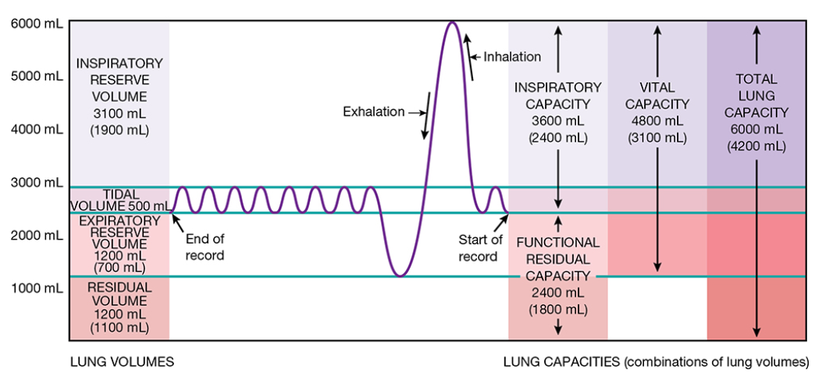
Important lung volumes
Figure 23.15
  Tidal volume
  Inspiratory reserve volume
  Forced Vital Capacity (FVC)
  Forced Expiratory Volume₁ (FEV₁)
  Ratio of FEV/FVC
  Peak flow
Images taken from Tortora, GJ., Derrickson, B., Burkett, B., Peoples, G.,Dye, D., Cooke, J., et al. Principles of anatomy and physiology. Second Asia-Pacific ed. Queensland, Australia: John Wiley & Sons; 2019.

Slide 8
Patterns of Respiratory disease
Obstructive disease (COPD / Asthma)
  Decreased FEV1,
  Normal or decreased FVC,
  Decreased FEV1/FVC ratio (normal is 70-80%)
Restrictive disease (Interstitial lung disease, semi-paralysis of diaphragm or skeletal muscles
  Decreased Total lung capacity (FVC)
  Decreased FEV1 and FVC
  Normal FEV1 /FVC

Slide 9
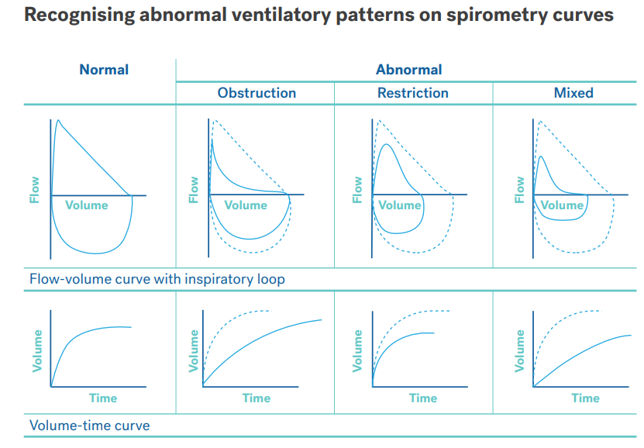
Taken from Spirometry quick reference guide. National Asthma Council Australia available at https://d8z57tiamduo7.cloudfront.net/resources/NAC_Spirometry-Quick-Reference-Guide_2020.pdf

Slide 10
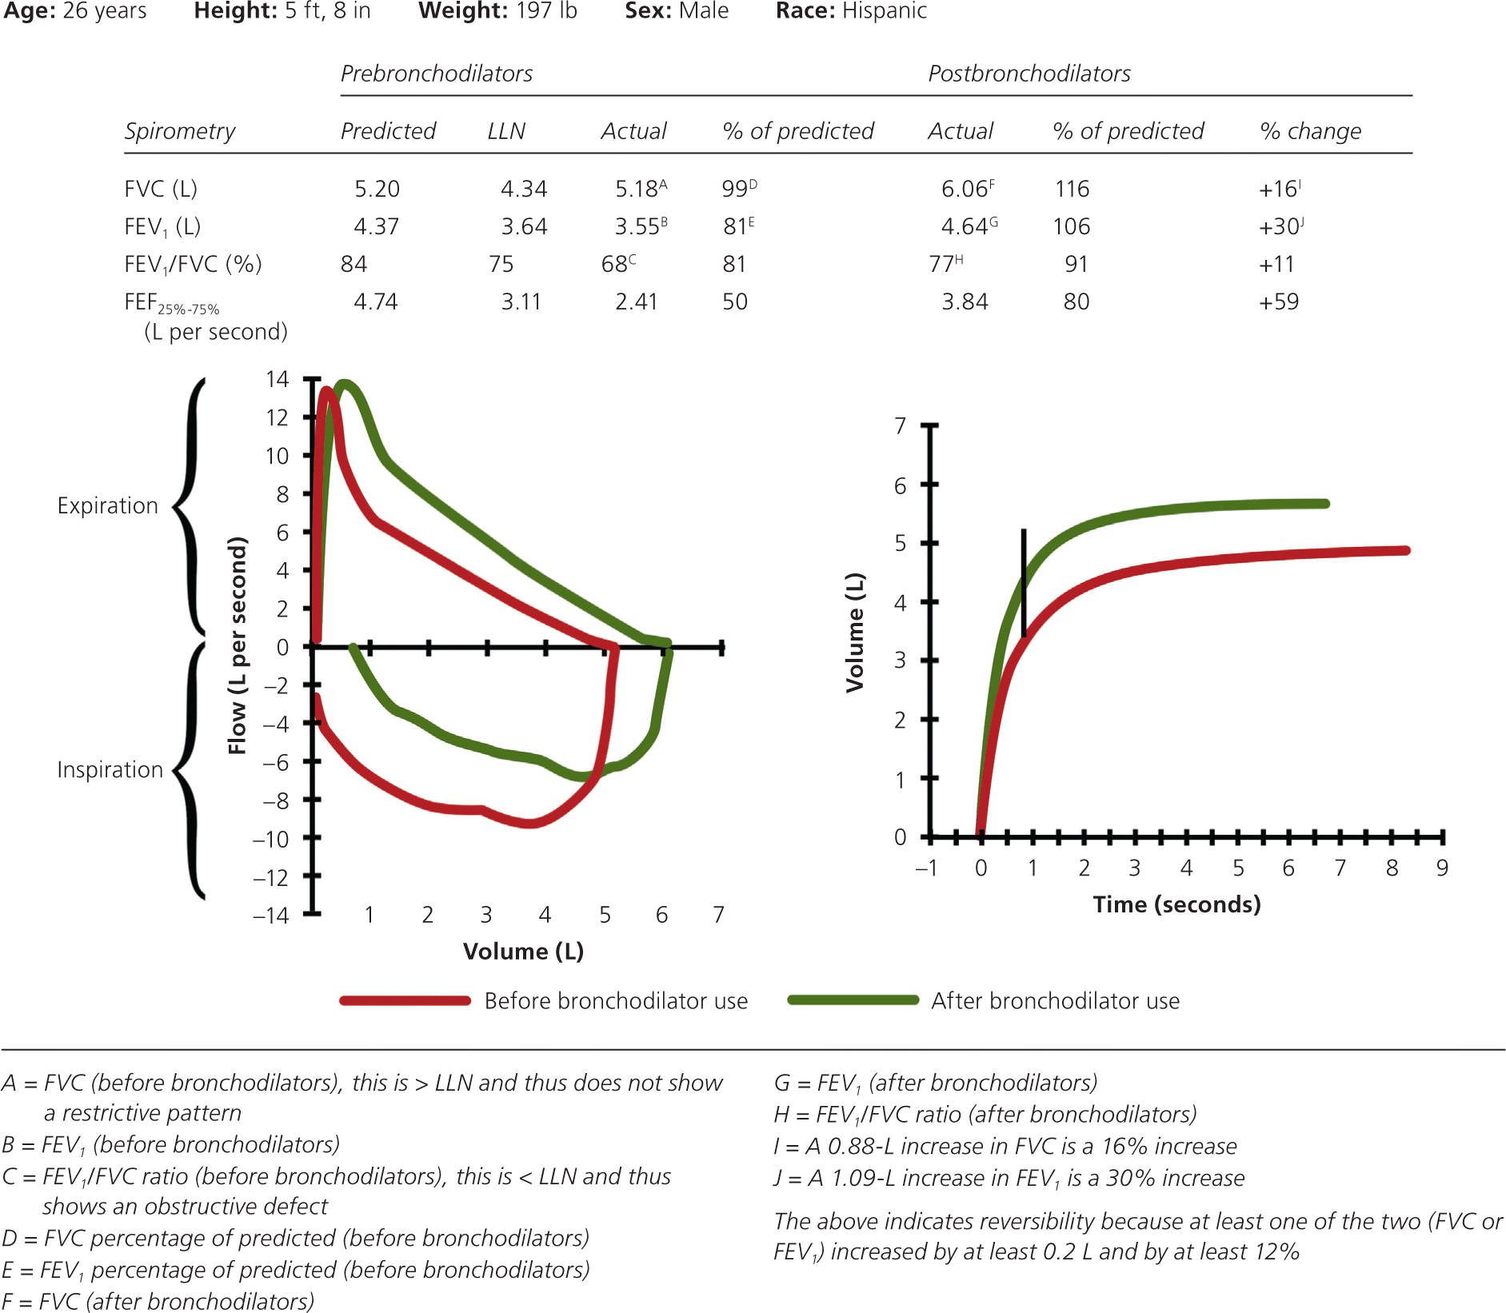
Spirometry – obstructive defect with reversibility
Perform baseline spirometry
Administer bronchodilator (4 puffs salbutamol via MDI and spacer
Wait 10-15 minutes
Repeat spirometry
The obstructive defect is reversible because at least one of the two measurements (FVC or FEV₁) increased by at least 0.2 L and by at least 12%.
Figure taken from Johnson, J. and Theurer, W. A stepwise approach to the interpretation of pulmonary function tests. American Family Physician. 2014 Mar 1;89(5):359-366.

Slide 11
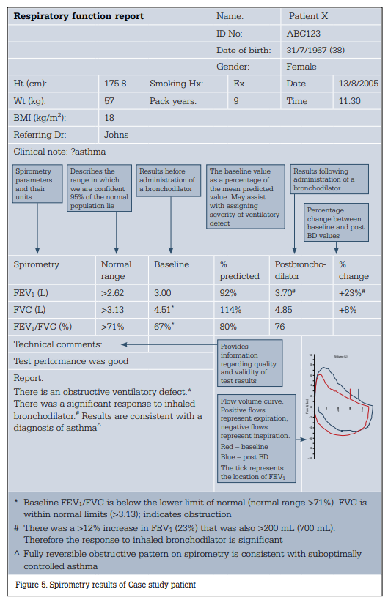
Example respiratory report
Things to note
  Low baseline FEV1
  Low baseline FEV1/FVC
  Post-bronchodilator
    Improvement in FEV1
    Improvement in FVC
    FEV1/FVC ration improvement
Figure 5 taken from: Borg, B. & Maughton, M. Spirometry. Australian Family Physician. 2011, April;40:4;216-219.

Slide 12
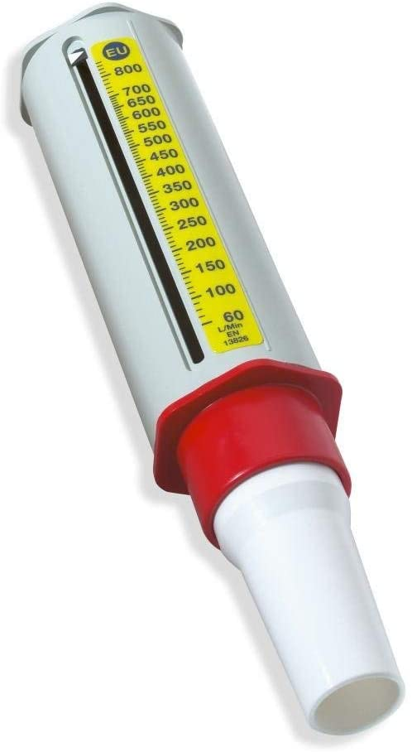
Peak flow meters
Measures peak (maximum) rate at which a person can expel air
Provides an indication of the degree of obstruction in
  Asthma
  COPD
Only used by a minority of patient
  Can objectively identify disease flares
  Disease progress over time (spirometry better for this)
Not diagnostic for asthma or COPD
Just useful for home measurement

Slide 13
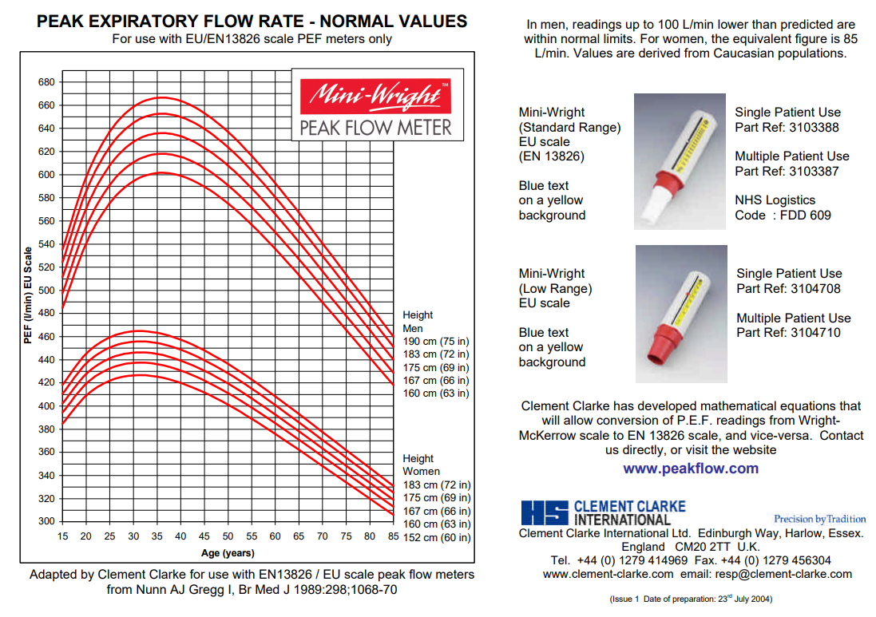
Image taken from http://www.peakflow.com/top_nav/normal_values/

Slide 14
