Slide 1
Chronic Obstructive Pulmonary Disease (COPD)
Part 2 – Diagnosis & Treatment
PC3303 – Integrated Therapeutics 3
Cassie Lanskey

Slide 3
Asthma and COPD can co-exist
Asthma – airflow limitation is reversible with use of bronchodilator
COPD – airflow limitation is not fully reversible
However, patients can respond to treatment differently → categorisation by ‘phenotype’
Image taken from: Lung Foundation Australia. The COPD-X plan: Australian and New Zealand guidelines for the management of chronic obstructive pulmonary disease. Lung Foundation Australia website.

Slide 4
Diagnosis
Usually based on a:
History of smoking or exposure to another noxious agent PLUS
A FEV1/FVC < 0.7 post-bronchodilator
I.e. airflow limitation not reversible with a bronchodilator

Slide 5
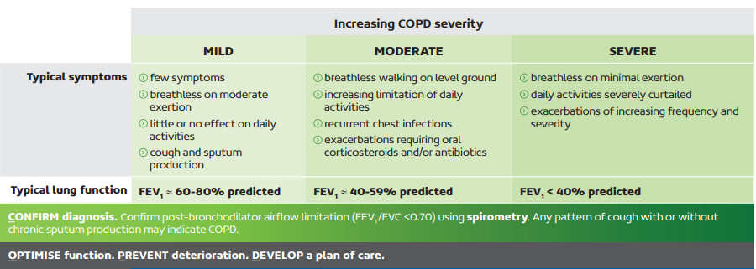
Severity
COPD Assessment Test (CAT)
Figure taken from: Global Initiative for Chronic Obstructive Lung Disease, Inc. Global strategy for the diagnosis, management, and prevention of chronic obstructive pulmonary disease. GOLD COPD website. https://goldcopd.org/gold-reports/#.
Figure taken from: Lung Foundation Australia. Stepwise Management of Stable COPD. Lung Foundation Australia website. Updated 2022. Available at https://lungfoundation.com.au/resources/stepwise-management-of-stable-copd/

Slide 6
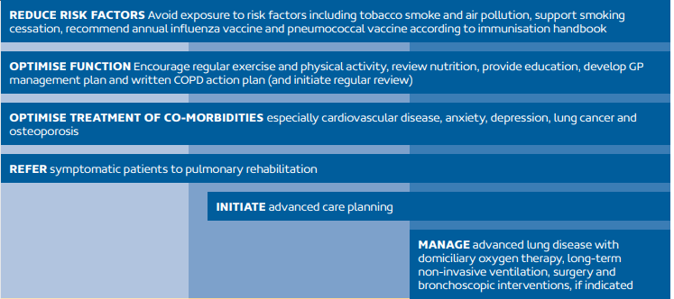
Non-Pharmacological Treatment
Smoking cessation!!
Pulmonary rehabilitation
Regular exercise
Vaccination
Influenza
Pneumococcal
COVID
Etc.
COPD action plan
Figure taken from: Lung Foundation Australia. Stepwise Management of Stable COPD. Lung Foundation Australia website. Updated 2022. Available at https://lungfoundation.com.au/resources/stepwise-management-of-stable-copd/

Slide 7
Pharmacological Treatment
Check adherence & inhaler technique
Figure taken from: Lung Foundation Australia. Stepwise Management of Stable COPD. Lung Foundation Australia website. Updated 2022. Available at https://lungfoundation.com.au/resources/stepwise-management-of-stable-copd/

Slide 8
LABAs in COPD
Some are more common in COPD → indacaterol, salmeterol, olodaterol
Indacaterol – common S/E is post-inhalation cough
Vilanterol (available in in combination with LAMA, ICS or both)
Indacaterol Onset ~5 mins Once daily | Olodaterol Onset ~5-10 mins Once daily
Salmeterol Onset ~10-30 mins Twice daily | Formoterol Onset ~1-3 mins Twice daily

Slide 9
Inhaled Anticholinergics - SAMAs and LAMAs
Acetylcholine is a neurotransmitter of the parasympathetic nervous system
Acetylcholine induces bronchoconstriction and increased secretions when it acts on muscarinic receptors in the airways
Short-acting | Long-acting
Ipratropium | Aclidinium – BD dosing Glycopyrronium – OD dosing Tiotropium – OD dosing Umeclidinium – OD dosing

Slide 10
Inhaled Anticholinergics - SAMAs and LAMAs
Adverse effects
Dry mouth, throat irritation
Dry eyes
Urinary retention
Constipation
Counselling
Avoid contact with your eyes, close your eyes or wear eye protection during nebulisation (e.g. of ipratropium)
Do not use LAMAs for immediate relief of symptoms
Onset of action is too long
Avoid using a SAMA (i.e. ipratropium) with a LAMA

Slide 11
Inhaled Corticosteroids in COPD
Added to LABA/LAMA combination
Indicated for moderate to severe COPD, especially if there are recurrent exacerbations
Benefits
Reduced exacerbations
Improved QoL
Adverse effects
Pneumonia
Triple inhaler therapy:
Trelegy® - Fluticasone + Umeclidinium + Vilanterol
Breztri® - Budesonide + Glycopyrronium + Formoterol
Trimbow® - Beclometasone + Glycopyrronium + Formoterol

Slide 13
Theophylline
No longer recommended for treatment of COPD in Australia
Evidence pre-dates current standard of care
Class: Methylxanthine
MOA:
Causes bronchial smooth muscle relaxation
Pulmonary vasodilator
CNS stimulation

Slide 14
Theophylline (Nuelin® SR)
Adverse effects
Hypotension
Tachycardia
Palpitations
Headache
Insomnia
Tremor
Narrow therapeutic index
Trough level 10-20mg/L
Interactions!!
Drugs
Tobacco smoking
Your COPD patient tries to quit smoking after having been taking theophylline 200mg BD for 3 months. What will happen to their theophylline level??

Slide 15
COPD Exacerbations
Acute onset
Beyond normal day-to-day variations
Increasing dyspnoea, tachypnoea, cough frequency, sputum production
Right heart failure → observable ankle oedema
Following a hospitalisation for COPD, the 12-month mortality rate is ~25%.
May be triggered by infection (viral or bacterial) or non-infective causes (e.g. pollutants, stressors, heart failure, etc.)

Slide 16
COPD Exacerbations
SABAs and SAMAs
Higher doses
Salbutamol - 100microg MDI x 4-8 puffs via spacer PRN
Salbutamol - 2.5-5mg via nebuliser PRN
Ipratropium – 21microg MDI x 4 puffs via spacer Prn
Ipratropium – 500microg via nebuliser PRN
Corticosteroids
Oral prednisolone – 30-50mg mane for 5 days then stop
Antibiotics
Only indicated if the patient has all 3 of:
Acute increase in dyspnoea, increased sputum volume, and purulent sputum
+/- fever
Use amoxicillin or doxycycline
Avoid amoxicillin with clavulanic acid (= unnecessary broader spectrum treatment)

Slide 17
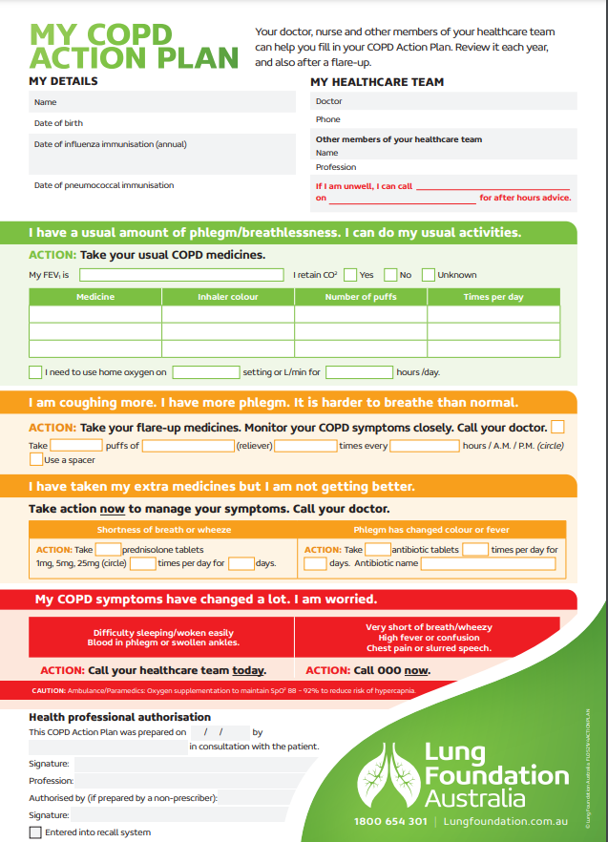
Summary: COPD-X
Confirm diagnosis
Optimise function
Prevent deterioration
Develop a plan of care
Manage exacerbations
COPD Action Plan taken from: Lung Foundation Australia. Resources. Lung Foundation Australia website. Updated 2021. Available at https://lungfoundation.com.au/resources/copd-action-plan/

Slide 18
Activity 2
Assign MOA and place-in-therapy
Class | Drug | Main Indication (Asthma vs COPD)
SABA
SAMA
LABA
LAMA
Methylxanthine
ICS
Salbutamol
Ciclesonide
Formoterol
Tiotropium
Aclidinium
Budesonide
Terbutaline
Umeclidinium
Beclometasone
Vilanterol
Fluticasone
Glycopyrronium
Indacaterol
Ipratropium
Salmeterol
Theophylline
Olodaterol

Slide 19
Activity 3
Personal Reflection – Mrs X (Part 1)
Newly diagnosed with COPD
Anxious +++
Presents you with a new script
Have you seen a patient like Mrs X?
How do you engage with Mrs X to develop rapport?

Slide 20
References
Lung Foundation Australia. COPD Overview. Lung Foundation Australia website. https://lungfoundation.com.au/health-professionals/conditions/copd/overview. Updated 2023.
Global Initiative for Chronic Obstructive Lung Disease, Inc. Global strategy for the diagnosis, management, and prevention of chronic obstructive pulmonary disease. GOLD COPD website. https://goldcopd.org/. Updated 2024.
Chronic Obstructive Pulmonary Disease (COPD). In: eTG complete (Respiratory). Therapeutic Guidelines. Updated May 2022.
National Heart, Lung, and Blood Institute (NHLBI). The Basics of Chronic Obstructive Pulmonary Disease (COPD). NHLBI website. Updated June 2018.
Australian Government. Chronic obstructive pulmonary disease (COPD). Australian Institute of Health and Welfare website. https://www.aihw.gov.au/reports/chronic-respiratory-conditions/copd/contents/deaths. Updated August 25, 2020.

