Slide 1
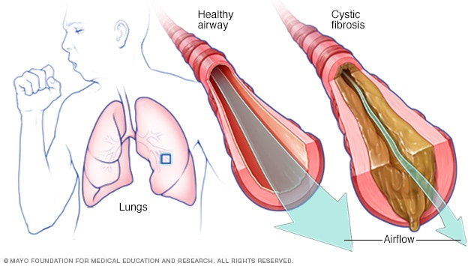
Cystic Fibrosis (CF)
Part 1 – Epidemiology & Pathophysiology
PC3303 – Integrated Therapeutics 3
Cassie Lanskey
Image taken from: https://www.mayoclinic.org/diseases-conditions/cystic-fibrosis/symptoms-causes/syc-20353700#dialogId61259186

Slide 3
Learning Objectives
Understand the pathophysiology of CF
List the drug treatment options
Place in therapy
Mechanism of action
Common adverse effects
Monitoring and counselling
Understand the principles of infection prevention & treatment
Apply this knowledge to a case study
Identify common clinical problems
Create a pharmaceutical care plan

Slide 4
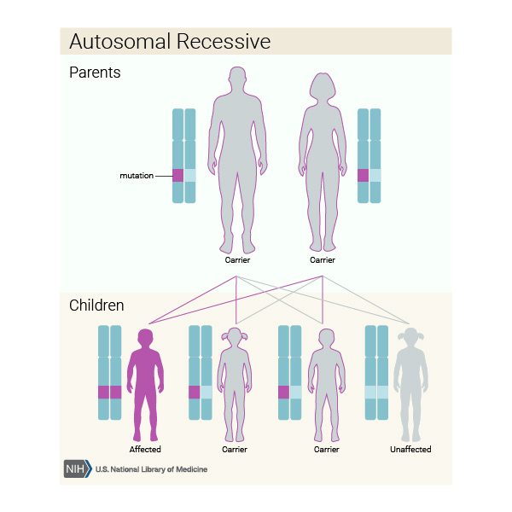
Introduction
The most common life-limiting genetic disease in Caucasians
In Australia, 1 baby is born with CF every 4 days (approx. 1 in 2,500 babies)
Autosomal recessive genetic disease
Complex multisystem disease
Affecting lungs, GI tract, sinuses, sweat glands, bones and reproductive organs
Image taken from: https://ghr.nlm.nih.gov/primer/inheritance/inheritancepatterns

Slide 5
Pathophysiology
The CF gene encodes a protein known as the cystic fibrosis transmembrane conductance regulator (CFTR)
CF gene mutations → abnormal variants of CFTR protein
There are many different types of CF gene mutations possible → different types of CFTR variants each associated with different degrees of CF disease severity

Slide 6
Pathophysiology of CF
https://www.youtube.com/watch?v=6IbP1ASGv9w&ab_channel=biointeractive
The CFTR protein normally functions to regulate the movement of chloride ions out of cells into the airway or GI lumen
Sodium ions follow the chloride ions.
Both attract a layer of water to promote fluidity & movement of secretions.
In CF, the lumen surface is lacking Cl⁻, therefore it is lacking Na⁺ and H₂O (→)

Slide 7
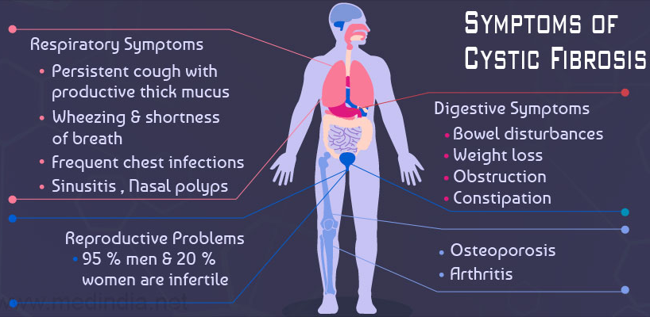
Overview of Symptoms
Image taken from: https://www.medindia.net/patients/patientinfo/cystic-fibrosis.htm

Slide 8
Diagnosis
Newborn Screening Program
All children are tested at birth (via heel-prick blood sample)
Infants with two CF mutations are referred directly to a specialist CF centre
Infants with one CF mutation identified undergo a sweat test to determine if they have CF or if they are a simply a carrier of the gene mutation
Skin
Image adapted from: https://www.youtube.com/watch?v=cu6rfyEMFiQ

Slide 9
Prognosis
Depends on the type of CFTR mutation
Previously, CF was considered primarily a paediatric disease
Now, CF patients are surviving well into adulthood
Medium survival time is ~35 years
Better outcomes are attributable to better management strategies
All CF patients are managed by (or in consultation with) a specialist CF centre
No changes to prescribed therapies are made without consulting this centre

Slide 10
Respiratory Goals
“Limit progression of lung damage caused by bacterial infection and neutrophilic inflammation”
Established treatment modalities include:
Effective airway clearance
Chest physiotherapy and mucolytics
Anti-inflammatory drugs
Drugs to correct CFTR protein function
Early aggressive antibiotic therapy
Heightened need to prevent development of antimicrobial resistance

Slide 11
Cystic Fibrosis (CF)
Part 2 – Approach to Treatment
PC3303 – Integrated Therapeutics 3
Cassie Lanskey
Image taken from: https://www.mayoclinic.org/diseases-conditions/cystic-fibrosis/symptoms-causes/syc-20353700#dialogId61259186

Slide 13
Learning Objectives
Understand the pathophysiology of CF
List the drug treatment options
Place in therapy
Mechanism of action
Common adverse effects
Monitoring and counselling
Understand the principles of infection prevention & treatment
Apply this knowledge to a case study
Identify common clinical problems
Create a pharmaceutical care plan

Slide 14
Overview
Effective airway clearance
Anti-inflammatory drugs
Potentiator therapy with drugs to correct CFTR protein function
Infection control in CF
Optimising antibiotic therapy

Slide 15
1. Effective Airway Clearance
Chest physiotherapy
Exercise
Beta-agonists
Short-acting beta-agonists may be used prior to chest physiotherapy and PRN if spirometry results improve post-SABA use
Long-acting beta-agonists may be used if there is evidence of associated asthma / LABA improves the patient’s symptoms

Slide 16
1. Effective Airway Clearance
Nebulised mucolytics
Dornase alfa (Pulmozyme®)
Cleaves extracellular DNA released from dead neutrophils in the airways
Dose: 1 nebule (2.5mg) once daily
Adverse effects: voice alteration, pharyngitis, laryngitis, rash
Counselling: Do not dilute or mix with other drugs in the nebuliser
Hypertonic saline
Sodium chloride 6% solution
Adverse effects: may cause bronchospasm, pre-treatment with bronchodilators may be required
Counselling: Solution must remain sterile, discard unused portion of opened sachets
Inhaled mannitol

Slide 17
2. Anti-inflammatory agents
Azithromycin
Class: Macrolide
Used in patients with chronic Pseudomonas aeruginosa infection
Anti-inflammatory (augments neutrophil function) as well as antibiotic effect
Dose (Adult): Oral 250-500mg 3x/week
Oral corticosteroids
Controversial
Serious adverse effects, e.g. growth suppression, diabetes, cataracts, osteoporosis
Inhaled corticosteroids
Lacking evidence but may be used
Assess for benefit by monitoring for changes in spirometry results

Slide 18
3. Potentiator Therapy
Ivacafor (Kalydeco®)
Increases channel opening of the CFTR protein, facilitating chloride ion transport across cell membranes
Only effective for patients with a certain type of CF gene mutation (i.e. approx. 8% of all patients with CF in Australia)
Dose (Adult): 150mg Oral BD
Adverse effects: Abdominal pain, diarrhoea, dizziness, headache, rash, upper respiratory tract infections, raised LFTs
Counselling: Monitor LFTs, take with a fatty meal

Slide 19
4. Infection Control in CF
Respiratory pathogens are highly transmissible
Burkholderia cepacia can be transmitted from an infected to a non-infected patient and it is especially difficult to treat
Provide a single room for all CF patients where possible
Hand hygiene
Vaccination
Avoid mould/ stagnant water
Image taken from: https://www.redbrick.me/review-five-feet-apart/

Slide 20
5. Antibiotic Therapy
In children, infections are predominantly caused by Staphylococcus aureus and Haemophilus influenzae.
In adolescents and adults, the predominant organism is Pseudomonas aeruginosa.
Initially, the P. aeruginosa is antibiotic-sensitive.
Once resistance develops, infection becomes chronic and antibiotic therapy may only suppress the infection (not eradicate it).
Early, aggressive antibiotic therapy is essential to delay deterioration

Slide 21
5. Antibiotic Therapy
S. aureus and H. influenzae
Oral antibiotics are often suitable
Duration is normally 2-4 weeks
E.g. flucloxacillin, cefalexin, clindamycin, trimethoprim+sulfamethoxazole, or amoxicillin+clavulanate
Initial P. aeruginosa infection
Goal is eradication until this is no longer possible and chronic infection takes hold
Duration is normally 2-3 months
IV antibiotic treatment options may include piperacillin+tazobactam, ceftazidime, tobramycin
Adjunct treatment options may include oral ciprofloxacin or nebulised tobramycin

Slide 22
5. Antibiotic Therapy
Chronic P. aeruginosa infection
Goal is to suppress infection and reduce morbidity
It is common to use inhaled tobramycin BD in a month-on/month-off regimen

Slide 24
Advanced Lung Disease in CF
FEV1 < 30%
Supplemental oxygen
Non-invasive ventilation
Lung transplant

Slide 25
Cystic Fibrosis (CF)
Part 3 – Case Study
PC3303 – Integrated Therapeutics 3
Cassie Lanskey
Image taken from: https://www.mayoclinic.org/diseases-conditions/cystic-fibrosis/symptoms-causes/syc-20353700#dialogId61259186

Slide 27
Learning Objectives
Understand the pathophysiology of CF
List the drug treatment options
Place in therapy
Mechanism of action
Common adverse effects
Monitoring and counselling
Understand the principles of infection prevention & treatment
Apply this knowledge to a case study
Identify common clinical problems
Create a pharmaceutical care plan

Slide 28
Patient CF
A 21-year old male
Weight 54kg, eGFR > 90
Presents to ED with shallow breathing, haemoptysis, increasing mucus, and increasing lethargy
NKDA
Past medical history
Cystic fibrosis
Severe lung disease
Chronic multidrug-resistant pseudomonas infection
Pancreatic insufficiency
Depression
Non-adherent to prescribed medication regime

Slide 29
Medications on admission
Medication name | Indication | Directions
Tobramycin (300mg/5ml) inhalation | Antibiotic | Nebulise and inhale 1 nebule twice a day for 1 month on and then one month off
Fluticasone/salmeterol 125/25microg inhaler | Improve control of airways disease | Inhale 2 puffs twice a day. Rinse mouth out with water after each use.
Sodium chloride 6% inhalation solution | Mucolytic | Nebulise and inhale 5ml of solution twice a day. Discard unused portion of sachets.
Dornase alfa (2.5mg/2.5ml) inhalation | Mucolytic | Nebulise and inhale 1 dose (2.5ml) at night
Salbutamol 100microg inhaler | Open airways | Inhale 2-4 puffs four times a day (before physiotherapy and when required)
Ivacaftor 150mg tablets | Improve lung function | Take 1 tablet twice a day with a fatty meal or snack
Pancreatic extract (Creon) 25,000 unit capsule | Pancreatic enzyme supplement | Take 1-10 capsules three times a day with meals *self-adjusted based on caloric intake as per directions from dietician*
Mirtazapine 30mg tablets | To assist mental health | Take 1 tablet at night

Slide 30
Medication Changes in Hospital
New: IV Antibiotics (as per recommendations of Prince Charles Hospital CF Specialist)
Ceftazidime 3g Q8H
Tobramycin 320mg IV nocte
Withhold: Dornase alfa (due to haemoptysis)

Slide 31
Patient CF
A 21-year old male
Weight: 54kg
Presents to ED with shallow breathing, haemoptysis, increasing mucus, and increasing lethargy
NKDA
Past medical history
Cystic fibrosis
Severe lung disease
Chronic multidrug-resistant pseudomonas infection
Pancreatic insufficiency
Depression
Non-adherent to prescribed medication regime

Slide 32
Infective Exacerbation of Resp. Symptoms
Airway clearance
SABA charted
Mucolytic
Hypertonic saline nebs charted, dornase alfa withheld
Anti-inflammatory
ICS charted as per pre-admission
Potentiator therapy
Patient qualifies for ivacaftor
Antibiotics as per specialist CF centre
Ceftazidime 3g Q8H
Tobramycin 320mg IV nocte

Slide 33
Pancreatic Insufficiency
Pancreatic exocrine dysfunction
Dehydrated secretions → obstructed pancreatic ducts
Lack of pancreatic enzyme → inability to digest food/ absorb nutrients
Pancreatic enzyme supplements
Dose: Patients are trained to titrate the dose according to caloric intake and specialist/dietician
Capsules are to be swallowed whole or opened and sprinkled onto soft food and taken immediately (do not crush/chew)
Avoid hot food/liquid as this can destroy the enzymes
Pancreatic endocrine dysfunction
CF-related diabetes
Do NOT restrict carbohydrates
Control BGL using insulin

Slide 34
Others
Depression
Mirtazapine 30mg nocte
Offer social and professional psychological support
Non-adherence
Simplify treatment regimes as much as possible
Explain treatment rationale, and negotiate treatment options where possible
Fertility
Most males are infertile
IVF may be an option

Slide 35
References
Therapeutic Guidelines (eTG) – Respiratory (Cystic Fibrosis)
Cystic Fibrosis Australia website - https://www.cysticfibrosis.org.au/
AMH
MIMs
Micromedex

