Slide 1
Respiratory anatomy and physiology Revision
Assoc. Prof. John Smithson

Slide 2
PC3303 – Integrated Therapeutics 3
Welcome
Subject matter – 3 areas
Respiratory / Ear / Nose / Throat
Pain & Musculoskeletal conditions
Neurological conditions
Assessment

Slide 3
PC3303 – Integrated Therapeutics 3
Teaching in this subject
1 weekly introductory session
Lecture content delivered using online format
Guided Learning Sessions – weekly for 4 hours
Tutorials – 7 times a semester

Slide 4
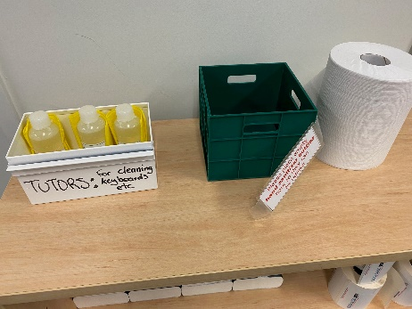
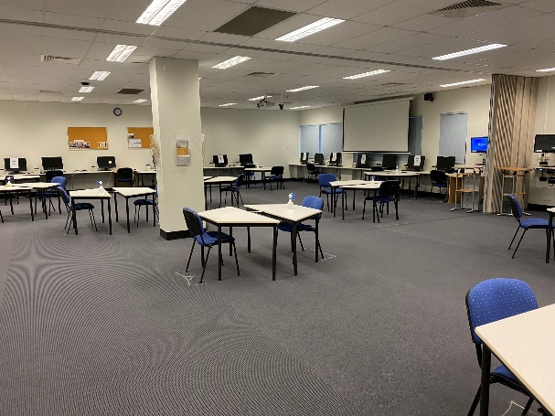
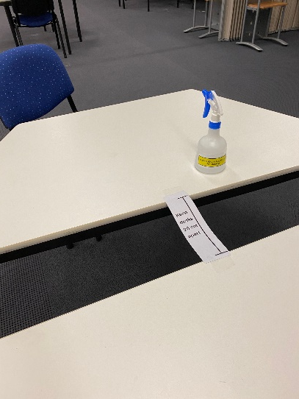
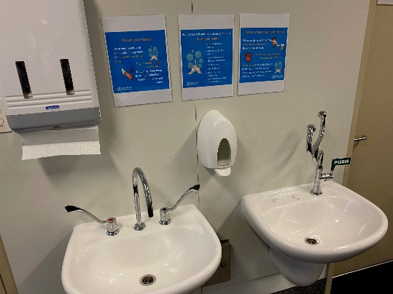
Class Declaration – COVID-19
By attending a face to face teaching activity, you are declaring that you are well and have not, in the past 24 hours, had the following symptoms:
fever
cough
sore throat
shortness of breath
fatigue
aches and pains
headaches
runny or stuffy nose
loss of smell or taste
nausea or vomiting
diarrhoea
loss of appetite
If you have experienced one of these symptoms in the past 24 hours you should not attend the class (or leave the class immediately if you are already there). You should notify your Subject Coordinator/Academic Advisor, and arrange to be tested for COVID-19 as soon as possible.

Slide 5
Learning outcomes
Be able to:
Describe the relevant anatomy and physiology of the respiratory system
Understand the concept of acid/base balance in the body
Describe the three main ways the body regulates acid-base balance
Review clinical measurements of acid-base imbalances and indicate the imbalance and compensatory mechanisms for the 4 types of acid/base imbalance

Slide 6
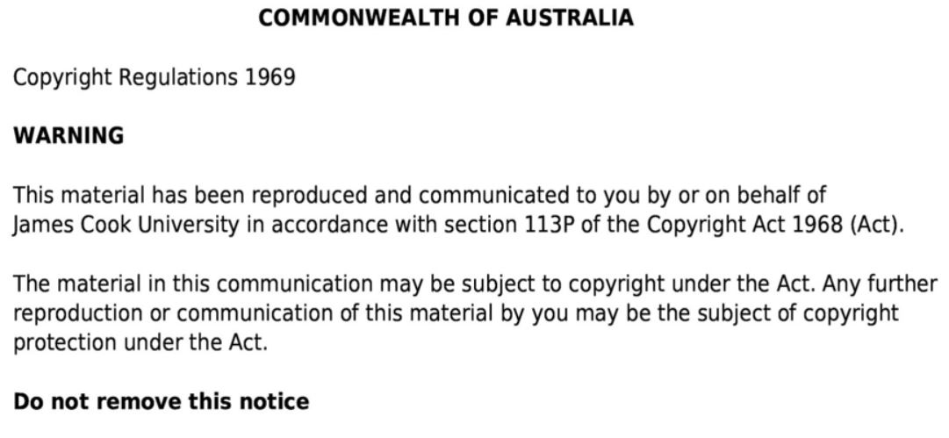

Slide 7
Structure of the respiratory system
Figure 23.1
Nose
Pharynx
Nasopharynx
Oropharynx
Laryngopharnyx
Trachea
Bronchus
Lungs (R=3, L=2 lobes)
Cardiac notch
Images taken from Tortora, GJ., Derrickson, B., Burkett, B., Peoples, G.,Dye, D., Cooke, J., et al. Principles of anatomy and physiology. Second Asia-Pacific ed. Queensland, Australia: John Wiley & Sons; 2019.

Slide 8
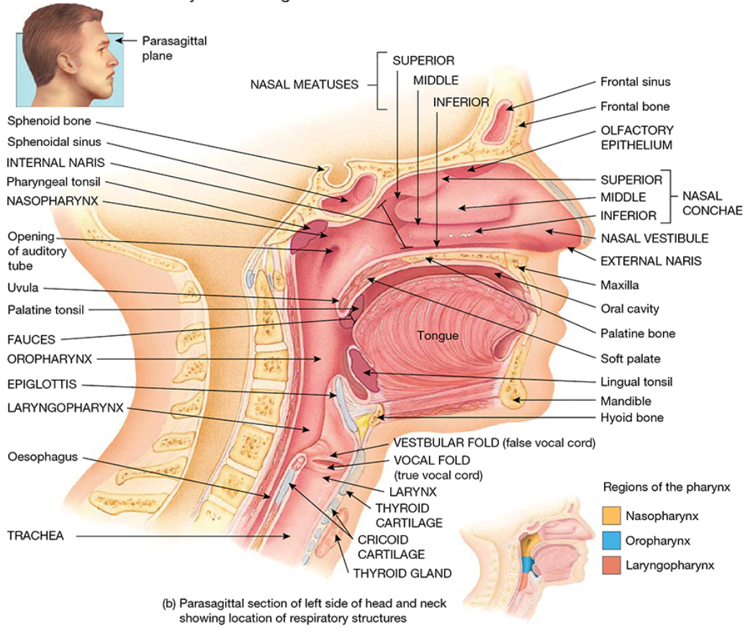
Respiratory structures of the head and neck
Figure 23.2
Nasal meatus
Nasal Conchae
Nasopharynx
Oropharynx
Laryngopharynx
Thyroid cartilage
Epiglottis
Trachea
Oesophagus
Images taken from Tortora, GJ., Derrickson, B., Burkett, B., Peoples, G.,Dye, D., Cooke, J., et al. Principles of anatomy and physiology. Second Asia-Pacific ed. Queensland, Australia: John Wiley & Sons; 2019.

Slide 9
Bronchi
Figure 23.7
Larynx
Trachea
Carina
Main bronchi
Bronchioles
Terminal bronchioles
Images taken from Tortora, GJ., Derrickson, B., Burkett, B., Peoples, G.,Dye, D., Cooke, J., et al. Principles of anatomy and physiology. Second Asia-Pacific ed. Queensland, Australia: John Wiley & Sons; 2019.

Slide 10
Alveoli and terminal bronchioles
Figure 23.10
Helical arrangement of smooth muscle
Lymphatic vessel
Pulmonary arteriole
Pulmonary venule
Alveolar sac
Alveoli
Images taken from Tortora, GJ., Derrickson, B., Burkett, B., Peoples, G.,Dye, D., Cooke, J., et al. Principles of anatomy and physiology. Second Asia-Pacific ed. Queensland, Australia: John Wiley & Sons; 2019.

Slide 11
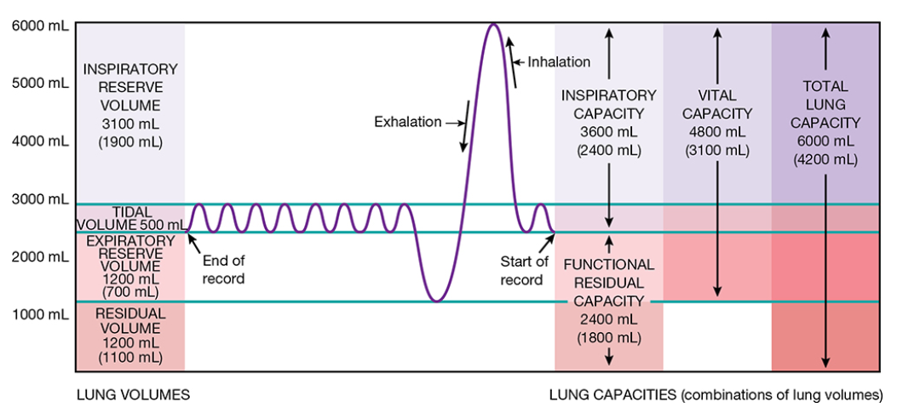
Important lung volumes
Figure 23.15
Tidal volume
Inspiratory reserve volume
Forced Vital Capacity (FVC)
Forced Expiratory Volume₁ (FEV₁)
Images taken from Tortora, GJ., Derrickson, B., Burkett, B., Peoples, G.,Dye, D., Cooke, J., et al. Principles of anatomy and physiology. Second Asia-Pacific ed. Queensland, Australia: John Wiley & Sons; 2019.

