Slide 1
Atrial Fibrillation
Part 1 - Introduction
PC3301 – Integrated Therapeutics 2
Cassie Lanskey

Slide 3
Learning Objectives
Understand what atrial fibrillation is and the different types
List the possible symptoms / clinical manifestations
Understand the epidemiology and risk factors
Understand the approach to screening and diagnosis
Understand the sequelae / prognosis
Be able to describe the approach to management of atrial fibrillation
Be able to compare and contrast options for the treatment of the dysrhythmia itself (i.e., rate vs rhythm control)
Be able to provide individualised advice as to whether or not therapeutic anticoagulation is required for prevention of thromboembolic complications
If anticoagulation is indicated, outline the option(s) and justify your recommendations

Slide 4
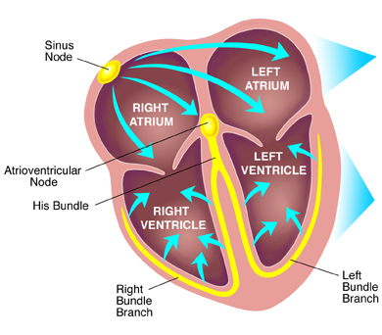
Normal Cardiac Conduction
In sinus rhythm:
Action potentials generated by the sinoatrial (SA) node spread across the atria by cell-to-cell conduction → atrial contraction (P wave)
The atrioventricular (AV) node slows the electrical impulses considerably to allow sufficient time for complete atrial depolarisation and contraction prior to ventricular depolarisation
The slowed electrical impulses enter the ventricle at the Bundle of His and then follow the left bundle branch (LBB) and right bundle branch (RBB)
The LBB and RBB divide into an extensive network of Purkinje fibres that carry the impulses across the ventricles
The result is rapid depolarisation of ventricular myocytes → ventricular contraction
Image taken from: https://www.uptodate.com/contents/pacemakers-beyond-the-basics/print

Slide 5
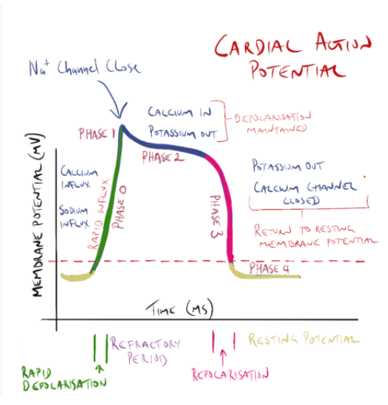
The Cardiac Action Potential
Week 1 !!
Figure drawn by Associate Professor John Smithson

Slide 6
Introduction
Definition of atrial fibrillation (BMJ)
A supraventricular tachyarrhythmia with uncoordinated atrial electrical activation and consequently ineffective atrial contraction
In AF, the SA node is not the only source of electrical signals
Image taken from: https://herheart.org/heart-conditions/atrial-fibrillation/?gclid=EAIaIQobChMI6qOPounC7wIVVqaWCh28jQEOEAAYAiAAEgKFffD_BwE

Slide 7
Introduction
Image taken from: https://herheart.org/heart-conditions/atrial-fibrillation/?gclid=EAIaIQobChMI6qOPounC7wIVVqaWCh28jQEOEAAYAiAAEgKFffD_BwE
Image taken from: https://www.vin.com/apputil/content/defaultadv1.aspx?id=7259356&pid=14365&print=1

Slide 8
Introduction
In order to function as an efficient pump, the heart muscle must contract and relax in a coordinated manner
First the atria, then the ventricles
When inappropriate electrical signals are generated at multiple foci across the atria (i.e., in AF), the AV node and thus the ventricles do not receive a regular / reliable stimulus
So, rapid AF often leads to a rapid & irregular ventricular rate that manifests as a rapid & irregular pulse rate (100-180 beats/minute)
In the bottom ECG on the previous slide, different sized horizontal gaps between QRS complexes = different lengths of time between ventricular contractions

Slide 9
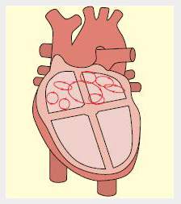
Pathophysiology
AF is usually associated with anatomically and histologically abnormal atria as a result of underlying heart disease
For example, fibrosis and inflammation can cause a difference in refractory periods across the atrial tissue that promotes an electrical re-entry phenomenon
The main electrical wave generated by the SA node may hit a ‘block’ or area of tissue that slows conduction where it is fractionated into multiple ‘wavelets’
See also… page 422-423 of Pathophysiology (6th Ed) by Banasik and Copstead, available online from the JCU library site
‘Wavelets of AF’.
Image taken from: https://bestpractice-bmj-com.ap1.proxy.openathens.net/topics/en-gb/3000087/aetiology

Slide 10
Types of Atrial Fibrillation
Most important differentiation:
Valvular atrial fibrillation
Atrial fibrillation affecting a patient with moderate to severe mitral stenosis or a prosthetic heart valve
Necessitates therapeutic anticoagulation with warfarin (see later)
Non-valvular atrial fibrillation
Atrial fibrillation that is not associated with moderate to severe mitral stenosis or a prosthetic heart valve
Types of atrial fibrillation:
Paroxysmal AF
AF terminates spontaneously, episodes of AF usually last less than 48 hours (infrequently up to 7 days)
Sinus rhythm can be sustained for periods of time between episodes of AF
Persistent AF
AF that is sustained for more than 7 days
Permanent AF
AF that is persistent for more than 1 year

Slide 11
Signs & Symptoms
AF is commonly asymptomatic
Palpitations
May be described by the patient as ‘racing heart’ or ‘fluttering in the chest’
Breathlessness / dyspnoea
Symptomatic hypotension
Fatigue
Chest pain / tightness / discomfort
Anxiety

Slide 12
Epidemiology
The most common recurrent arrhythmia encountered in clinical practice
Prevalence of AF in Australia is estimated to be 2-4%
But true prevalence is underestimated because AF commonly exists undiagnosed
Risk factors
Advancing age
Hypertension
Heart failure (rEF & pEF)
Genetics
Diabetes
Obstructive sleep apnoea
Obesity
ETOH / Smoking
Coronary artery disease
Valvular heart diseases
Hyperthyroidism
Stress / Anxiety

Slide 13
Screening & Diagnosis
Opportunistic point-of-care screening for AF in the clinic or community should be conducted in people aged 65 years or more
Pulse palpitation and ECG interpretation by GPs or practice nurses
1.4% of patients aged 65 years or more will have undiagnosed AF at a single point-in-time screening of their ECG trace
24-hour Holter monitoring may be used to detect undiagnosed AF in the community but this may not capture paroxysmal AF
Continuous inpatient ECG monitoring for AF is recommended for patients with an embolic stroke of uncertain source
Diagnostic tests include a 12-lead electrocardiogram (ECG), echocardiogram, and laboratory tests (i.e., full blood count, electrolytes, renal function, thyroid function tests).

Slide 14
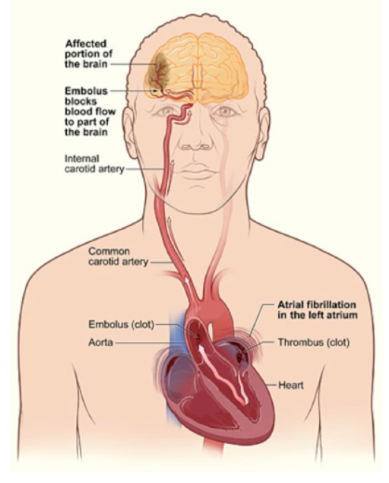
Complications of AF
Thromboembolic consequences of AF are a cause of substantial morbidity and mortality. These include embolic stroke and pulmonary embolism.
People with AF are 5 times more likely to have a stroke than those without AF
Previously unknown AF is associated with approximately 10% of all ischaemic strokes
When the heart is not pumping blood in a coordinated & forcible manner from the atria to the ventricles, there is an increased chance of blood pooling within the heart. Stagnation & pooling → clotting.
If a clot is ejected from the left side of the heart, this can cause an embolic stroke.
If a clot is ejected from the right side of the heart, this can cause a pulmonary embolism.
Image taken from: https://womensvoicesforchange.org/dr-pat-consults-the-anatomy-of-a-stroke.htm

Slide 15
Complications of AF
Myocardial infarction
Atrial fibrillation → rapid ventricular rate → increased myocardial oxygen demand
Heart failure
Increased myocardial oxygen demand → weaker heart muscle over time
Heart failure also commonly precedes AF (i.e., heart failure is a risk factor for AF)

Slide 16
Approach to Treatment
Diagnosis of AF
1. Rate vs Rhythm Control
2. Anticoagulation to Prevent Thromboembolism
Rhythm Control
Rate Control
Low Risk
Intermediate Risk
High Risk

Slide 17
References
National Heart Foundation of Australia & Cardiac Society of Australia and New Zealand. Australian Clinical Guidelines for the Diagnosis and Management of Atrial Fibrillation 2018. National Heart Foundation website. https://www.heartlungcirc.org/action/showPdf?pii=S1443-9506%2818%2931778-5.
Atrial Fibrillation. In: eTG complete (Cardiovascular). Therapeutic Guidelines. Updated December 2019.
New-Onset Atrial Fibrillation. In: BMJ Best Practice. London, England: BMJ Publishing Group; 2020. https://bestpractice-bmj-com.ap1.proxy.openathens.net/topics/en-gb/3000087.

