Slide 1
Atrial Fibrillation
Part 2 - Management
PC3301 – Integrated Therapeutics 2
Cassie Lanskey

Slide 3
Learning Objectives
Understand what atrial fibrillation is and the different types
List the possible symptoms / clinical manifestations
Understand the epidemiology and risk factors
Understand the approach to screening and diagnosis
Understand the sequelae / prognosis
Be able to describe the approach to management of atrial fibrillation
Be able to compare and contrast options for the treatment of the dysrhythmia itself (i.e., rate vs rhythm control)
Be able to provide individualised advice as to whether or not therapeutic anticoagulation is required for prevention of thromboembolic complications
If anticoagulation is indicated, outline the option(s) and justify your recommendations

Slide 4
Rate vs. Rhythm Control

Slide 5
Rate vs Rhythm Control in AF
 | Rate Control | Rhythm Control
Aims | Aims to slow down AV nodal conduction to control the ventricular rate while accepting that the patient will remain in atrial fibrillation | Aims to treat the atrial fibrillation by reverting to a normal sinus rhythm
Medications Used | Beta blockers Non-dihydropyridine calcium channel blockers Digoxin Amiodarone (not 1st line) | Amiodarone Sotalol Flecainide Disopyramide Lidocaine
Pros | Over time, many patients with AF progress from paroxysmal to persistent AF. Persistent AF is often unresponsive to rhythm control. Generally better tolerated | Can improve symptoms and possibly reduce the incidence of stroke (but still need anticoagulation)
Cons | May be inferior to rhythm control if the patient has highly symptomatic acute AF | May be associated with increased risk of adverse effects due to negative inotropic effects (so watch out in heart failure) and pro-arrhythmic effects Amiodarone is the least negatively inotropic antiarrhythmic and so it is safe in heart failure

Slide 6
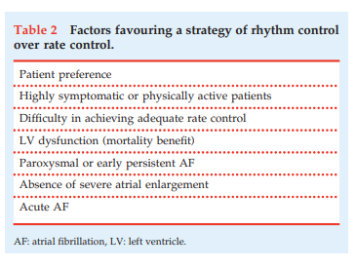
Rate vs Rhythm Control in AF
AFFIRM and RACE trials → both rate control and rhythm control are acceptable approaches to treatment of AF
Risks generally outweigh the benefits associated with maintenance (long-term) antiarrhythmic medications
Therefore, rate control is more common
However, some factors that may favour a rhythm control strategy are listed in the table →
Image taken from:
National Heart Foundation of Australia & Cardiac Society of Australia and New Zealand. Australian Clinical Guidelines for the Diagnosis and Management of Atrial Fibrillation 2018. National Heart Foundation website. https://www.heartlungcirc.org/action/showPdf?pii=S1443-9506%2818%2931778-5.

Slide 7
Rate Control in AF
Aim for a resting heart rate of < 110 beats per minute
Oral therapy is usually sufficient to achieve rate control (intravenous therapy is rarely needed)
First line therapies for rate control are atenolol and metoprolol
Start at low doses and increase up to max recommended dose if tolerated
For patients with LV dysfunction (LV EF < 40%), use one of the beta blockers recommended for use in heart failure (i.e., only bisoprolol, carvedilol, metoprolol XR, or nebivolol)
Second line therapies are diltiazem or verapamil
Must not be used for patients with LV dysfunction

Slide 8
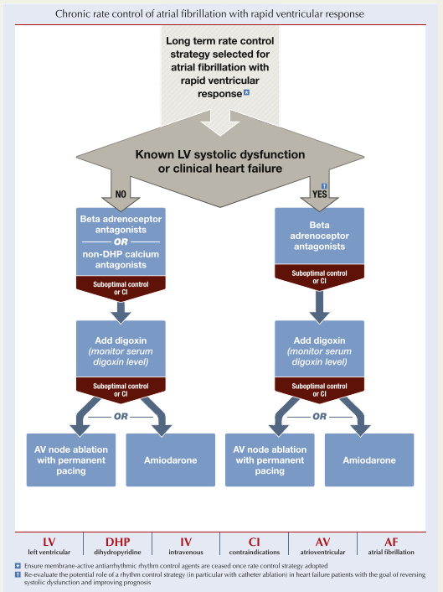
Rate Control in AF
Digoxin is especially useful for patients with both AF and heart failure
Digoxin monotherapy may lack efficacy
It is most effective if it can be used with a beta blocker (i.e., in stable euvolaemic heart failure)
Amiodarone is reserved as a last line option
It can be added if the aforementioned therapies are contraindicated or not sufficiently controlling the ventricular rate
Amiodarone has many adverse effects
Figure taken from: National Heart Foundation of Australia & Cardiac Society of Australia and New Zealand. Australian Clinical Guidelines for the Diagnosis and Management of Atrial Fibrillation 2018. National Heart Foundation website. https://www.heartlungcirc.org/action/showPdf?pii=S1443-9506%2818%2931778-5.

Slide 9
Rhythm Control in AF
Antiarrhythmic drug therapy has 2 main goals:
Termination of an arrhythmia
Prevention of recurring arrhythmia
In patients with acute symptomatic AF who are known to have been in AF for more than 48 hours or for an unknown duration who are not already anticoagulated:
Consider the risk that a left atrial thrombus has developed due to the AF and wait until this is excluded with echocardiography before attempting cardioversion for acute rhythm control (because electrical or pharmacological cardioversion can cause a clot to break loose and cause an embolism)
For chronic rhythm control
Flecainide is used first-line in patients without HFrEF or coronary artery disease
Amiodarone is used first-line in patients with HFrEF or coronary artery disease
For all other patients, amiodarone is second line
Although it has superior efficacy over other antiarrhythmic drugs, it has more adverse effects
Sotalol may be considered but requires close monitoring of the QT interval

Slide 10
Rhythm Control in AF
Remember that only 1 option should be chosen (rate control or rhythm control, not both)
If a rate control strategy is chosen, do not use flecainide or sotalol
This is because flecainide and sotalol have potential pro-arrhythmic side effects that cannot be justified when we are choosing not to pursue rhythm control
However, if a rhythm control strategy is chosen and flecainide is prescribed
AV nodal blocking medication (beta-blocker, non-dihydropyridine CCB, or digoxin) is recommended to prevent an increase in ventricular rate (1:1 conduction of atrial depolarisations) caused by flecainide

Slide 11
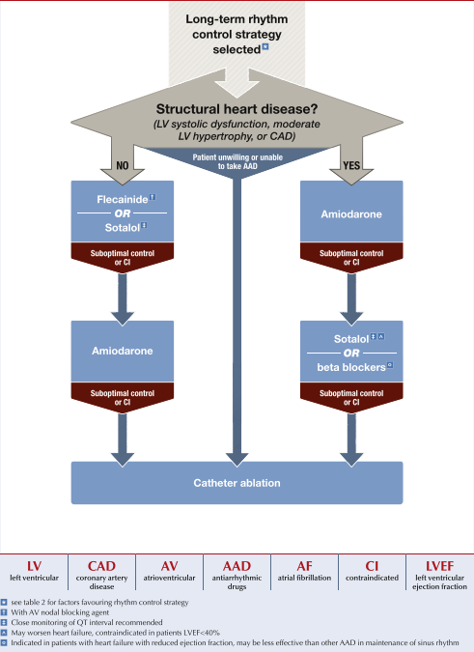
Rhythm Control in AF
Summary of previous slides
Figure taken from: National Heart Foundation of Australia & Cardiac Society of Australia and New Zealand. Australian Clinical Guidelines for the Diagnosis and Management of Atrial Fibrillation 2018. National Heart Foundation website. https://www.heartlungcirc.org/action/showPdf?pii=S1443-9506%2818%2931778-5.

Slide 12
Rhythm Control - Vaughan Williams Classification of Antiarrhythmics
The Vaughan Williams Classification groups antiarrhythmic drugs with similar electrophysiological effects at the cellular level
It is a useful broad guide to understanding drug pharmacology
But not all drugs within a class have identical pharmacological actions and properties
Vaughan Williams Class | Major Action | Examples
I | Na+ channel block | Disopyramide, Lidocaine, Flecainide, Mexiletine
II | Beta blockade | Beta blockers (esp. Nadolol, Esmolol, Propranolol, Metoprolol)
III | Action potential prolongation (usually by K+ channel block) | Amiodarone, Sotalol
IV | Ca²⁺ channel block | Verapamil, Diltiazem

Slide 13
Rhythm Control - Vaughan Williams Classification of Antiarrhythmics
Class I antiarrhythmics
Block sodium channels
When sodium channels are blocked, a greater stimulus for membrane depolarisation is required to open enough sodium channels at the resting membrane potential and elicit an action potential
Delay the rise of phase 0 of the action potential
Further divided into 3 subgroups (1a, 1b, and 1c)
Class 1a antiarrhythmics include disopyramide
Class 1b antiarrhythmics include lidocaine and mexiletine
Class 1c antiarrhythmics include flecainide

Slide 14
Rhythm Control - Vaughan Williams Classification of Antiarrhythmics
Class II antiarrhythmics
Are beta blockers, which are not very effective antiarrhythmic drugs… but which may
Inhibit the effects of the sympathetic nervous system
Decrease atrioventricular conduction
Interfere with potassium reuptake back into cells that occurs in phase 4 of the action potential
Increases the functional refractory period of the action potential
Decrease the propagation of abnormal impulses that may interrupt a normal cardiac action potential

Slide 15
Rhythm Control - Vaughan Williams Classification of Antiarrhythmics
Class III antiarrhythmics
Include amiodarone and sotalol
Prolong the action potential duration (usually by blocking potassium channels)
Refer to lecture slides entitled ‘prolonged QT interval & torsades de pointes’
Hopefully after having reviewed these slides you will understand how antiarrhythmic drugs can have pro-arrhythmic effects

Slide 16
Rhythm Control - Vaughan Williams Classification of Antiarrhythmics
Class IV antiarrhythmics
Are the calcium channel blockers (verapamil and diltiazem)
Like beta blockers, are not very effective antiarrhythmic drugs
Prolong the action potential and prolong the refractory period

Slide 17
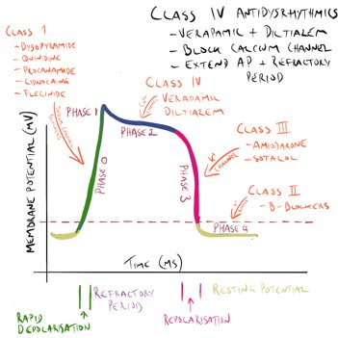
Figure drawn by Associate Professor John Smithson

Slide 18
Other Antiarrhythmics
Digoxin
Will be covered by Robi in week 6
Adenosine
Used for acute treatment of supraventricular tachycardia
I.e., not used for treatment of AF
Atropine
Used for a few different indications, including treatment of bradycardia with haemodynamic compromise
Isoprenaline
Use for a few different indications, including treatment of bradycardia with haemodynamic compromise

Slide 19
Non-Pharmacological Options
Non-drug therapies that may be used for AF include:
Direct current cardioversion
Defibrillation
Pacemakers
Catheter ablation of the AV node

Slide 20
Anticoagulation in Atrial Fibrillation

Slide 21
Anticoagulation in AF
Mortality associated with AF is rarely from the arrhythmia is itself but rather from thromboembolic complications
Treatment with anticoagulants has proven morbidity and mortality benefits, but also comes with adverse effects (esp., a risk of major bleeding)
Important considerations before prescribing an anticoagulant:
Check full blood count (including haemoglobin, platelet count, white blood cell count, red blood cell count, etc.)
Check renal and liver function
Check coagulation studies (including INR, APTT, etc.)
Paroxysmal, persistent, & permanent AF all have a similar risk of thromboembolism and stroke

Slide 22
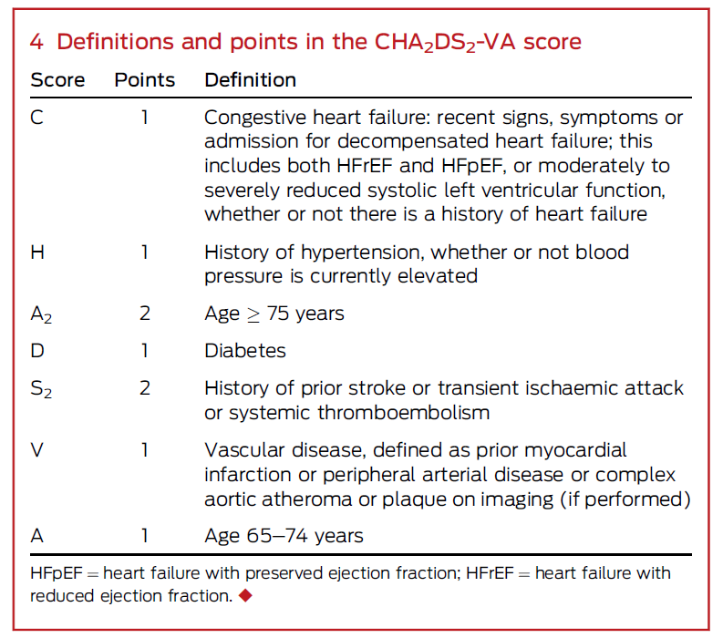
When to Use Anticoagulants
The CHA₂DS₂-VA score is recommended to assess stroke risk in non-valvular AF
Previously, a CHA₂DS₂-VASc score was used
This tool included an additional criteria that added 1 point to the overall score if the person was female
However, this was a cumbersome practice, and female sex alone or in the presence of 1 additional risk factor does not confer sufficient or consistent increased risk of thromboembolism due to AF
Table taken from: Brieger D, Amerena J, Attia JR, et al. National Heart Foundation of Australia and Cardiac Society of Australia and New Zealand: Australian Clinical Guidelines for the Diagnosis and Management of Atrial Fibrillation 2018. MJA. 2018;209(8):356-362.

Slide 23
When to Use Anticoagulants
For all patients with valvular AF (i.e., moderate- to severe- mitral stenosis or a mechanical heart valve)
Anticoagulate with warfarin
Other anticoagulants must not be used
For patients with non-valvular AF
Anticoagulation is not recommended if the CHA₂DS₂-VA score is 0
Anticoagulation is recommended if the CHA₂DS₂-VA score is ≥ 2
Unless there are contraindications to anticoagulation
Anticoagulation should be considered if the CHA₂DS₂-VA score is 1
Decision is made by the doctor and patient together with careful evaluation of risk/benefit

Slide 24
What Anticoagulant to Use?
Non-Vitamin K Antagonist Oral Anticoagulants (NOACs) are preferred over Warfarin
EXCEPT for patients with valvular AF who should be considered to be at very high risk of thromboembolic complications and so be given warfarin
Non-Vitamin K Antagonist Oral Anticoagulants (NOACS) include:
Apixaban
Rivaroxaban
Dabigatran
Antiplatelet therapy is not recommended for stroke prevention in AF, regardless of CHA₂DS₂-VA score
Antiplatelets are less effective than anticoagulants at preventing thromboembolism in AF
Antiplatelets may have bleeding rates similar to oral anticoagulants in AF

Slide 25
What Anticoagulant to Use?
 | Warfarin | Apixaban | Rivaroxaban | Dabigatran
Evidence | Must use warfarin for valvular AF. | In non-valvular AF, the ARISTOTLE study compared apixaban to warfarin → apixaban was safer and significantly more effective than warfarin. | In non-valvular AF, the ROCKET-AF study compared rivaroxaban to warfarin → rivaroxaban safer than warfarin and at least as effective as warfarin. | In non-valvular AF, the RE-LY study compared dabigatran to warfarin → dabigatran safer than warfarin and at least as effective as warfarin.
Dose (for Stroke Prevention in AF) Note: CrCl = Creatinine Clearance | Titrate dose to target INR of 2-3 (sometimes target INR is 2.5-3.5 for valvular AF). No requirement for dose reduction in renal impairment. | Usual dose is 5mg BD. If at least 2 of the following criteria are met, reduce dose to 2.5mg BD: Weight < 60kg Age > 80 years Creatinine > 133 micromol/L | CrCl ≥ 50 ml/min = 20mg once daily. CrCl 15-49 ml/min = 15mg once daily. Contraindicated if CrCl < 15 ml/min. | Usual dose is 150mg BD. Reduce dose to 110mg BD if age > 75 years or if CrCl is 30-50 ml/min. Contraindicated if CrCl < 30 ml/min.
Practice Points | Monitor INR regularly. Anticoagulant effect can be reversed with vitamin K (phytomenadione). | Anticoagulant effect cannot be monitored or reversed. | Anticoagulant effect cannot be monitored or reversed. Important to take with food. | Anticoagulant effect cannot be monitored but can be reversed with idarucizumab.

Slide 26
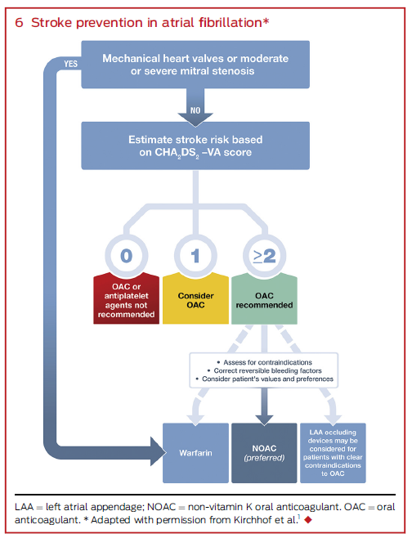
Image taken from: https://www.abingtonhealth.org/services-specialties/heart-vascular/patient-stories/someone-to-watch-over-me/
Table taken from: Brieger D, Amerena J, Attia JR, et al. National Heart Foundation of Australia and Cardiac Society of Australia and New Zealand: Australian Clinical Guidelines for the Diagnosis and Management of Atrial Fibrillation 2018. MJA. 2018;209(8):356-362.

Slide 27
Minimising Bleeding Risk
For patients on warfarin
Closely monitor the INR and titrate warfarin dose to ensure INR remains within the target range
For patients on a NOAC
Ensure an appropriate dose is chosen according to age and renal function
The HAS-BLED tool is used to identify and mange modifiable bleeding risk factors.
The HAS-BLED score should not be used to decide whether or not to use an anticoagulant for prevention of thromboembolism in AF
The HAS-BLED Tool *Modifiable | Each criteria = 1 point A score of ≥3 denotes a high risk of bleeding
H* | Hypertension, uncontrolled (systolic BP > 160)
A | Abnormal liver or renal function (1 point each)
S | Stroke history
B | Bleeding history (or anaemia), esp. a prior major bleed
L* | Labile INR (INR in therapeutic range < 60% of the time)
E | Elderly (age > 65 years)
D* | Drugs (i.e., antiplatelet drugs, NSAIDs, alcohol > 8 drinks/week)

Slide 28
Minimising Bleeding Risk
In addition to the HAS-BLED criteria, consider the person’s risk of falls
Risk of falls might be reduced by falls prevention programs and allied health reviews (e.g., physiotherapy and occupational therapy)
Recurrent falls despite efforts to minimise the risk of falls may result in a decision to cease anticoagulant therapy, as a fall in a person who is taking oral anticoagulants can lead to a catastrophic intracranial haemorrhage

Slide 29
Triple Therapy
Refers to treatment with an anticoagulant indicated for stroke prevention in AF PLUS dual antiplatelet therapy with aspirin and a P2Y₁₂ inhibitor indicated after an acute coronary syndrome and/or stent insertion
Note: In this situation, clopidogrel is the recommended P2Y₁₂ inhibitor
With regards to the anticoagulant
For patients on warfarin with a usual target INR of 2-3, tighter control to a target of 2-2.5 is recommended
For patients on rivaroxaban, reduce the rivaroxaban dose from 20mg to 15mg daily
For patients on dabigatran, reduce the dabigatran dose from 150mg BD to 110mg BD
The risk of gastrointestinal bleeding in patients on triple therapy can be reduced by concomitant administration of a proton pump inhibitor (PPI), e.g., pantoprazole
Duration of triple therapy should be as short as possible to minimise bleeding, while ensuring adequate coverage of the initial period post-ACS or stenting that is associated with the highest thrombotic risk
Ensure there is a plan regarding the intended duration of triple therapy

Slide 30
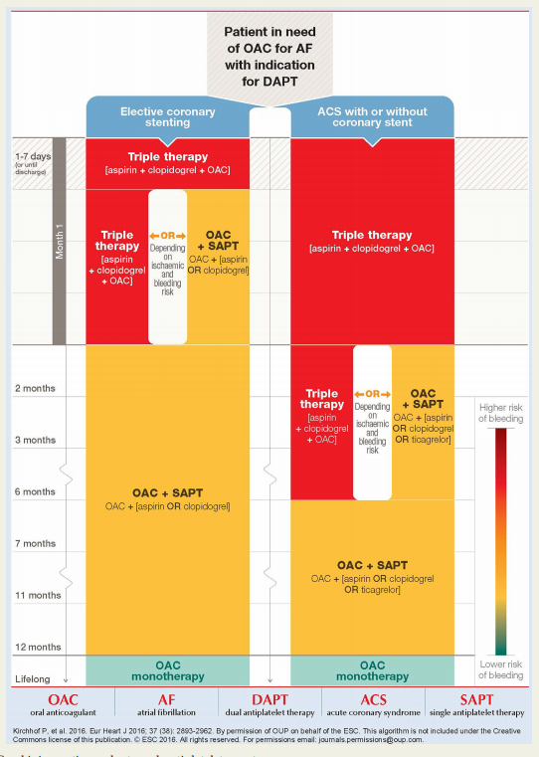
Triple Therapy
Recommended duration of triple therapy post-elective coronary stenting
Compared to…
Recommended duration of triple therapy post-ACS with or without coronary stent
No need to memorise this
Image taken from:
National Heart Foundation of Australia & Cardiac Society of Australia and New Zealand. Australian Clinical Guidelines for the Diagnosis and Management of Atrial Fibrillation 2018. National Heart Foundation website. https://www.heartlungcirc.org/action/showPdf?pii=S1443-9506%2818%2931778-5.

Slide 31
Atrial Fibrillation - Summary
2 main treatment considerations:
Rate vs Rhythm Control
Anticoagulant Therapy for Stroke Prevention
Predicting stroke risk using the CHA₂DS₂VA score
Minimising bleed risk using the HAS-BLED score
Also remember to optimise treatment of comorbidities

Slide 32
References
National Heart Foundation of Australia & Cardiac Society of Australia and New Zealand. Australian Clinical Guidelines for the Diagnosis and Management of Atrial Fibrillation 2018. National Heart Foundation website. https://www.heartlungcirc.org/action/showPdf?pii=S1443-9506%2818%2931778-5.
Atrial Fibrillation. In: eTG complete (Cardiovascular). Therapeutic Guidelines. Updated December 2019.
AMH Online.

