Slide 1
Drugs that affect coagulation
Assoc. Prof. John Smithson
Adapted from lectures by Assoc. Prof. Ian Heslop

Slide 2
Learning outcomes
Be able to:
Revise the pharmacology of the different antiplatelet drugs.
Describe how the 5 different classes of anticoagulants reduce clotting.
Describe how existing clots can be reversed using thrombolytics.
Understand the common side effects and risks associated with each of the different classes

Slide 3
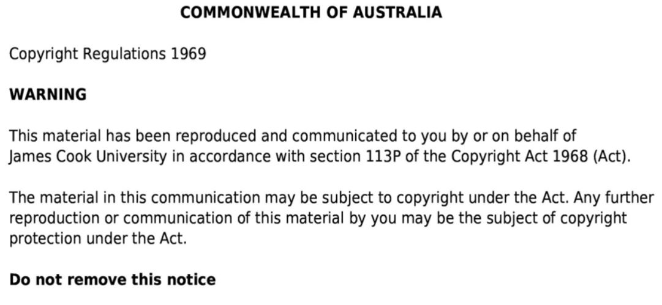

Slide 4
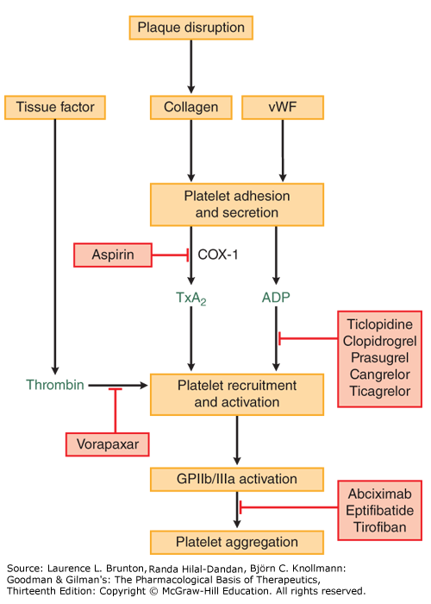
Revision of antiplatelet therapy
Classes of Antiplatelets:
P2Y₁₂ Antagonists
Clopidogrel
Ticagrelor
Prasugrel (less common)
Glycoprotein IIb/IIIa Inhibitors
Eptifibatide
Tirofiban
Other
Aspirin (COX-1 inhibition)
Dipyridamole (mainly used for secondary stroke prevention, therefore will be discussed in semester 2)

Slide 5
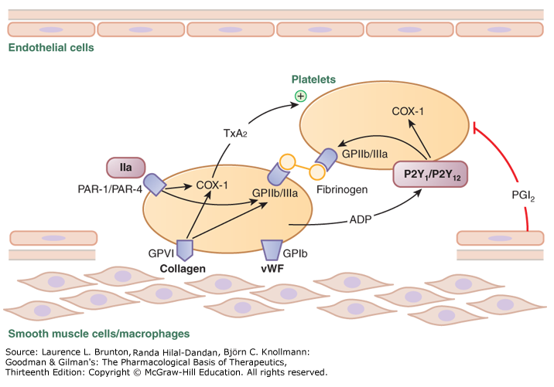
Revision of antiplatelet therapy
Classes of Antiplatelets:
P2Y₁₂ Antagonists
Clopidogrel
Ticagrelor
Prasugrel (less common)
Glycoprotein IIb/IIIa Inhibitors
Eptifibatide
Tirofiban
Other
Aspirin
Dipyridamole (mainly used for secondary stroke prevention, therefore will be discussed in semester 2)

Slide 6
Revision of antiplatelet therapy
Classes of Antiplatelets:
P2Y₁₂ Antagonists
Clopidogrel
Ticagrelor
Prasugrel (less common)
Glycoprotein IIb/IIIa Inhibitors
Eptifibatide
Tirofiban
Other
Aspirin
Dipyridamole (mainly used for secondary stroke prevention, therefore will be discussed in semester 2)

Slide 7
Anticoagulants
The Anticoagulants can be divided into:
Indirect Parenteral Anticoagulants
Heparin
Low Molecular Weight Heparins (LMWHs) and Danaparoid
Direct thrombin inhibitors (NOAC)
Dabigatran
Bivalirudin
Vitamin K antagonists
Warfarin
Phenindione
Factor Xa inhibitors (NOAC)
Apixaban
Rivaroxaban
Fondaparinux

Slide 8
Indirect parenteral anticoagulants:
Heparin, LMWH and Danaparoid

Slide 9
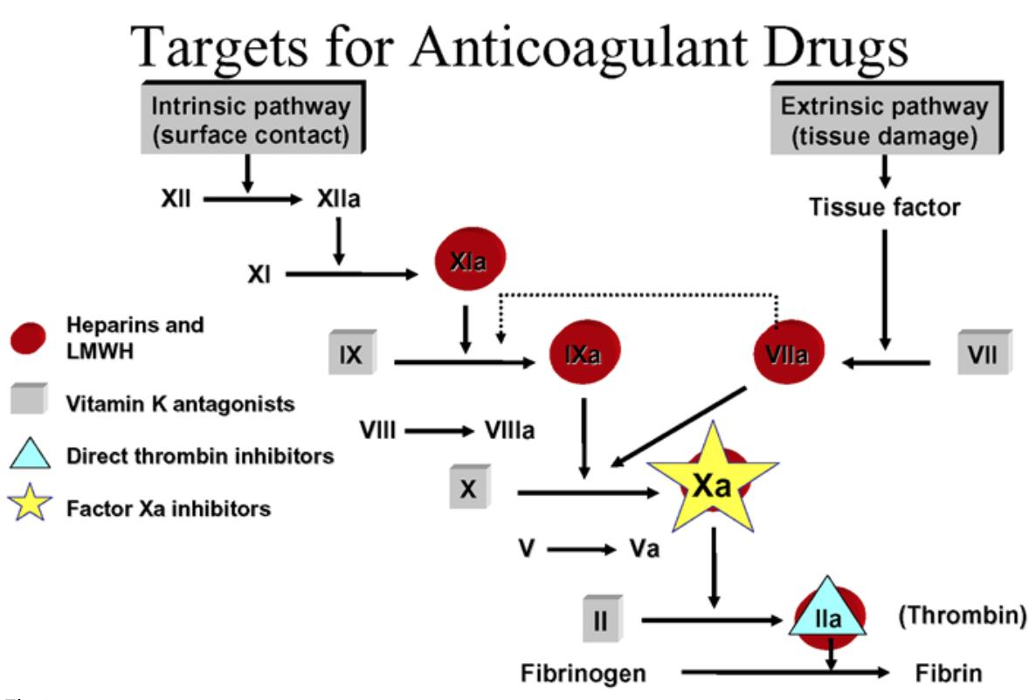
Indirect parenteral anticoagulants (IPAs) - Heparin
Unfractionated Heparin (UFH) is a mixture of sulfated glycosaminoglycans with a molecular weight of 5000 to 30,000 extracted commercially from porcine intestine or bovine lung
Rapidly-acting, parenteral anticoagulant (immediate effect) therefore used for acute treatment or prophylaxis of thromboembolic disorders or until anticoagulant effect of warfarin is established.
Mode of action
UFH affects Thrombin indirectly by binding to Antithrombin III to cause a rapid anticoagulant effect (maximal anticoagulation occurs within minutes) after IV injection
Antithrombin III inhibits serine proteases including some blood clotting factors including Thrombin (factor IIa) and factor Xa.

Slide 10
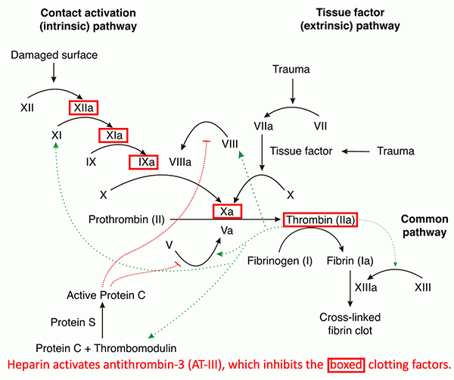
Indirect parenteral anticoagulants (IPAs) - Heparin
In the absence of heparin, Antithrombin III slowly interacts with thrombin
The binding of heparin to antithrombin III produces a conformational change ACTIVATING antithrombin – this rapidly binds with and inhibits thrombin (except thrombin already bound to fibrin)
Also inactivates factor Xa (to further inhibit thrombin activity)
Therapeutic Uses
Major antithrombotic drug for treatment and prevention of DVT & PE
Decreases incidence of recurrent thrombotic episodes
Used prophylactically to prevent postoperative venous thrombosis
Coronary artery rethrombosis after thrombolytic therapy reduced with heparin
Used to prevent thrombosis with extracorporeal machines (e.g. dialysis machines)
Useful with pregnant women as it does not cross the placenta
Heparin has the advantage of speedy onset of action plus rapid termination of action on withdrawal of therapy
Image taken from https://emcrit.org/ibcc/heparin/. Accessed March 2021

Slide 11
Heparin activates anti-thrombin and inhibits Factor Xa and thrombin
https://youtu.be/_2B40juput0. Watch until 1.10 minutes.

Slide 12
Indirect parenteral anticoagulants (IPAs) - Heparin
Pharmacokinetics
Must be given SC or IV (Do not give IM – risk of haematoma)
Often given as an IV bolus to achieve immediate anticoagulation followed by lower doses or continuous infusions
Contraindications
Previous thrombocytopenia with Heparin or LMWH
Bleeding disorders
Thrombocytopenia
Peptic ulcer
Cerebral haemorrhage or severe uncontrolled hypertension
Severe liver disease including oesophageal varices
Major trauma or recent surgery
Adverse effects
Chief complication is haemorrhage (up to 6% of patients) – may be managed by stopping heparin or use of Protamine sulphate
Bruising, pain at injection site
Thrombocytopenia
Mild, reversible form is common
Immune modulated severe thrombocytopenia occurs in <1% of patients, may result in major ischaemic complications (stroke, limb ischaemia), bleeding or death. Withhold Heparin if platelet count drops 30-50% below baseline
Hypersensitivity reactions – animal product (antigenic)
Drug interactions
Aspirin, NSAIDS – increase risk of bleeding – preferably use other analgesics, but use low dose aspirin where indicated
Concurrent use of heparins with spinal or epidural anaesthesia or analgesia, or lumbar puncture increases risk of intraspinal haematoma →paralysis. If possible avoid heparins for 12hrs before or after procedure and for 6 hours after catheter removal

Slide 13
Therapeutic drug monitoring - Heparin
Heparins are available as Na or Ca salts – little difference in effect
Time to clot formation measured in seconds measured by aPTT
aPTT – Partial Thromboplastin Time and activated Partial Thromboplastin Time measure the same thing – the reference ranges are different as an activator (aPTT) is added to speed up the clotting time and narrow the reference range making it more sensitive than PPT.
Reference range for aPTT is 30-40 seconds
(Reference range for PTT is 60-70 seconds)
Therapeutic aPTT is usually 1.5 – 2.5 times the reference range
APTT measured and heparin dose adjusted every 6 hours
Once stable – measured daily
Unexpectedly high Activated Partial Thromboplastin Time (APTT) can occur if a blood sample is taken from the same arm as a heparin infusion
Measure of efficacy of the coagulation pathways
Monitoring
Platelet count on days 0, 3 and 5, then on alternate days if treatment continued

Slide 14
Indirect parenteral anticoagulants (IPAs) – LMWHs and Danaparoid
Danaparoid (‘Dana-par-oid’)
Dalteparin (‘Dalt-e-parin’) (LMWH)
Enoxaparin (‘E-nox-a-parin’) (LMWH)
Therapeutic Uses
Prevention of venous thromboembolism in surgical/medical patients
Treatment of venous thrombosis
Haemodialysis
Treatment of NSTEACS
In pregnancy
Danaparoid only indicated for prevention of venous thromboembolism in surgical patients and for those with heparin-induced thrombocytopenia.
Pharmacokinetics
Monitoring using antifactor Xa considered only in patients with high risk of bleeding.
No evidence that monitoring reduces bleeding risk
APTT not monitored
If monitoring is necessary; during SC treatment, plasma concentrations should be >0.3units antifactor Xa/ml before injection and <1.0units antifactor Xa/ml 3-4 hours after injection

Slide 15
LMW Heparin activates anti-thrombin and inhibits Factor Xa but has little effect on thrombin
https://youtu.be/_2B40juput0?t=70. Start at 1.10 min – watch until the end.

Slide 16
IPAs – LMWHs and danaparoid compared with heparin
Incidence of bleeding similar. Protamine sulphate only partly effective with LMWHs
Incidence of bleeding in renal impairment higher with LMWHs (reduce dose of LMWH)
Incidence of severe immune-mediated thrombocytopenia lower with LMWHs. But 90% cross reactivity means LMWHs not an alternative to heparin in heparin-induced thrombocytopenia (→ Danaparoid: 10% cross-reactivity)
LMWHs have similar efficacy in preventing thromboembolism in general surgical patients
Can be given once daily but are more expensive
LMWHs seem more effective in preventing thromboembolism in orthopaedic patients
In treatment of DVT, LMWH are at least as effective as Heparin in preventing recurrence and reducing overall mortality in hospital patients. But are more expensive.
Reduction in time spent in hospital (treated as outpatient) and reduced APTT monitoring may offset increased cost of the LMWH

Slide 17
Direct thrombin inhibitors:
Dabigatran (oral) and
Bivalirudin (Parenteral)

Slide 18
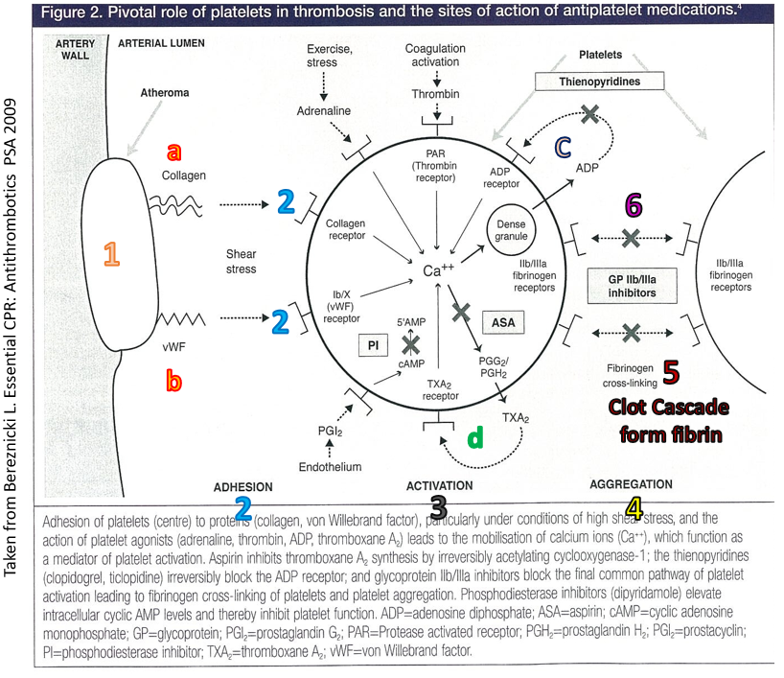
Direct Thrombin Inhibitors
DTIs bind directly to thrombin and block its effect.
Two are available in Australia:
Dabigatran (‘Da-big-a-tran’) (oral)
Bivalirudin (‘Biv-ali-rudin’) (parenteral)
Thrombin is central to clotting process
It activates factors V, VIII and XI and activates platelets
It is involved in the conversion of fibrinogen to fibrin
Therefore DTIs have both antiplatelet and anticoagulant effects.
Image taken from https://emcrit.org/ibcc/heparin/. Accessed March 2021

Slide 19
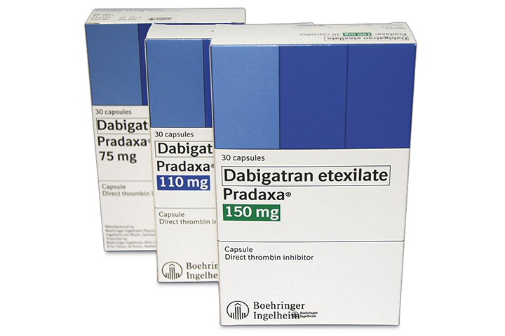
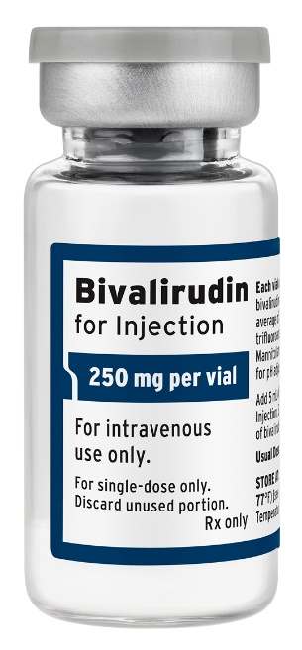
Direct thrombin inhibitors
Patients with active bleeding or at increased risk of severe bleeding; risk vs. benefit when using DTIs.
Severe bleeding is common for bivalirudin, rare for dabigatran
Bivalirudin: used in STEMI patients undergoing PCI. Useful in patients with heparin-induced thrombocytopenia.
Nausea is common, thrombocytopenia and rash are infrequent.

Slide 20
Direct Thrombin inhibitors - Dabigatran
Dabigatran (Pradaxa): has started to appear in community pharmacy for the prevention of venous thromboembolism.
Prevention of VTE after elective hip or knee replacement
Treatment of acute VTE and prevention of subsequent VTE
Non-valvular AF and a high risk of stroke or systemic embolism
Contraindications:
Prosthetic heart valves
If CrCl<30ml/min (reduce dose if CrCl 30-50ml/min)
Has several drug interactions with commonly used drugs which can increase the risk of bleeding, or decrease the efficacy of Dabigatran;
Clarithromycin, Ketoconazole, Verapamil.
Cease a few days before surgery, longer if impaired renal function.
Gastritis, dyspepsia and GI bleeding are common side effects.
Patients may require a warning bracelet and need to be counselled effectively on the importance of not missing doses.
Do not open caps or chew/crush pellets (increased risk of bleeding)
Take at same time of day
Monitor for signs of bleeding (see warfarin counselling points)
Dabigatran (cont)
Practice issues:
Do not use within 2hrs of spinal/epidural catheter removal
Measure renal function at baseline and monitor regularly
Reversal agent (idarucizumab) – dabigatran may be given after 24 hrs after reversal agent if renal function is normal (delay may be necessary in renal impairment)
Little data on effectiveness for VTE prevention in AF in patients with valvular disease or prosthetic heart valves

Slide 21
Factor Xa Inhibitors:
Fondaparinux (SC),
Apixaban (O) & Rivaroxaban (O)

Slide 22
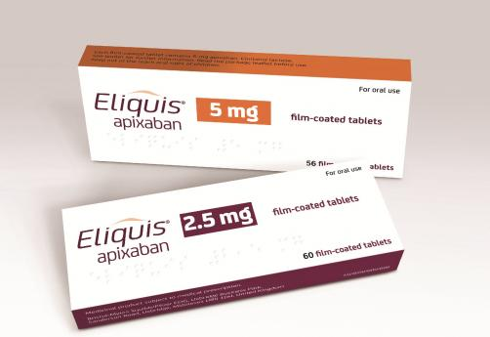
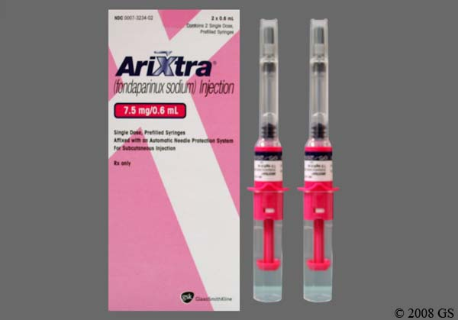
Factor Xa Inhibitors
Fondaparinux (‘Fon-dap-a-rinux’) (SC),
Apixaban (‘A-pix-a-ban’) (oral),
Rivaroxaban (‘Riva-rocks-a-ban’) (oral)
Selectively inhibit factor Xa, blocking thrombin production, conversion of fibrinogen to fibrin and thrombus development
Indicated for prevention of venous thromboembolism in high risk orthopaedic surgery – hip fracture, knee or hip replacement
Apixaban and Rivaroxaban have a similar onset of action and half life (approx 12 hrs)
But, Apixaban is taken BD and Rivaroxaban is taken once daily
Caution/side effects – bleeding
Concomitant aspirin etc increases bleeding risk

Slide 23
Vitamin K Antagonists:
Warfarin

Slide 24
Vitamin K antagonist - Warfarin
Note: proteins C and S have anticoagulant properties.
Warfarin (‘War-frin’)
Clotting factors II, VII, IX and X need Vit K to activate
Inactive Factors II, VII, IX & X
Vitamin K reduced
Vitamin K Reductase
-
Warfarin
Vitamin K epoxide
Active Factors IIa, VIIa, IXa & Xa
Image taken from https://emcrit.org/ibcc/heparin/. Accessed March 2021

Slide 25
Vitamin K antagonist - Warfarin
Warfarin (‘War-frin’)
Clotting factors II, VII, IX and X need Vit K to activate
Warfarin impairs the utilisation of Vitamin K and reduces the synthesis of active factors II, VII, IX and X and the anticoagulant proteins C and S
Warfarin has no direct action on the coagulation factors present in the blood, so the effects of warfarin develop as the factors are cleared.
Half lives of the factors are
Factor VII and protein C – 6-8hrs
Factor IX –24 hrs
Factor X – 36 hrs
Factor II – 54hrs
Protein S – 30hrs
Therefore, UFH and LMWH therapy should be continued for at least 48 hours after the INR reaches the therapeutic range.
Inactive Factors II, VII, IX & X
Vitamin K reduced
Vitamin K Reductase
-
Warfarin
Vitamin K epoxide
Active Factors IIa, VIIa, IXa & Xa

Slide 26
Vitamin K antagonist - Warfarin
Therapeutic uses
Prevention and treatment of venous thromboembolism (DVT and PE)
Prevention of thromboembolism in patients with prosthetic heart valves
Primary stroke prevention in patients with AF associated with mitral valve problems or other risk factors
Secondary stroke prevention in patients with AF
Prevention of thromboembolism pre or post cardioversion
Prevention of stroke in patients with previous MI and increased embolic risk
Contraindications
Bleeding disorders, previous GI bleed
Haemorrhagic retinopathy, intracerebral aneurysm/haemorrhage
Severe hypertension, Bacterial endocarditis
Alcoholism, unsupervised dementia (+compliance?) and frequent falls
Care with Renal and hepatic impairment – increased bleeding risk
Caution with elective surgery (stop warfarin several days before – replace with heparin or reduce warfarin dose if necessary e.g. people with artificial heart valves)
Avoid in pregnancy – teratogenicity and fetal/placental haemorrhage.

Slide 27
Vitamin K antagonist - Warfarin
Drug Interactions
Caution : Multiple potential interactions (always check)
Many drugs interact with warfarin causing increased or decreased anticoagulant effect
Mechanisms of Drug Interactions – very diverse, for example:
Decreased hepatic synthesis of procoagulant factors
Inhibition of enzymatic metabolism of warfarin
Accelerated metabolism of warfarin secondary to stimulation of hepatic microsomal enzyme activity
Alteration of procoagulant synthesis or catabolism
Increased receptor affinity for warfarin
Decreased vitamin K synthesis secondary to alterations in intestinal flora
Displacement of warfarin from protein binding sites
Increased metabolism of warfarin
Interference with enterohepatic circulation of warfarin

Slide 28
Vitamin K antagonist - Warfarin
Examples of drugs decreasing the anticoagulant effect include:
St John’s Wort, Carbamazepine, Barbiturates, Rifampicin, Phenytoin (can also rarely increase anticoagulant effect)
Examples of drugs increasing the anticoagulant effect include:
Antifungals and various antibiotics, Thyroid Hormones, Statins, Aspirin, NSAIDS, Paracetamol and SSRIs.
N.B. Paracetamol – widely used as an analgesic for patients taking warfarin and is preferred to Aspirin and COX-2 inhibitors (increased risk of bleeding)
Small occasional doses of paracetamol do not usually alter anticoagulant effect of warfarin
Larger doses of paracetamol (2-4g daily for several days (therapeutic guidelines) or 3.5-7g per week (AMH 2008)) may Increase INR
Options
Consider substituting an interacting drug with a non-interacting drug if possible or
Monitor INR and increase/decrease warfarin dose accordingly (interacting drug should be taken regularly avoid prn use as INR would be difficult to stabilise) (N.B. need to review/monitor again if the interacting drug is stopped)
See Queensland Health anticoagulant guidelines for other clinically significant reactions

Slide 29
Vitamin K antagonist - Warfarin
Dosage: start at 5mg once daily for 5 days then adjust according to INR – keep on heparin/LMWH until 2 consecutive days in INR range.
Dose adjusted according to Prothrombin Time (PT), which is reported as INR
The International Normalised Ratio (INR) was adopted by WHO in 1983
Standardised reporting of PT ratios
Allows comparisons to be made between different labs, hospitals and countries
Warfarin use represents a balance between thrombosis (lower end of the therapeutic range) and haemorrhage (upper end of the therapeutic range)
Strong relationship between INR and bleeding risk (especially if INR is over 5 - 6)
(Normal dose between 1-10mg once daily)
Queensland Health recommendations for INR ranges:
2.0 - 3.0 AF, DVT, PE and bio-prosthetic heart valves in patients with SR for 6 weeks post-op
2.5 - 3.5 Mechanical prosthetic heart valves

Slide 30
Vitamin K antagonist - Warfarin
Initiation of therapy
Heparin given concurrently until INR shows adequate warfarin response (when INR is in therapeutic range (usually 5-6 days including at least 2 days with INR in the therapeutic range))
Maintenance dosing
Regular monitoring is required and dosage adjustments made if required due to
Drug interactions when drug regimens are altered
Coexisting disease
Large alterations in intake of Vitamin K
Monitor INR 2-3 times weekly until 3 consecutive readings are within 0.5 of each other, then weekly for 4 weeks, then every 4-6 weeks when stable.

Slide 31
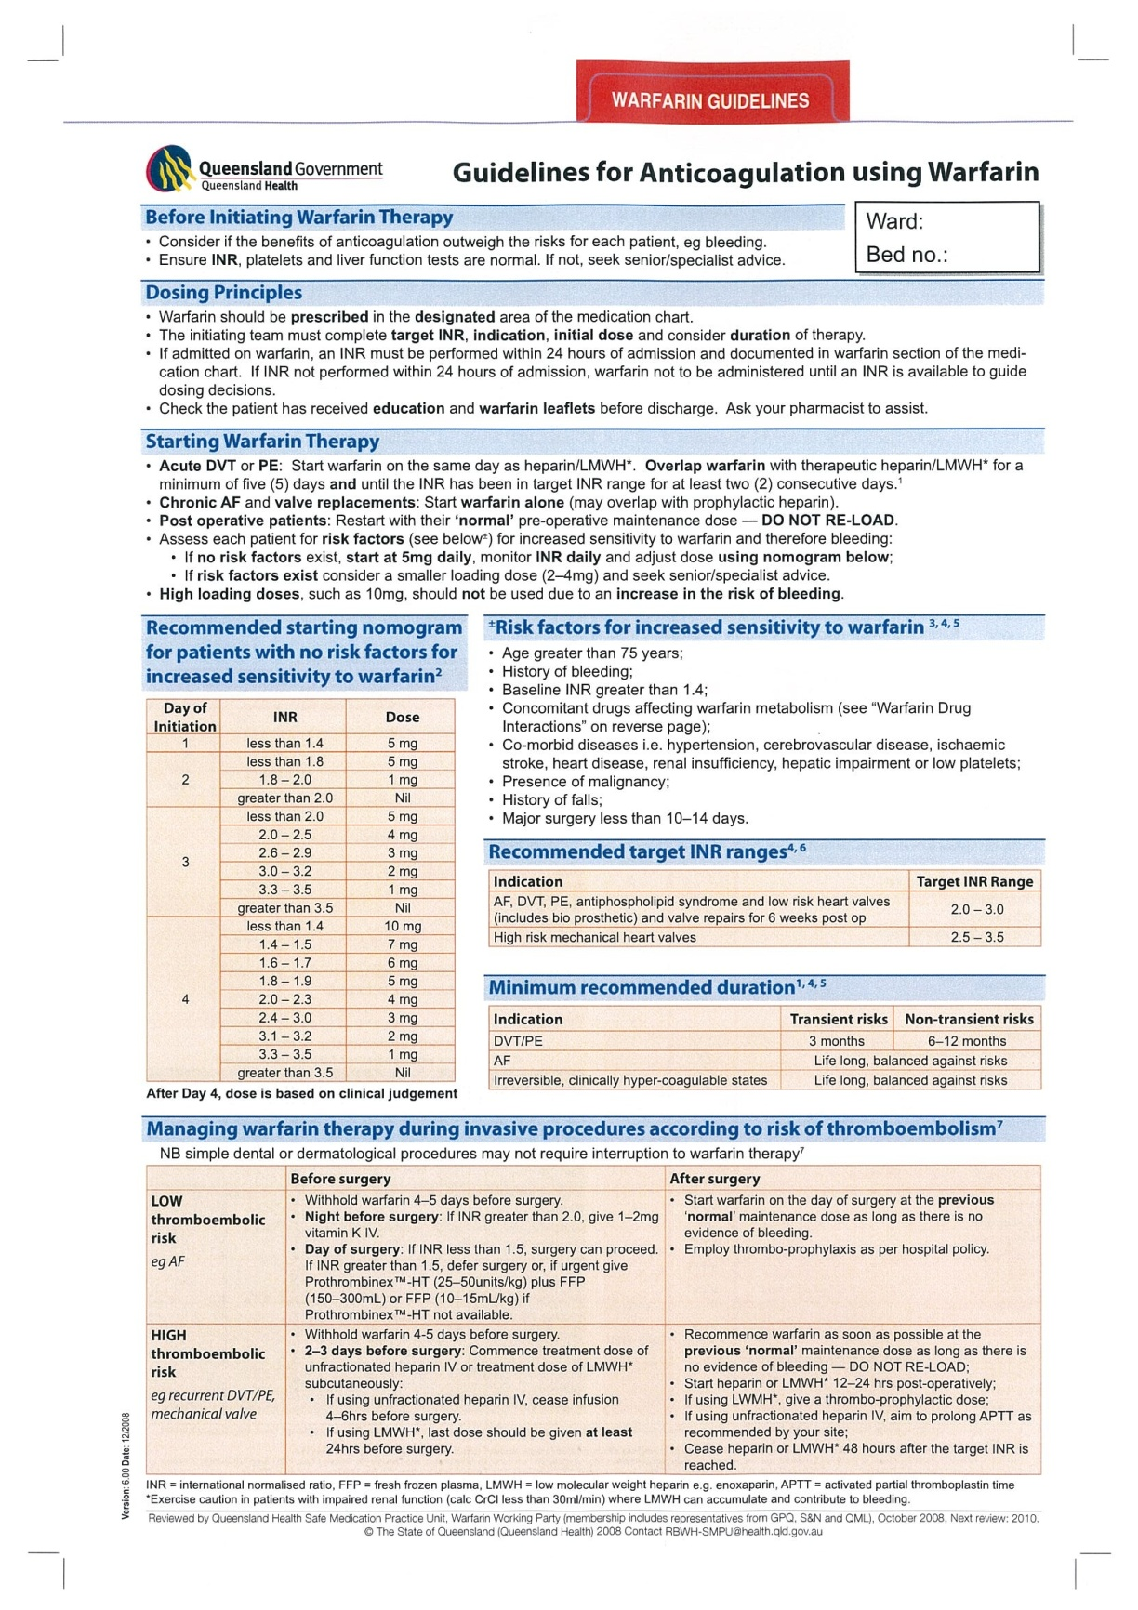
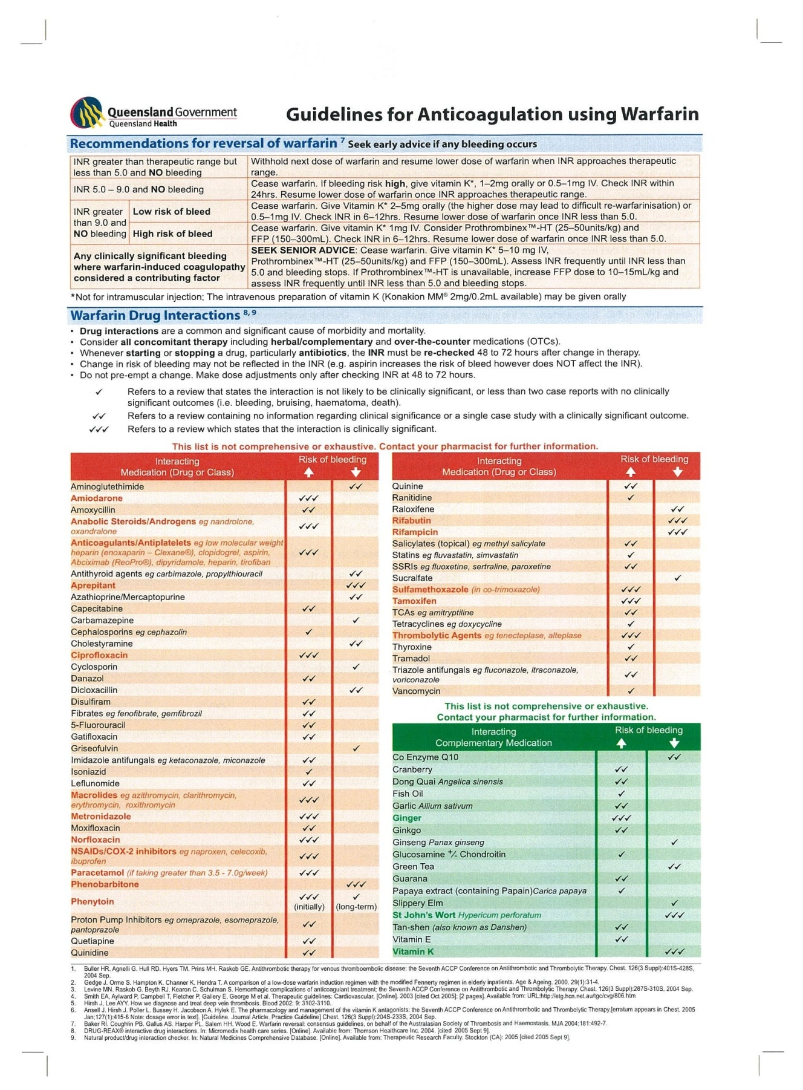

Slide 32
Vitamin K antagonist - Warfarin
Important counselling points
Do not change brands (Marevan or Coumadin)
Take tablets at same time of day (use a calendar to remind patient)
Stabilise intake of vitamin K (uniform daily intake of green leafy vegetables)
Avoid excessive alcohol intake (especially bingeing)
Care with OTC & Herbal products
Warn patient about early signs of haemorrhage – bleeding from gums, unexplained bruising or nosebleeds, unusual heavy bleeding from cuts, heavy/unexpected menstrual bleeding, pink/red urine, red/black faeces.
Reversal of Warfarin’s Anticoagulant effect
If over-anticoagulated – see previous slides
Antidote = Vitamin K

Slide 33
Thrombolytic agents

Slide 34
Thrombolytics (Fibrinolytic agents)
Alteplase (rt-PA), Reteplase, Streptokinase, Tenecteplase and Urokinase (not used in Australia)
All convert plasminogen to plasmin which then catalyses the breakdown of fibrin
Used to break down clots associated with
MI (Alteplase, streptokinase, reteplase, tenecteplase)
DVT, PE (alteplase, streptokinase and urokinase)
Peripheral arterial thromboembolism (streptokinase and urokinase)
Thrombosed haemodialysis shunts (streptokinase and urokinase)
Acute ischaemic stroke within 3 hours of onset of symptoms (alteplase)
Streptokinase – antigenic potential, likely to be ineffective if given between 5 days and 12 months after a previous streptokinase treatment (or of acute severe streptococcal infection – streptokinase is a protein produced by beta haemolytic streptococci)
Alteplase, Reteplase and Tenecteplase – more fibrin specific and so activate thrombus-associated plasminogen in preference to circulating plasminogen
Reteplase and Tenecteplase can be given as IV bolus – quicker to give/store in rural situations etc
Streptokinase cheapest
Side effects:
Bleeding – at injection sites, intracerebral bleeding and GI and genitourinary bleeding
Allergic reactions

Slide 35
Summary
The antiplatelet drugs have various targets on the platelet surface including P2Y₁₂, Glycoprotein IIb/IIIa, COX-1 and others.
Heparin indirectly blocks the action of thrombin and Factor Xa via the increased activation of Antithrombin III.
In contrast, the LMWHs block Factor Xa by activating Antithrombin III but have little effect at thrombin. The direct thrombin inhibitors directly bind to thrombin and block it’s effect. Because thrombin has both anticoagulant actions and also activates platelets – the DTIs have both antiplatelet and anticoagulant effects.
The Factor Xa inhibitors selectively inhibit Factor Xa blocking thrombin production. This reduces fibrin and thrombus formation.
Warfarin, the only Vitamin K antagonist blocks the effect of Vitamin K reductase. This reduces the activation of the vitamin K dependent clotting factors II, VII, IX and X.
The thrombolytics are not anticoagulants. Rather they break down formed clots by converting plasminogen to plasmin which then catalyses the breakdown of fibrin.

