Slide 1
DVT & PE – Prevention and Management
Assoc. Prof. John Smithson
Adapted from Lectures by Assoc. Prof. Ian Heslop.

Slide 2
Learning outcomes
Be able to:
Relate the pathophysiology DVT and PE to the disease and risks of untreated thrombosis.
Identify risk factors for DVT in different patient populations
Apply preventative strategies to reduce risk of DVT and PE in different patient populations
Justify recommendations for the treatment of DVT and PE

Slide 4
Deep Vein Thrombosis
In previous lectures we covered the
Coagulation system and
The main groups of drugs that can affect the coagulation system
Anti-platelets (week 2)
Anti-coagulants
Thrombolytics (Fibrinolytics)
In this lecture we will discuss the prevention and treatment of the two most common venous thromboembolic conditions:
Deep Vein Thrombosis and
Pulmonary Embolism
https://youtu.be/0QEo9QAqA3k.

Slide 5
Virchow’s Triad
Main Physiological mechanisms
involved in DVT
Endothelial injury exposes collagen (as it does in arteries but not absolutely necessary as in artery clots)
And if blood stasis or hypercoagulability is present:
Causes platelet aggregation and triggers the coagulation system.
This leads to thrombus formation, and a subsequent risk of emboli.
Most venous thrombi begin in the valve cusps of the deep calf veins (usually due to a combination of the aforementioned risk factors).
Tissue thromboplastin is released, forming thrombin and fibrin, and trap red blood cells and propagate as a red or fibrin thrombus which is the predominant venous lesion.
Damage to vessel wall
Virchow’s
Triad
Hypercoagulability
Blood Flow Turbulence
Forms a RED Clot
RBC + Fibrin + a little bit of Platelet

Slide 6
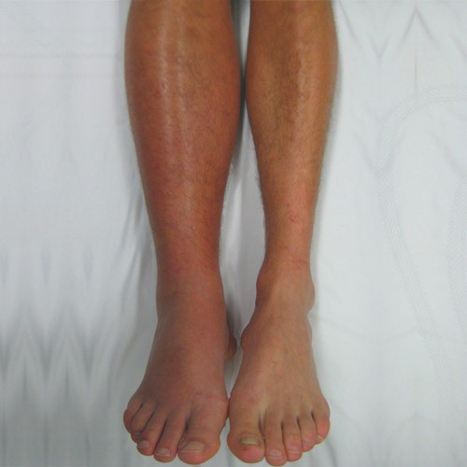
Deep vein thrombosis usually starts around the valvar cusp –stasis, turbulent blood flow etc
https://www.dicardiology.com/article/society-interventional-radiology-understand-long-term-risks-dvt.

Slide 7
What are the deep veins of the arm and leg we are talking about
https://teachmeobgyn.com/pregnancy/medical-disorders/haematological/venous-thromboembolism/
Deep veins of the leg
Deep veins of the arm
https://en.wikipedia.org/wiki/Basilic_vein.

Slide 8
Risk factors for DVT
Possible factors that contribute to venous thrombosis include:
Injury to endothelium of the vein:
Possibly due to in-dwelling catheters, injection of irritating substances, septic phlebitis ,etc.
Hypercoagulability
Associated with malignant tumors, blood dyscrasias, pregnancy, increased age, oral contraceptives, etc
Stasis
Associated with postoperative and postpartum states, varicose thrombophlebitis and the thrombophlebitis that may prolong the bed rest of chronic illnesses, heart failure, stroke and trauma
Prolonged immobilisation of legs
Traveling for long periods of time, (e.g. “Economy class syndrome”) is a risk factor for all people, and especially important in those with other risk factors.
Increased age and pregnancy cause blood to favour clotting.
Venous thrombi do NOT require initial damage unlike arterial thrombi; stasis and hypercoagulability is all that is needed to initiate platelet aggregation.

Slide 9
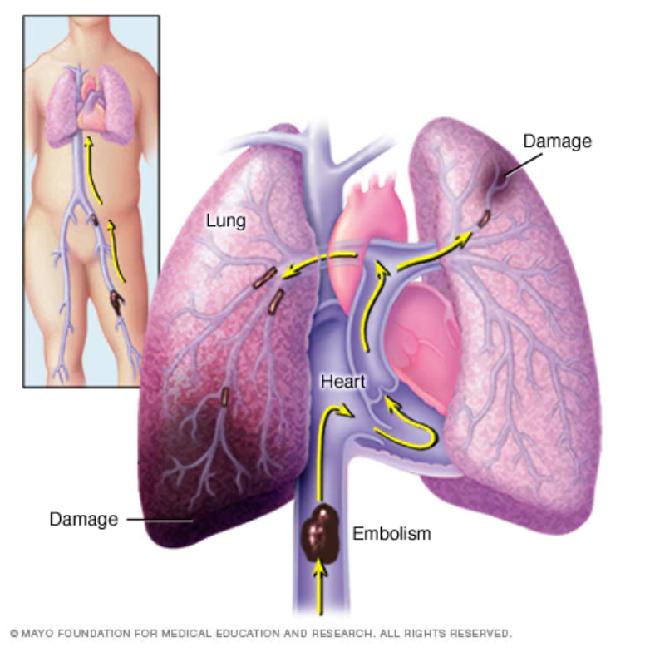
DVT symptoms
Symptoms:
DVT may be asymptomatic,
Or may manifest as a feeling of tenderness, pain, oedema, warmth, skin discolouration and prominent superficial veins over the affected area.
At least 3 main veins drain the lower leg so thrombosis in one does not significantly obstruct venous return, so there may be no swelling, cyanosis of the skin or dilated superficial veins. Patients complain of soreness on standing and walking and is usually relieved by rest with the leg elevated. Examination shows deep tenderness .
Diagnosis confirmed with duplex ultrasound.
Prognosis:
DVT is usually benign but can cause lethal pulmonary emboli or chronic venous insufficiency.
https://www.mayoclinic.org/diseases-conditions/pulmonary-embolism/symptoms-causes/syc-20354647#dialogId66791518

Slide 10
Pulmonary Embolism
Most common type of pulmonary embolus is a thrombus that has usually migrated from a leg or pelvic vein
Once released into the venous circulation, thromboemboli are distributed to:
Both lungs – 65% of cases
Right lung – 25% of cases
Left lung – 10% of cases
Lower lobes are involved 4x more frequently than upper lobes
Most thromboemboli lodge in large or intermediate (elastic or muscular) pulmonary arteries and fewer reach the smaller arteries
https://www.mayoclinic.org/diseases-conditions/pulmonary-embolism/symptoms-causes/syc-20354647#dialogId66791518

Slide 11
Pulmonary Embolism
Acute PE is a dynamic process – thrombi begin to lyse (breakdown) immediately after reaching the lung
Lysis is usually complete within several weeks in the absence of pre-existing cardiopulmonary disease
Even large thrombi may lyse significantly in a few days
However, massive emboli may cause death within minutes if they block one of the major pulmonary vessels.
Pathophysiology
PE may result in derangements in pulmonary haemodynamics, gas exchange and mechanics
Change in cardiopulmonary function varies with the size and number of emboli obstructing the pulmonary arteries and the patient’s pre-embolic cardiopulmonary status (i.e. baseline pulmonary and cardiovascular functionality)

Slide 12
Pulmonary Embolism
Resulting physiological changes include:
Pulmonary hypertension with right ventricular failure
Shock
Dyspnoea with tachypnea and hyperventilation
Arterial hypoxemia
Pulmonary infarction
Symptoms
Clinical manifestations can be nonspecific and vary in intensity
PE is notorious for being difficult to differentially diagnose from other pulmonary conditions.
Small emboli may be asymptomatic
Manifestations usually develop abruptly in minutes and can last several days

Slide 13
Pulmonary Embolism
Symptoms (cont)
Breathlessness, tachypnea
Anxiety and restlessness
Some patients may present with light-headedness, syncope, seizures and neurological deficit (reflects transient fall in cardiac output with secondary cerebral ischaemia)
Signs of a pulmonary infarct include cough, haemoptysis, pleuritic chest pain, fever, evidence of pleural fluid and possibly pleural friction rub.
Diagnosis
Chest x-ray, ECG, serum enzyme studies and lung perfusion scans may be used.
Prognosis
Mortality after the initial PE varies with the extent of the PE and the patient’s pre-existing cardiopulmonary status
Likelihood that a patient with marked compromised cardiopulmonary function will die after significant PE is high (>25%)
Patient with normal cardiopulmonary function is unlikely to die unless the occlusion exceeds 50% of the pulmonary vascular bed
When the initial embolic event is fatal, death often occurs within 1-2hours
Likelihood of a recurrent embolus in an untreated patient is about 50% and as many as half of these recurrences will be fatal.
Anticoagulant therapy reduces the rate of recurrence to about 5%

Slide 14
DVT Risk Factors
DVT is a common complication of hospital admission, and
Simple prevention measures can greatly reduce an individuals’ risk of suffering a DVT.
Risk of developing DVT depends on:
Patient related factors (age, etc)
Features of predisposing medical condition or
The actual surgical procedure and it’s aftercare
Individual patient risk can be assessed using a stratification tool.

Slide 15
DVT Prevention (general drugs used)
Low-dose heparin
Safe and effective
No monitoring of APTT required (for prevention regimens)
Cheaper than LMWHs but needs 2-3 (SC) injections per day
Less effective than LMWHs in some high risk situations (e.g. Orthopaedics)
LMWHs (e.g. Enoxaparin)
Factor Xa inhibitors
Apixaban and Rivaroxaban
Oral anticoagulants for VTE prophylaxis after hip of knee replacement
More effective than Enoxaparin 40mg with similar risk of bleeding
Fondaparinux
More effective than LMWHs in reducing VTE in orthopaedics
Direct Thrombin Inhibitors
Dabigatran
Oral prophylaxis for VTE prophylaxis after elective total hip or knee replacement
Similar efficacy and bleeding rates to Enoxaparin
Other measures
Compression stockings
May prevent asymptomatic DVT in general surgery and when immobile, but have not been shown to prevent pulmonary embolism
May cause superficial thrombophlebitis in varicose veins
May cause ischaemic complications in patients with peripheral vascular disease or diabetic neuropathy
Hydration
Calf exercises/regular leg movement

Slide 16
DVT Prevention - surgical prophylaxis
Assessment made against risk factors for developing VTE and PE and also risk of bleeding
Pharmacological treatment examples
Total hip replacement: LMWH or fondaparinux or rivaroxaban or dabigatran or apixaban for 28-35 days
Total knee replacement: LMWH or fondaparinux or rivaroxaban or dabigatran or apixaban for 10-14 days
Hip fracture: LMWH or fondaparinux for 28-35 days
Major surgery: LMWH, UFH for up to 1 week or fully mobilized
Neurosurgery: UFH or LMWH – caution as high risk of bleeding
Trauma: consider LMWH when risk of bleeding is low
Cancer patients: LMWH or UFH [NB4] depending on bleeding risk; continue for at least 7 to 10 days postoperatively
Consider 28 days of LMWH in patients having major abdominal or pelvic surgery for cancer

Slide 17
DVT Prevention -non-surgical prophylaxis
Recommended Prophylactic regimes
For patients with ischaemic stroke with immobility.
Depending on degree of immobility LVWH or UFH until medical condition is stable
For patients with other conditions that predispose patient to VTE
LMWH or UFH [NB2]; continue until resolution of acute medical illness, mobilisation or hospital discharge

Slide 18
DVT Prevention (surgical prophylaxis)
Long Distance Air travel:
Increased risk of DVT associated with long distance air travel due to blood stasis.
Advisable that passengers traveling by air >5hours
Drink a lot of fluids – but avoid excessive alcohol
Dehydration may cause low blood volume and inadequate blood clearance from the legs
Perform calf contractions each hour for a number of minutes
Moderate risk passengers should also use knee length graduated compression stockings (at least 20mmHg pressure at the ankle)
High risk passengers should have LMWH immediately before departure

Slide 19
Treatment of DVT and PE without haemodynamic compromise
Objectives of treating an established venous thromboembolism is to prevent:
Thrombus extension/enlargement
Pulmonary Embolism (PE)
Post-thrombotic syndrome
Recurrent venous thromboembolism
Less evidence to guide treatment of distal DVT compared for proximal DVT and PE
Treat distal DVT in same way as proximal DVT and PE
Adequate anticoagulant therapy reduces death associated with PE
Oral factor Xa inhibitors
Apixaban 10mg orally, BD for days then decrease to 5mg BD
Or
Rivaroxaban 15mg orally BD for 21 days then reduce to 20mg once daily
OR
Direct thrombin Inhibitor
Parenteral anticoagulant (heparin/LMWH) for 5 days then start dabigatran
Or
Vitamin K inhibitor
Parenteral anticoagulant (heparin/LMWH) + Warfarin then cease heparin once INR in range
Target INR 2-3
Pregnancy: LMWH – no safety data for others. Avoid warfarin – foetal harm
Cancer associated VTE: LMWH – no safety data for others. Avoid warfarin – higher incidence of reoccurrence

Slide 20
PE + Shock and hypotension
Thrombolytic therapy + anticoagulant therapy
Alteplase bolus + infusion or tenecteplase bolus
THEN
Low Molecular Weight Heparin
Dalteparin or enoxaparin
Or
Unfractionated heparin

Slide 21
Duration of treatment
Proximal DVT or PE and major provoking factor no longer present: 3 months
Isolated distal DVT and major provoking factor no longer present: 6 weeks
Unprovoked proximal or distal DVT or PE : 3 months
Compression stockings
Graduated compression stockings should be used in all cases (should provide 30-40mmHg pressure at the ankle and extend to the knee). Should be worn for up to 18 months and indefinitely if post-thrombotic syndrome is present

