Slide 1
Acute and chronic complications of diabetes - DKA
Assoc. Prof. John Smithson

Slide 2
Learning outcomes
Be able to:
Describe the condition of DKA
Describe the change in insulin and counter regulatory hormones in DKA
Relate the symptoms of DKA to patient presentation
Relate the pathophysiology of DKA to diabetes and the triad of presenting symptoms
Describe the basic approach to the emergency management of DKA

Slide 3
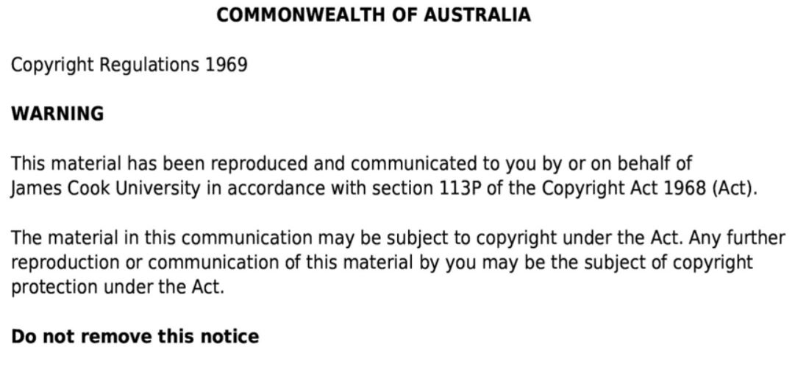

Slide 4
Revision - most common types of diabetes
Type 1 DM
Total insulin deficiency
Type 2 DM
Reduced pancreatic insulin production
Gestational
Typically autoimmune – stronger familial link
Typical early life onset
Insulin resistance
Incidence increases with age
Insulin resistance due to increased growth hormone
Insufficient insulin production
Maternal and fetal hyperglycemia

Slide 5
Acute complications of diabetes
Diabetic ketoacidosis
Hyperosmolar hyperglycemic state (HHS)
Hypoglycemia
Glycaemic emergencies
Caused by:
Changes / inadequate nutrition
Inactivity / over activity
Improper use of hypoglycaemic medications
Or a combination of these

Slide 6
Acute complications of diabetes
Hyperglycaemic Emergency
Hypoglycaemic Emergency
Diabetic Ketoacidosis (DKA)
Hyperosmolar Hyperglycaemic State (HHS)
Hypoglycaemia
→Hypoglycaemic coma
Symptoms of acute hyperglycaemia:
Polydipsia – excessive thirst of drinking
Polyphagia – extreme hunter
Polyuria – excessive urine production
Metabolic issues
Hydration issues
Symptoms of acute hypoglycaemia
Pale skin
Sweating
Shaking
Palpitations
Anxiety
Hunger
Drop in intellectual function
Confusion
Inappropriate behaviour
Coma
Seizure
High BGL
Low BGL

Slide 7
DKA triad
Hyperglycaemia
Ketonemia
Acidemia
Ketones present in blood and urine
Ketone product of lipid metabolism for energy
Diabetic Ketoacidosis
Ketones production lowers blood pH
Arterial pH is usually 7.3 or less
Complication of diabetes – usually Type-1 DM
Almost always presents with hyperglycaemia
(14 mmol/l or higher)

Slide 8
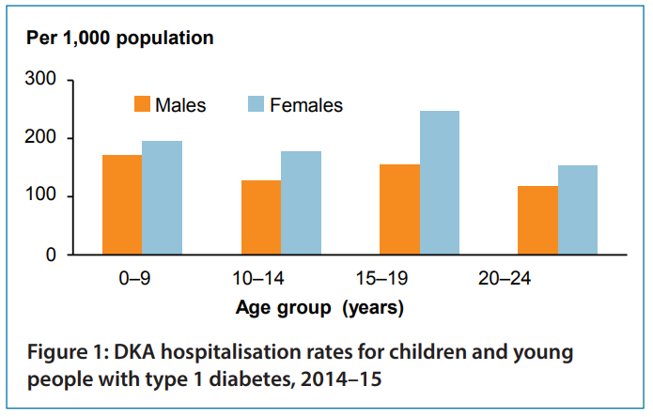
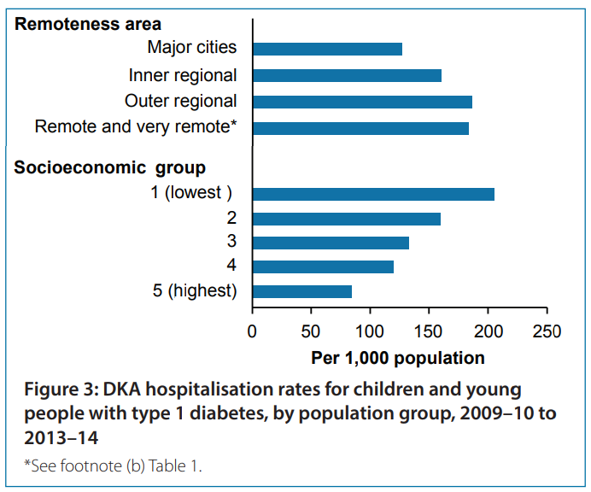
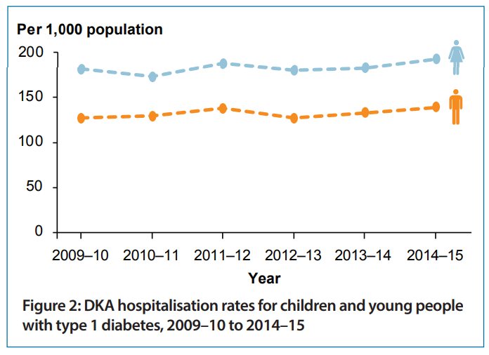
Diabetic Ketoacidosis
Figures taken from AIHW Diabetic Ketoacidosis among children and young people with type 1 diabetes https://www.aihw.gov.au/getmedia/16775f2c-595a-4c94-af26-a7680f316b94/20443.pdf.aspx?inline=true#:~:text=The%20number%20of%20hospitalisations%20for,population%20with%20type%201%20diabetes .
1.4 x higher in females
1.5 x higher in outer regional to remote areas
2.4 x higher in lowest SES groups
192/1000 (F) --- 138/1000 (M) with T-1 diabetes

Slide 9
Diabetic Ketoacidosis
Medical emergency
Absolute (or relative?) insulin deficiency
Problem in T-1 DM mostly
Can also occur with sodium-glucose co-transporter 2 (SGLT2) inhibitors
Potential for morbidity (T1D) rate around 10%
Associated with an increase in insulin counter-regulatory hormones
↑ catecholamines
↑ cortisol
↑ glucagon
↑ growth hormone

Slide 10
Diabetic Ketoacidosis
Characterised by
Dehydration
Hyperglycaemia,
Polyuria
Polydipsia
Tachypnoea
Deep sighing respiration
Acetone smell on breath
Nausea and vomiting
Abdominal pain
Confusion
Drowsiness
Decreased level of consciousness

Slide 11
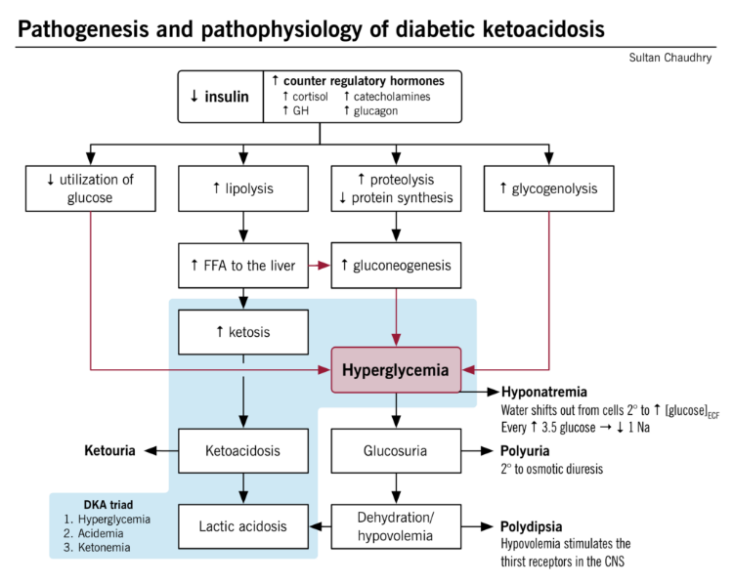
Pathogenesis and pathophysiology of DKA
Image taken from http://www.pathophys.org/hyperglycemic-emergencies-diabetic-ketoacidosis-and-hyperosmolar-hyperglycemia-state/. Accessed February 2021.
Characterised by
Absolute insulin deficiency
Ketosis
Acidosis
Hyperglycaemia
Osmotic driven dehydration / hypovolemia
Hyponatremia

Slide 12
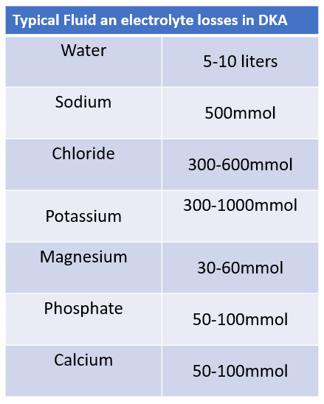
Diagnosis of DKA
No definitive test for DKA diagnosis
Based on clinical symptoms and pathology
Serum glucose > 14mmol/L
↓ Bicarb
↓ K+
↓ Na+
Arterial pH <7.3
Ketones present in urine
Ketones present in serum
Plus clinical symptoms and presence of diabetes (may be undiagnosed)

Slide 13
Management of DKA
Fluid replacement - normally isotonic saline
IV insulin therapy
Monitor blood glucose levels
IV potassium infusion if K⁺ is low
Continue with patients usual long acting insulin
(if on a continuous ambulatory insulin pump – remove it)
Then
Continued fluid therapy
When BGL decreases continue with IV insulin + glucose
Glucose stimulates pancreatic insulin secretion
?to protect against hypoglycaemia
? Protect against hyperkalaemia

Slide 14
Summary - DKA
Occurs when there is an absolute or relative insulin deficiency
Switch to lipolysis → gluconeogenesis to produce glucose in cell
Byproduct is ketones
Characterised by
Hyperglycaemia
Acidemia
Elevated ketone
Symptoms
Dehydration, confusion, drowsiness, polyuria, polydipsia, dec LOC, tachyapnoea, ketone breath, foul smelling urine

Slide 15
Next
Hyperosmolar Hyperglycaemic State (HHS)

