Slide 1
Acute and chronic complications of diabetes - HHS
Assoc. Prof. John Smithson

Slide 2
Learning outcomes
Be able to:
Describe the condition of HHS
Relate the pathophysiology of HHS to diabetes and the triad of presenting symptoms
Describe the fluid changes associated with HHS and impact on the circulatory system
Describe the basic approach to the emergency management of HHS
Fluid resuscitation, BGL correction, hypokalaemia, arterial/venous thromboembolism risk reduction
Justify the risks of rapid correction of BGL on cardiovascular system

Slide 3
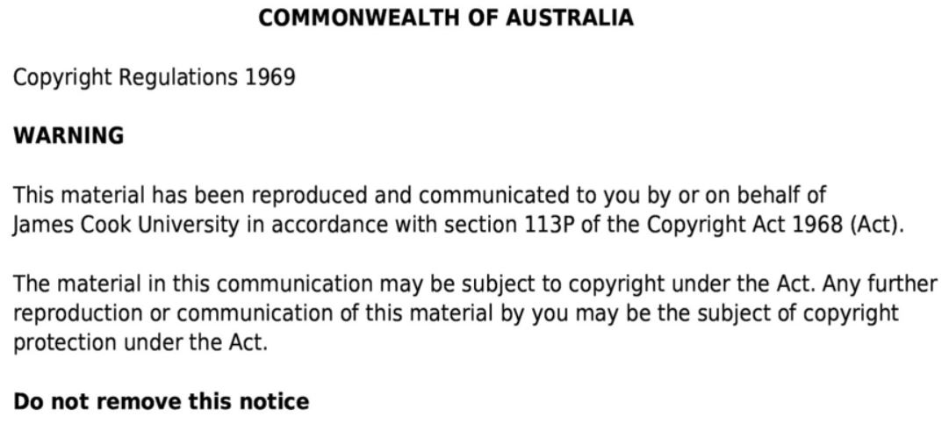

Slide 4
HHS triad
Severe dehydration
Hyperosmolality > 320 mosm/L
Hyperglycaemia > 30 mmol/L
Different from DKA
- No ketosis – probably result of minimal insulin presence
- No acidosis
- Much slower than DKA
Hyperosmolar Hyperglycaemic State
Significant dehydration secondary to significant hyperglycaemia
Complication of Type-2 DM
Prolonged very high hyperglycaemic state
Typical hyperglycaemic level > 30 mmol/L

Slide 5
HHS VS DKA
 | DKA *T1D/undiagnosed | HHS *T2D
Insulin | - | +
FFA | ++++ | ++
Ketosis | ++++ | -
Dehydration | ++ | ++++
Glucose levels | ++ | ++++ (because of dehydration)
Time to onset | Slow - rapid | Slowest

Slide 6
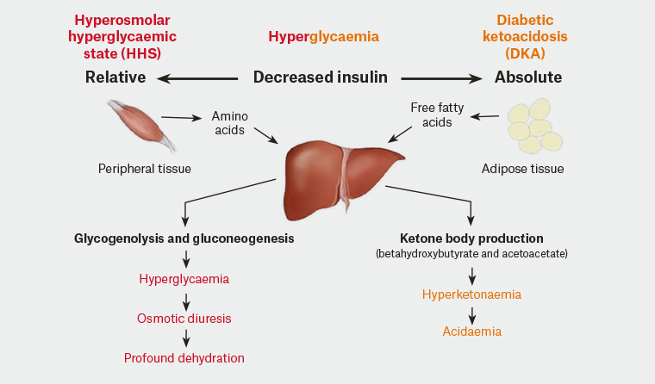
HHS VS DKA
Figure taken from Willix, C., Griffiths, E. & Singleton, S. Hyperglycaemic presentations in type 2 diabetes. (2019) AJGP. Volume 48, Issue 5, May 2019.

Slide 7
Hyperosmolar Hyperglycaemic State
Medical emergency
Some residual insulin function
Marked hyperglycaemia usually > 30 mmol/L
Potentially more serious than DKA – mortality rate higher
Normal ketone (probably a result of residual insulin function and suppression of free fatty acid production and conversion to ketone via liver metabolism)
Symptoms
Hyperglycaemia
Glucosuria
Hypokalaemia
Polyuria
Neurological changes – confusion to stupor and coma
Severe dehydration
→ shock
→ coma
Ketones NORMAL

Slide 8
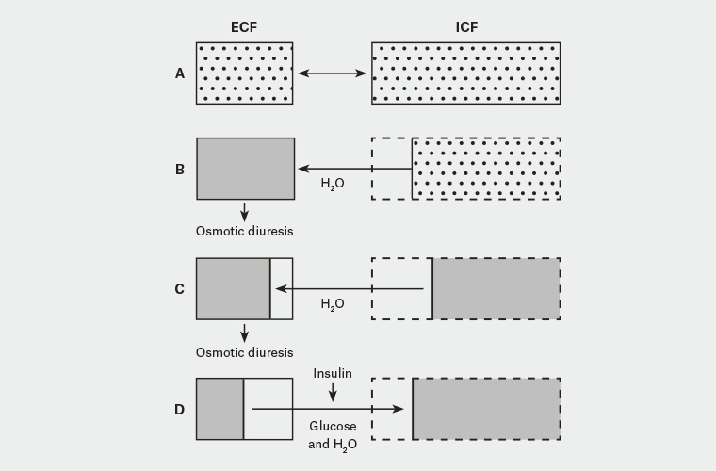
Figure taken from Willix, C., Griffiths, E. & Singleton, S. Hyperglycaemic presentations in type 2 diabetes. (2019) AJGP. Volume 48, Issue 5, May 2019.

Slide 9
Management of HHS
Fluid resuscitation to correct electrolyte homeostasis
Typically 0.9% sodium chloride +/- potassium chloride
Provides volume resuscitation
Provides reduction in Blood Glucose Levels (BGL)
Reduce hyperglycaemia
Insulin infusion if hyperglycaemia dropping too slowly
Warning – accelerated correction of hyperglycaemia can cause cardiovascular collapse
Treat / manage cause of HHS
High risk of developing arterial and venous thrombosis – manage with anticoagulant prophylaxis

Slide 10
Summary - HHS
Occurs when there is a relative insulin deficiency
Super-high BGL causes osmotic diuresis – significant loss of fluid via kidneys
Loss of fluid leads to ECF volume reduction and shock/coma
Rapid correction of hyperglycaemia has potential for ECF volume reduction and shock/coma
Characterised by
Hyperglycaemia > 30mmol/L
Marked hyperglycaemia usually > 30 mmol/L
Dehydration
Leads to
Cardiovascular collapse secondary to volume loss
Shock
coma
Treatment – fluid resuscitation, +/-potassium correction, +/- insulin infusion, prevent arterial and venous thrombosis formation

Slide 11
Next
Hypoglycaemia

