Slide 1
Acute and chronic complications of diabetes - Hypoglycaemia
Assoc. Prof. John Smithson

Slide 2
Learning outcomes
Be able to:
Recognise the signs and symptoms of hypoglycaemia
Identify the risk factors for hypoglycaemia
Be able to differentiate the difference between mild and moderate hypoglycaemia and severe hypoglycaemia
Describe the treatment of mild and moderate hypoglycaemia
Describe the treatment of severe hypoglycaemia
Be able to use a GlucaGen Hypokit and know the dose for children under the age of 12 and children and adults > 12 years of age

Slide 3
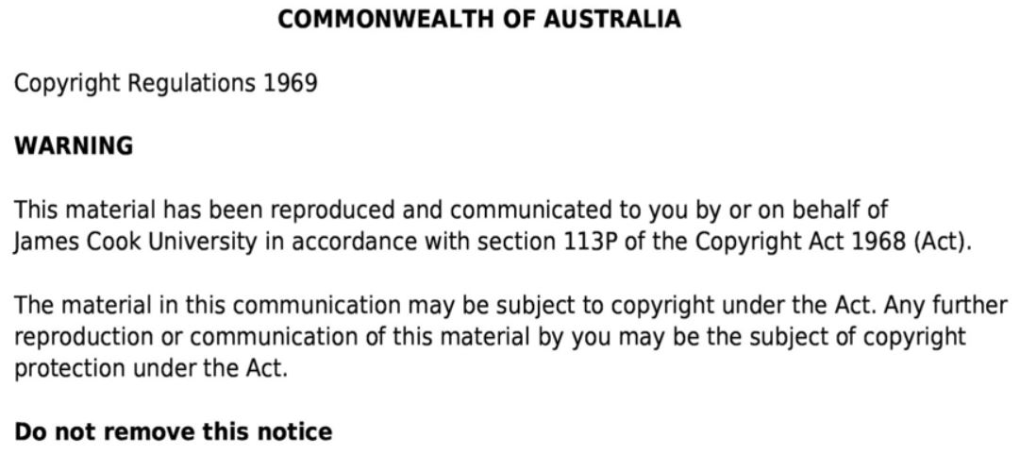

Slide 4
Hypoglycaemia
Low blood glucose concentration  < 4mmol/L – varies per patient
Excess insulin (or hypoglycaemic medication)
Insufficient glucose for CNS (Brain) to function – confusion, coma and death

Slide 5
Risk factors for hypoglycaemia
History of severe hypoglycaemia
Hypoglycaemic unawareness
Patients using insulin > 10 yrs
Driving ?
Longer duration of diabetes
Insulin or sulfonylurea therapy
Increasing age
Cognitive impairment
Renal impairment
Malabsorption diseases
Recent weight loss.
Variation in carb content of food (*insulin)
Suppression of gluconeogenesis by alcohol
Dose failure/omission/error
Vigorous or prolonged exercise
Primary failure of hormones which ↑↑ BGL
Hypopituriarism
Adrenal corticoid failure
Growth hormone deficiency

Slide 6
Symptoms of hypoglycaemia
Adrenergic symptoms
(Sympathetic NS)
Neuroglycopenic symptoms
(altered brain function)
Pale skin
Sweating
Shaking
Palpitations
Anxiety
Hunger
Drop in intellectual function
Confusion
Inappropriate behaviour
Coma
Seizure

Slide 7
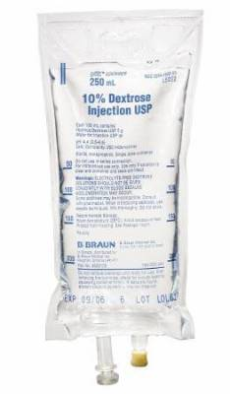
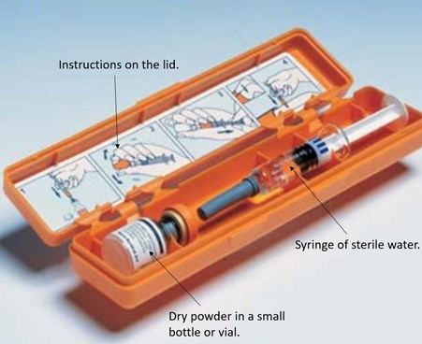
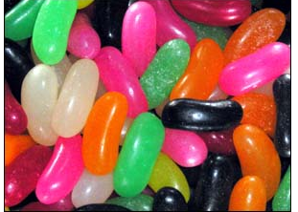
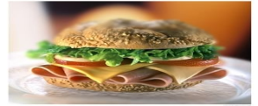
Treatment of hypoglycaemia
< 4.0mmol/L – patients may experience symptoms
< 2.8mmol/L symptoms may or may not be present
< 2.2mmol/L symptoms usually present
< 1.1mmol/L associated with seizures & coma

Slide 8
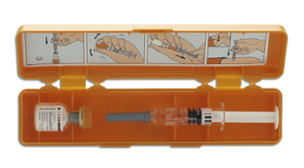
Treatment of hypoglycaemia
Severity | Symptoms
Mild Adrenergic symptoms (Patient conscious and cooperative) | Symptoms Anxiety Sweating Tremor Palpitations Hunger | Patient able to consume quick acting carbohydrates (glucose) -> long acting carbohydrates (low GI – sandwich) Repeat if after 10-15mins BGL < 4mmol/L
Moderate Defective nervous system | Symptoms Blurred vision Confusion ++hunger ++headache Behaviour changes | Patient may require help but is not unconscious. Honey, sugar -> complex carbohydrate (sandwich)
Severe (Patient unable to self treat due to confusion or LOC) | Severe confusion and agitation Sweating Tremor Palpitations Convulsions-coma | Patient in recovery position -> medical help. Glucagon  respond after 5-6 mins. A second Glucagon 1mg IM may be needed if patient does not respond (means insufficient hepatic glycogen stores) IV Glucose 10 – 20% or IV Glucose 50% by slow injection with caution (NB: do not use in children)

Slide 9
Summary - hypoglycaemia
Occurs when blood glucose is low
Symptoms of hypoglycaemia include both sympathetic and neuroglycopenic symptoms
Mild to moderate hypoglycaemic symptoms can be treated with consumption of glucose (jelly beans or honey) plus a low GI glucose source such as a sandwich
Severe hypoglycaemia can be identified by patients inability to treat their own hypoglycaemia
Severe hypoglycaemia treated with
Glucogon (GlucaGen Hypokit)
IV glucose

