Slide 1
Oxygen therapy, hyperbarics and gas laws
Assoc. Prof. John Smithson

Slide 2
Learning outcomes
Be able to:
Describe the significance of the different gas laws to respiratory physiology.
Apply knowledge of Dalton’s laws to explain the benefit of oxygen therapy.
Apply knowledge of Henry’s laws to explain the use of hyperbaric oxygen therapy.
Apply knowledge of Boyle’s law to explain how inspiration occurs in negative pressure breathing animals such as humans.

Slide 3
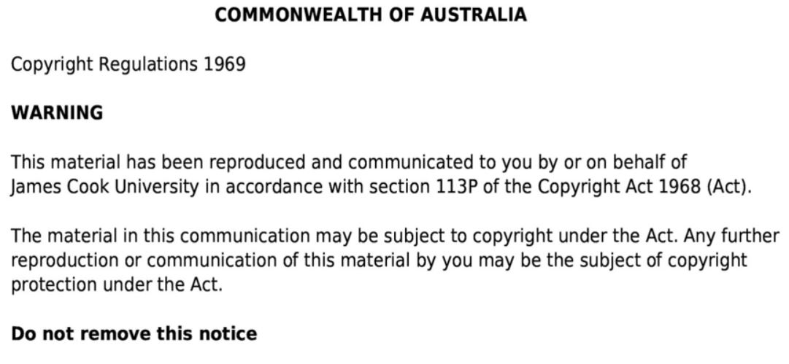

Slide 4
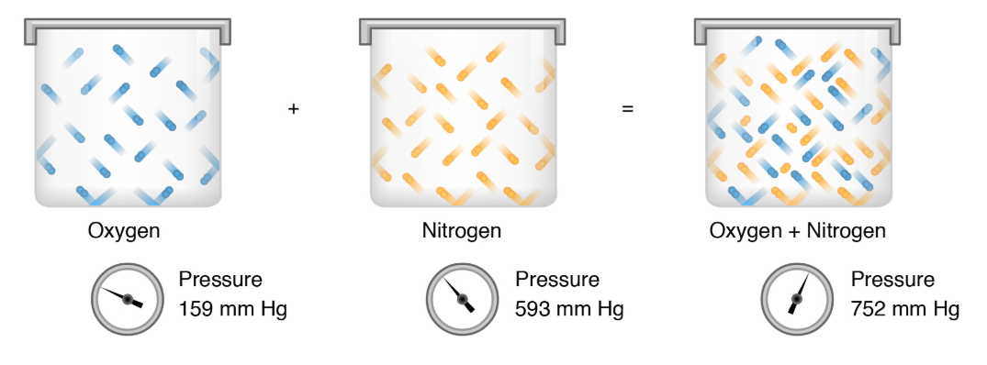
Dalton’s Law
Dalton’s law states each gas in a mixture of gases exerts its own pressure as if no other gases were present.
The pressure of a specific gas in a mixture is called its partial pressure;
In the example of arterial blood gases below, we see the partial pressure of the different gases reported in mm/Hg.
pH 7.25 (Normal range 7.35 – 7.45)
pCO2 74 mmHg (Normal range 35 – 45 mm/Hg)
pO2 17 mmHg (Normal range 80 – 100 mm/Hg)
HCO3 33 mmol/L (Normal range 22-26 mmol/L)
Image taken from Dalton’s law of partial pressure Khan Academy presentation
available at https://www.khanacademy.org/science/chemistry/gases-and-kinetic-molecular-theory/ideal-gas-laws/a/daltons-law-of-partial-pressure
Image adapted from OpenStax, CC BY 3.0.

Slide 5
Dalton’s law
If we consider air – a mixture of a number of gases. By volume, dry air contains
78.09% nitrogen,
20.95% oxygen,
0.93% argon,
0.04% carbon dioxide,
small amounts of other gases.
Air also contains a variable amount of water vapor (on average between 0.4-1% but varies considerably due to atmospheric conditions).
Assuming we are at 1 atmosphere (1ATM – (760 mm/Hg)) we can work out the relative partial pressures of the different gases by multiplying the total pressure of the mixture by the % of the gas in the mixture.
For example, we can work out the partial pressure of oxygen in the atmosphere at sea level (1ATM)
20.95% x 760mm/Hg = PaO2 159.22 mm/Hg.

Slide 6
Dalton’s Law
This same law applies to the blood – there is a partial pressure of oxygen or CO2 or any other gas in the blood.
Arterial blood gas reference ranges –
PaCO₂ 35 – 45 mm Hg
PaO₂ 80 – 100 mm Hg
A quick comment about haemoglobin saturation and SpO2 (range 95-100%)
Image taken from https://www.ausmed.com/cpd/articles/interpreting-abgs

Slide 7
Partial pressure of oxygen in the blood
The next question is if the PaO2 of air is 159.22 mm/Hg and we know the normal partial pressure of oxygen in the blood is between 80-100 mm/Hg, what accounts for the difference?

Slide 8
Partial pressure of oxygen in blood
The alveolar partial pressure of oxygen is lower due to a number of factors:
The partial pressure of water (about 45-47 mm/Hg) needs to be accounted for
The partial pressure of CO2 (about 40-45 mm/Hg) is much higher than atmospheric conditions
Respiratory quotient (RQ)

Slide 9
Partial pressure of oxygen in blood
The alveolar partial pressure of oxygen can be calculated using the following equation:
Alveolar PAO2 = ((760 – partial pressure of water (45mm/Hg) x partial pressure of atmospheric oxygen (21%)) – Partial pressure of CO2 (40mm/Hg) multiplied by the RQ (0.8)
Alveolar PAO2 = (713 x 0.21) – (40 x 0.8)
Alveolar PAO2 = 149.7 – 50
Alveolar PAO2 = 99.7 mm/Hg (similar to what we expect).
What is the importance of this?

Slide 10
What is the application of Dalton’s law to patients
Increasing the fraction of inspired oxygen (DiO2) using oxygen therapy,
Increases the alveolar partial pressure of oxygen
Increases the partial pressure of oxygen in the blood.
Image taken from https://easyoxygen.com.au/blogs/articles/should-i-use-a-nasal-cannula-or-oxygen-mask-with-my-oxygen-concentrator

Slide 11
Relevance of Dalton’s law to patients
For every 2 liters of supplementary oxygen, we increase the FiO2 by approximately 4%.
If a patient was given 2 liters of oxygen via nasal prongs, the inspired FiO2 would be approximately 29%.
Alveolar PAO2 = ((760 – partial pressure of water (45mm/Hg) x partial pressure of atmospheric oxygen (29%)) – Partial pressure of CO2 (40mm/Hg) multiplied by the RQ (0.8)
Alveolar PAo2 = (713 x 0.29) – (40 x 0.8)
Alveolar PAO2 = 206.77 – 50
Alveolar PAO2 = 156.77 mm/Hg (greater than what is expected on room air (21%) at 99.7 mm/Hg).

Slide 12
Relevance of Dalton’s Law to patients
Oxygen therapy via a mask of other means increases the FiO2
Increasing the FiO2 increases the partial pressure of oxygen in the inspired air
At normal atmospheres, this means the partial pressure of oxygen in the alveolar is higher
This increases the partial pressure of oxygen in the blood
More oxygen available for cellular respiration
Alveolar PAO2 = ((760 – partial pressure of water (45mm/Hg) x partial pressure of atmospheric oxygen (29%)) – Partial pressure of CO2 (40mm/Hg) multiplied by the RQ (0.8)
Alveolar PAo2 = (713 x 0.29) – (40 x 0.8)
Alveolar PAO2 = 206.77 – 50
Alveolar PAO2 = 156.77 mm/Hg (greater than what is expected on room air (21%) at 99.7 mm/Hg).

Slide 13
Henry’s Law
Henry’s law states that the quantity of gas that will dissolve in a liquid is proportional to the partial pressure of the gas and the solubility of the gas in the solution (water or blood).
CO2 is very soluble in water (or blood) – about 24 times more than O2
O2 is soluble in water (or blood) – more than nitrogen
N2 is less soluble in water or blood (less than half as soluble as O2)

Slide 14
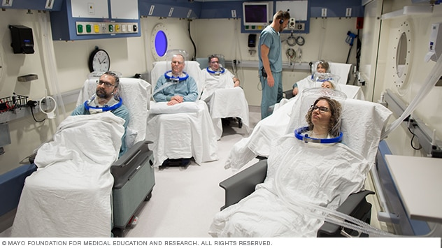
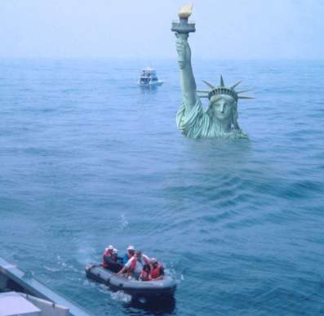
Henry’s Law
So Henry’s law tells us as the partial pressure of a gas increases - the solubility increases.
Take normal air at sea level (1 ATM or 760 mm/Hg)
760mm/Hg x 21% = PaO2 152 mm/Hg.
Take normal air at 2 atmospheres (1520 mm/Hg) in a hyperbaric dive chamber
1520mm/Hg x 21% = 319.2 mm/Hg
Take normal air at 3000m elevation with a barometric pressure of 522mm/Hg
522mm/Hg x 21% = 109.62 mm/Hg

Slide 15
Henry’s Law – scuba diving and the bends
Henry’s law - as the partial pressure of a gas increases - the solubility of the gas in solution increases.
Scuba diving at 10 meters (2 atmospheres or 1520 mm/Hg)
PO2 = 1520mm/Hg x 21% = 319.2 mm/Hg
PN2 = 1520mm/Hg x 79% = 1200.8 mm/Hg
Accumulation of nitrogen in the tissues and joints
Leads to decompression sickness (the bends)

Slide 16
Hyperbaric chambers
Allows patients to breath 100% oxygen
At 2-3 times normal atmospheric pressure
Image taken from Hyperbaric oxygen therapy. Mayo Clinic. Accessed July 2020. Available at https://www.mayoclinic.org/tests-procedures/hyperbaric-oxygen-therapy/about/pac-20394380.

Slide 17
Hyperbaric chambers
Benefits
acute dive related decompression injuries
Air or gas embolism
Anaemia due to sever blood loss
Carbon monoxide poisoning
Skin grafts and necrotizing soft tissue infections
Osteomyelitis
Arterial insufficiency or low blood flow
Acute traumatic ischaemia
Radiation injury
Anything you might want to treat by compressing residual gas bubbles or increase the partial pressure of oxygen in the blood.

Slide 18
Boyle’s Law
Boyle’s law states the pressure of gas in a closed container is inversely proportional to the volume of the container.
Images taken from Tortora, GJ., Derrickson, B., Burkett, B., Peoples, G.,Dye, D., Cooke, J., et al. Principles of anatomy and physiology. Second Asia-Pacific ed. Queensland, Australia: John Wiley & Sons; 2019.

Slide 19
How does Boyle’s Law apply to medicine
It explains how we can cause the inflow of air into the lungs
Diaphragm contracts down
Ribs rotate out and up
Increases volume of lungs
Pressure in lungs decreases
Air rushes in
Image taken from https://www.britannica.com/science/human-respiratory-system/The-mechanics-of-breathing

