Slide 1
Adult Bronchitis, Bronchiolitis and Bronchiectasis
Assoc. Prof. John Smithson

Slide 2
Learning outcomes
Be able to:
Be able to describe the pathophysiology of bronchitis, bronchiolitis and bronchiectasis.
Provide relevant evidence based education to patients regarding the pathophysiology and treatment of bronchitis and bronchiolitis.
Describe typical antibiotic and non-drug therapy for
Viral and bacterial bronchitis
Bronchiolitis
Bronchiectasis

Slide 3
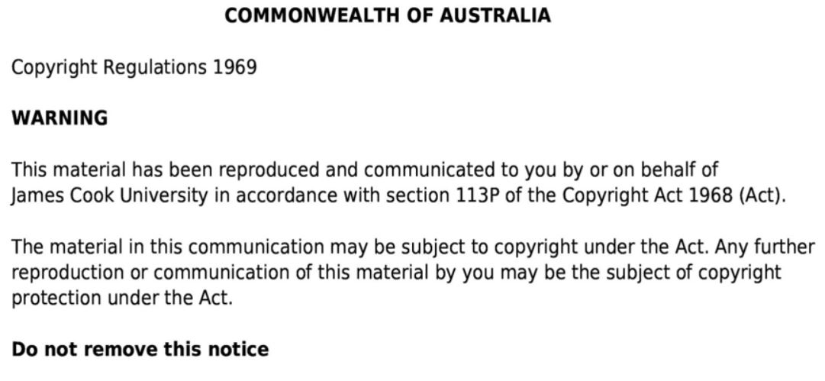

Slide 4
Structure of the respiratory system
Figure 23.1
Nose
Pharynx
Nasopharynx
Oropharynx
Laryngopharnyx
Trachea
Bronchus
Lungs (R=3, L=2 lobes)
Cardiac notch
Images taken from Tortora, GJ., Derrickson, B., Burkett, B., Peoples, G.,Dye, D., Cooke, J., et al. Principles of anatomy and physiology. Second Asia-Pacific ed. Queensland, Australia: John Wiley & Sons; 2019.

Slide 5
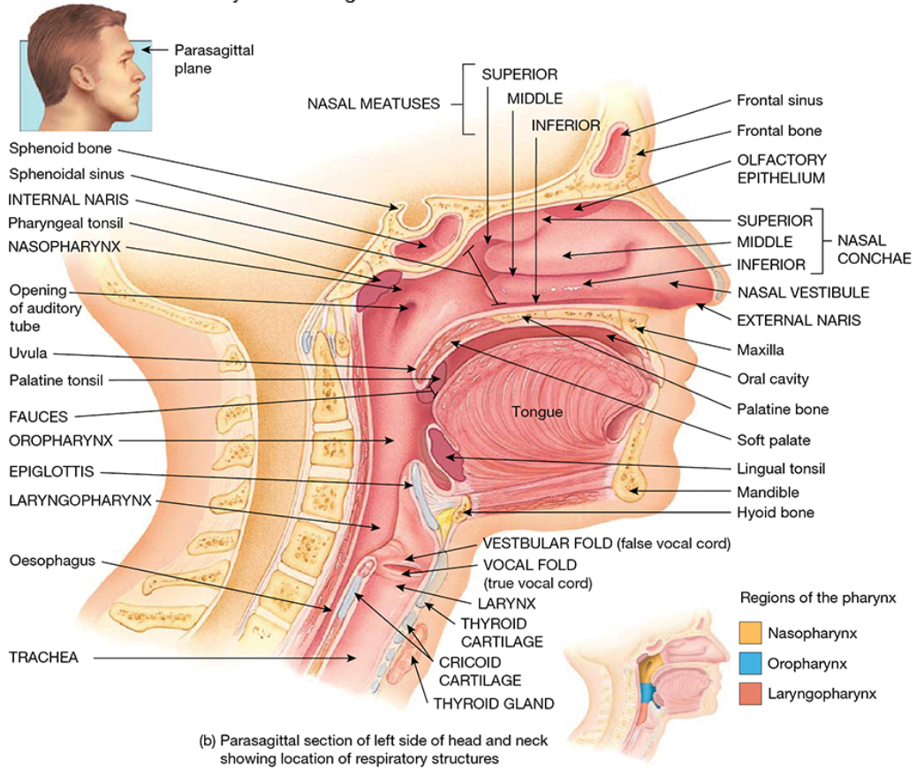
Respiratory structures of the head and neck
Figure 23.2
Nasal meatus
Nasal Conchae
Nasopharynx
Oropharynx
Laryngopharynx
Thyroid cartilage
Epiglottis
Trachea
Oesophagus
Images taken from Tortora, GJ., Derrickson, B., Burkett, B., Peoples, G.,Dye, D., Cooke, J., et al. Principles of anatomy and physiology. Second Asia-Pacific ed. Queensland, Australia: John Wiley & Sons; 2019.

Slide 6
Bronchi
Figure 23.7
Larynx
Trachea
Carina
Main bronchi
Bronchioles
Terminal bronchioles
Images taken from Tortora, GJ., Derrickson, B., Burkett, B., Peoples, G.,Dye, D., Cooke, J., et al. Principles of anatomy and physiology. Second Asia-Pacific ed. Queensland, Australia: John Wiley & Sons; 2019.

Slide 7
Alveoli and terminal bronchioles
Figure 23.10
Helical arrangement of smooth muscle
Lymphatic vessel
Pulmonary arteriole
Pulmonary venule
Alveolar sac
Alveoli
Images taken from Tortora, GJ., Derrickson, B., Burkett, B., Peoples, G.,Dye, D., Cooke, J., et al. Principles of anatomy and physiology. Second Asia-Pacific ed. Queensland, Australia: John Wiley & Sons; 2019.

Slide 8
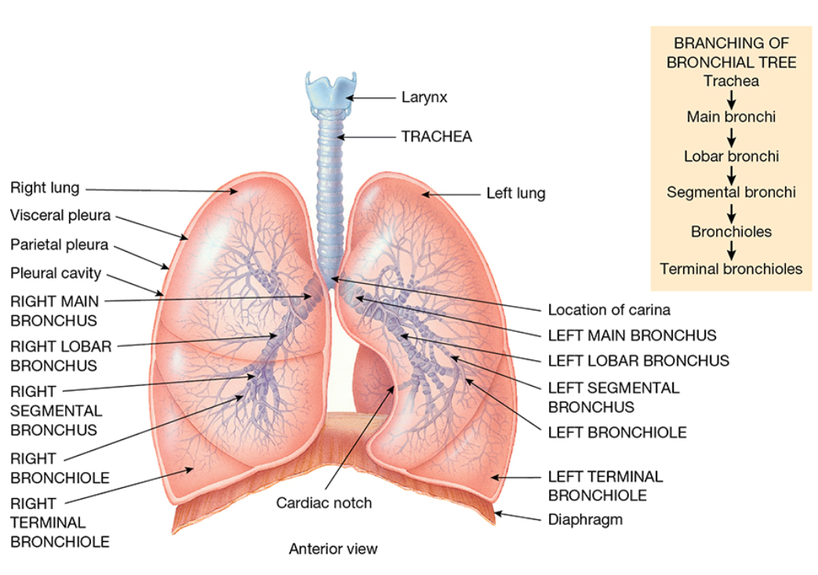
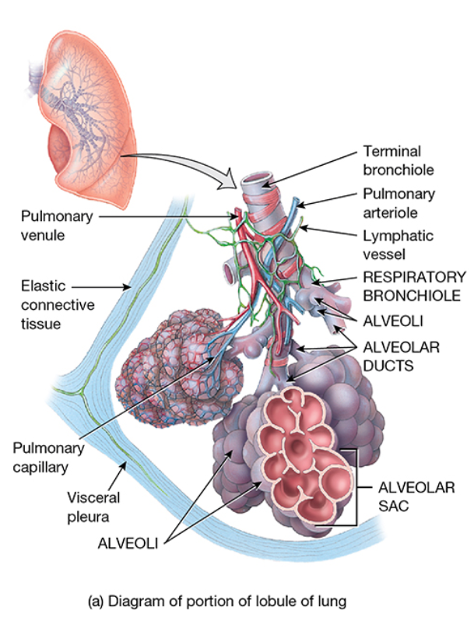
Bronchitis and bronchiolitis
Bronchitis
Affects bronchi – larger airways and is more common in older children and adults
Bronchiolitis
Affects the smaller bronchioles and is more common in children under two years of age
Image taken from Tortora, GJ., Derrickson, B., Burkett, B., Peoples, G.,Dye, D., Cooke, J., et al. Principles of anatomy and physiology. Second Asia-Pacific ed. Queensland, Australia: John Wiley & Sons; 2019.
Image taken from Tortora, GJ., Derrickson, B., Burkett, B., Peoples, G.,Dye, D., Cooke, J., et al. Principles of anatomy and physiology. Second Asia-Pacific ed. Queensland, Australia: John Wiley & Sons; 2019.

Slide 9
Acute bronchitis - Adult
Self limiting condition of the lower respiratory tract
Inflammation of bronchi causing productive or non-productive cough
90% viral in cause
Influenza A & B
Parainfluenza
Rhinovirus
adenovirus
Atypical bacterial infections can also cause bronchitis
Mycoplasma pneumonia
Chlamydophila pneumonia
Cough lasts 2-3 weeks – usually resolved by 4 weeks
Can persist for 8 weeks
Frustrating / concerning for patients – most seek pharmacological resolution (antibiotics) for which there is mostly no indication.

Slide 10
Acute bronchitis - adult
Self-limiting condition
Viral in nature
Antibiotics not typically indicated
Patient expectation
Antibiotics are reasonably commonly prescribed despite lack of evidence for benefit and risk of harm
May be used if the patient is at high risk of developing / has developed pneumonia
Pain from cough and fever:
NSAIDs or paracetamol
Quit smoking
Avoid irritants – dust, chemical fumes, other air pollutants
Useful to communicate this risk to patients who might ask you about antibiotics and bronchitis
Antibiotic resistance
Thrush infections
Clostridium difficile
Diarrhoea
Rash
Nausea
Hypersensitivity reactions

Slide 11
Acute bronchitis - Adult
Prevention
Flu vax yearly
Pneumococcal vax every 5 years
Quit smoking
Avoid irritants
Signs of bacterial infection
Mycoplasma pneumonia and Chlamydia pneumonia
Tetracyclines
Doxycycline
Macrolide antibiotics
Azithromycin
Clarithromycin
Erythromycin
Roxithromycin
Quinolones
Ciprofloxacin
Moxifloxacin

Slide 12
Acute bronchitis - Adult
Signs of bacterial infection
Bordetella pertussis
Macrolide antibiotics
Azithromycin
Clarithromycin
Trimethoprim + Sulfamethoxazole

Slide 13
Acute Bronchiolitis
Non-specific inflammatory injury that affects the small airways (airways <2mm in diameter with no cartilage)
Better known in children than adults
In adults it typically represents a pathophysiological response to injury
Treatment will depend on underlying cause and symptoms
In adults can be triggered by
Mycoplasma pneumoniae,
RSV,
measles,
influenza,
pertussis,
parainfluenza, and
adenovirus

Slide 14
Acute Bronchiolitis
Usually self limiting in healthy adults.
Many morphological types of bronchiolitis
Treatment depends on type
Antibiotic therapy to reflect bacterial agent present

Slide 15
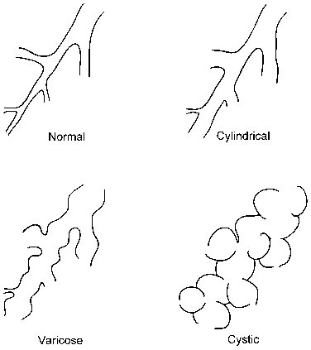
Bronchiectasis
Permanent dilatation (widening) of bronchi and bronchioles
Persistent or recurrent bronchial infection
Symptoms include
Cough
Usually sputum production
Results in chronic airway inflammation and resulting permanent airway damage
Muco-cillary escalator impaired (damaged or mucus impaired)
Accumulation of secretions and bacterial overgrowth in bronchiectic sections
Does not provoke cough until mucous / puss in bronchi
Airway obstruction
Recurrent infection causes bronchial fibrosis
Chronic inflammation causes loss of bronchial wall structure and balloon-like dilatations → saccular bronchiectasis
Diagram taken from Veves, P., Guerra, M., Ponce, P et.al. Non-cyctic bribrosis bronchiectasis. Interactive Cardiovascular and Thoracic Surgery. 2011; 13(6):619-25

Slide 16
Bronchiectasis
Permanent dilatation (widening) of bronchi and bronchioles
Persistent or recurrent bronchial infection
Symptoms include
Cough
Usually sputum production
Results in chronic airway inflammation and resulting permanent airway damage
Muco-cillary escalator impaired (damaged or mucus impaired)
Accumulation of secretions and bacterial overgrowth in bronchiectic sections
Does not provoke cough until mucous / puss in bronchi
Airway obstruction
Recurrent infection causes bronchial fibrosis
Chronic inflammation causes loss of bronchial wall structure and balloon-;ole dilatations → saccular bronchiectasis
Can be localized to one segment of the airway or generalized across both lungs
Causes
No known cause (idiopathic) in 50% of patients
Pneumonia – pseudomonas aeruginosa
Intraluminal obstruction such as endobronchial tumour or foreign body
Extrinsic compression of airway by enlarged lymph nodes
Many other less common causes

Slide 17
Bronchiectasis
Symptoms
Chronic cough
Sputum – purulent and may be blood stained
Wheeze and shortness of breath common during exacerbations
Crackles in lungs
Treatment
Mobilise secretions
Respiratory physiotherapy
Breathing and coughing techniques
Breathing training devices
Decrease sputum viscosity
Hypertonic saline
Dry powder mannitol
Bronchodilators
Salbutamol
Anti inflammatory drugs
Inhaled steroids
Weight management and strength
Diet and exercise
Spirometry to monitor lung function
Manage cross infection to limit reinfection
Immunisations
Flu vax yearly
Pneumococcal vax every 5 years
Pulmonary rehabilitation may benefit
Notes:
To avoid cross-infection, advise patients about standard infection control measures, including covering the mouth when coughing, attention to hand hygiene, and not sharing utensils. Patients with bronchiectasis requiring hospital treatment should be separated from patients with chronic suppurative lung diseases or with respiratory viral infections.

Slide 18
Bronchiectasis
Symptoms
Chronic cough
Sputum – purulent and may be blood stained
Wheeze and shortness of breath common during exacerbations
Crackles in lungs
For reversible component of airflow limitation
Treatment
Mobilise secretions
Respiratory physiotherapy
Breathing and coughing techniques
Breathing training devices
Decrease sputum viscosity
Hypertonic saline
Dry powder mannitol
Bronchodilators
Salbutamol
Anti inflammatory drugs
Inhaled steroids
Weight management and strength
Diet and exercise
Spirometry to monitor lung function
Manage cross infection to limit reinfection
Immunisations
Flu vax yearly
Pneumococcal vax every 5 years
Pulmonary rehabilitation may benefit
Notes:
To avoid cross-infection, advise patients about standard infection control measures, including covering the mouth when coughing, attention to hand hygiene, and not sharing utensils. Patients with bronchiectasis requiring hospital treatment should be separated from patients with chronic suppurative lung diseases or with respiratory viral infections.

Slide 19
Bronchiectasis
Non-severe exacerbations without P. aeruginosa
Amoxicillin 1g oral Q8H OR
Docycycline 100mg orally Q12H Or
Amoxicillin and clavulanate
10 days
Severe exacerbations without P. aeruginosa
As per non-severe or
Parenteral (IV) therapy
Ceftriaxone 2g daily or
Cefotaxine 2g Q8H or
Axoxicillin + clavulanate 1+0.2g Q8H
10 days

Slide 20
Bronchiectasis
Non-severe exacerbations with P. aeruginosa
Amoxicillin 1g oral Q8H OR
Docycycline 100mg orally Q12H Or
Amoxicillin and clavulanate 875+125mg
Oral
14 days
Severe exacerbations with P. aeruginosa
Parenteral (IV) therapy
Ceftazidime 2g Q8H OR
Piperacillin + tazobactam 4+0.5g Q6H
Plus
Tobramycin OD OR
Ciprofloxacin 400mg Q8H
Once stable – can switch to ciprofloxacin 750mg Q12H to complete 14 days therapy (IV + Oral)
14 days

Slide 21
Long term antibiotic therapy for bronchiectasis
Inappropriate for most cases
Increases development of antibiotic resistance
If patient has more than 3 exacerbations per year and airway clearance and exercise therapy are optimized
Long term AB therapy may reduce frequency of exacerbations

Slide 22
Long term antibiotic therapy for bronchiectasis
Inappropriate for most cases
Increases development of antibiotic resistance
Oral macrolide antibiotics (azith, clarit, eryth, roxith)
Reduction in frequency of exacerbagtions
Variable improvement in QoL
Increased AB resistance
GI adverse effects
If patient has more than 3 exacerbations per year and airway clearance and exercise therapy are optimized
Long term AB therapy may reduce frequency of exacerbations
Do not use long term use of quinolones – ciprofloxacin is only oral drug treatment for P. aeruginosa

